Slide 1
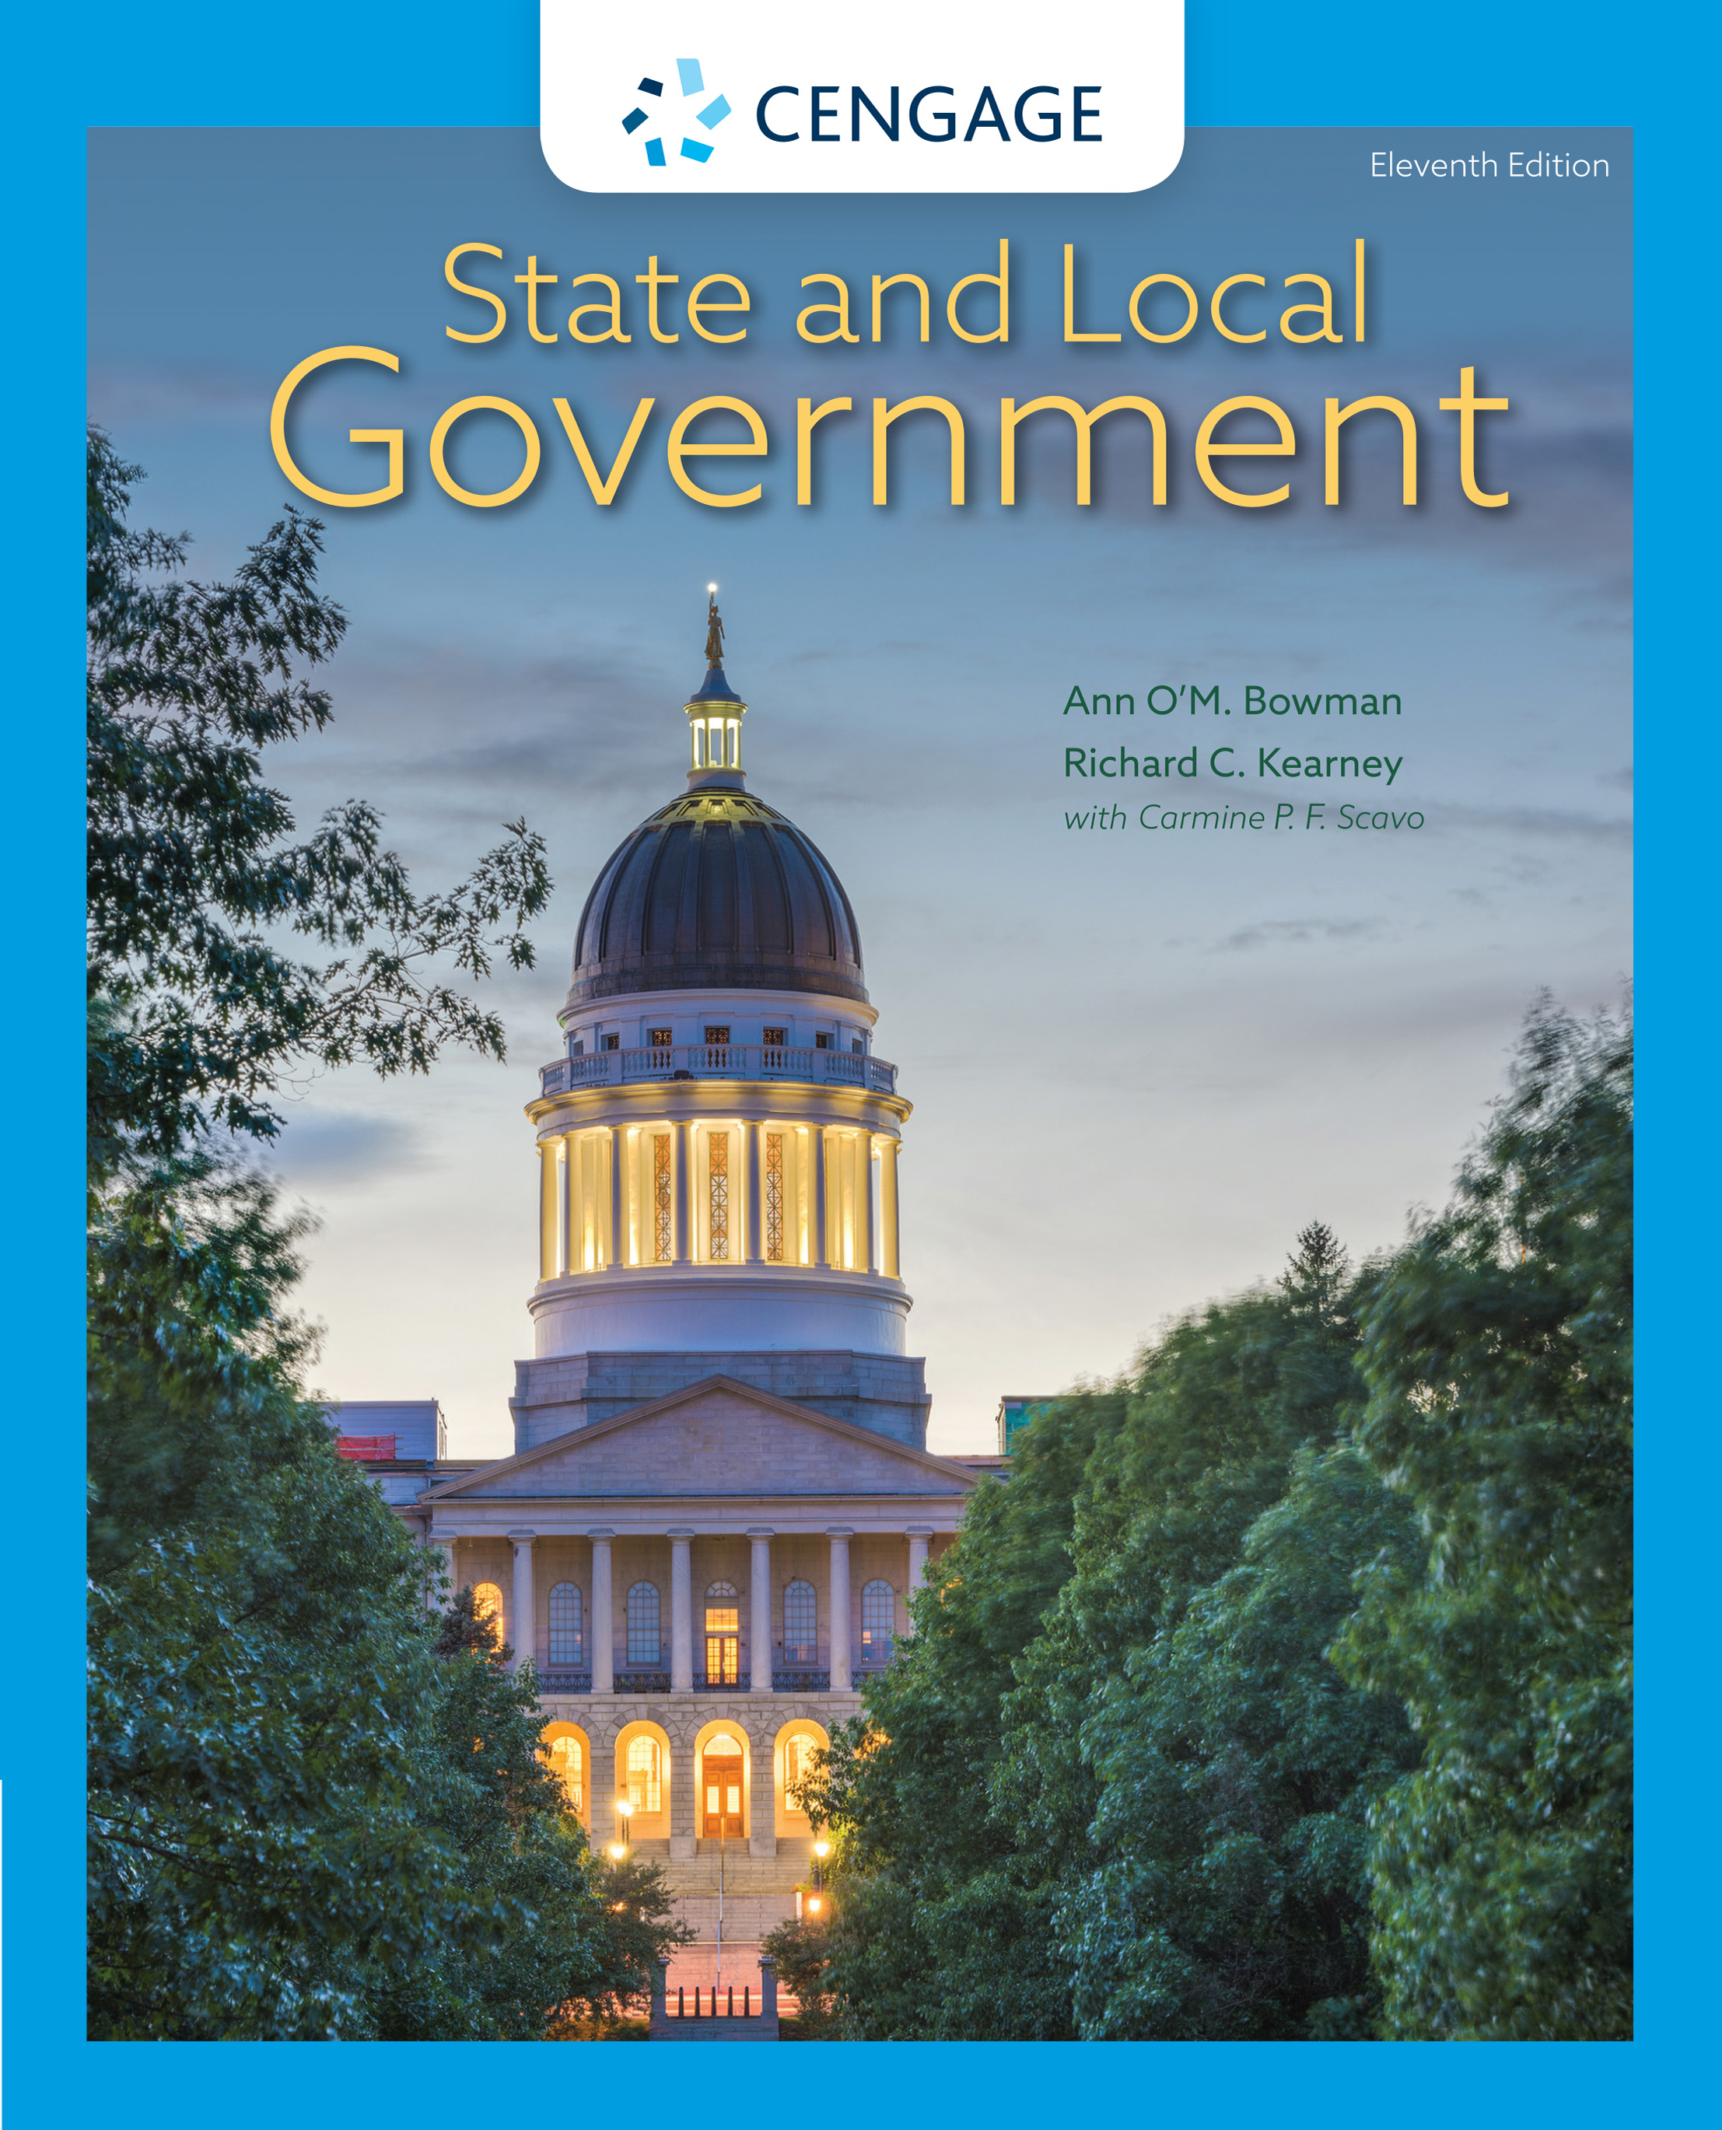
State and Local Government,
11e
Chapter 3: State Constitutions
Ann O’M, Bowman | Richard C. Kearney | Carmine P. F. Scavo | State and Local Government, Eleventh Edition. © 2022 Cengage. All Rights Reserved. May not be scanned, copied or duplicated, or posted to a publicly accessible website, in whole or in part.

Slide 2
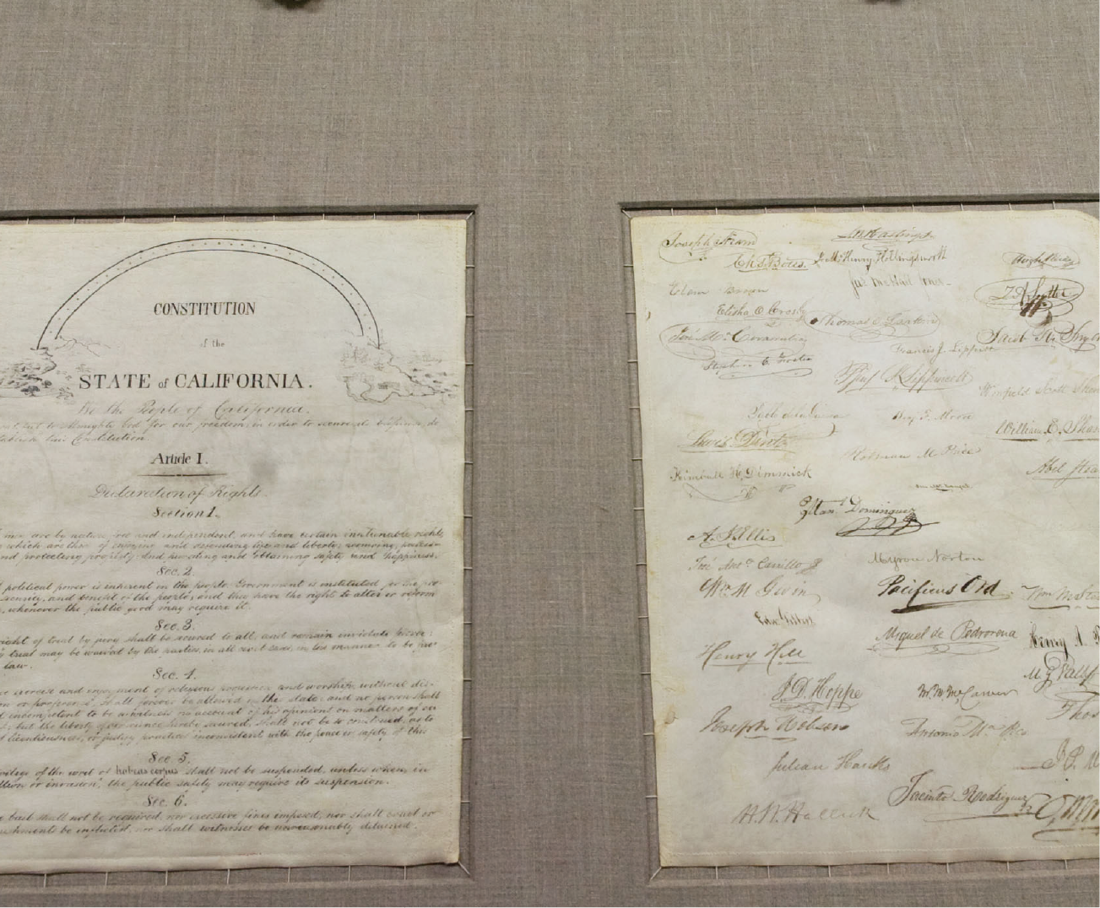
The original copy of California’s first constitution
Notes:
Sacramento Bee/ZUMA Press/Newscom

Slide 3
Learning Objectives
3.1 To identify the origins, evolution, and purposes of state constitutions.
3.2 To explain how state constitutions have evolved to meet the challenges of modern governance and how they have not.
3.3 To comprehend the basic content of state constitutions and how they compare with the U.S. Constitution.
3.4 To be able to describe the formal and informal methods for changing state constitutions.

Slide 4
The History and Development of the Fundamental Documents
Constitutions represent the fundamental law of a state, superior to statutory law.

Slide 5
The Evolution of State Constitutions
The First State Constitutions
  Natural rights and popular sovereignty identified
  Territorial integrity not well defined
  Extensions of colonial charters
Legislative Supremacy
Legislative supremacy: The legislature’s dominance of the other two branches of government
The Growth of Executive Power

Slide 6
Weaknesses of Constitutions
Excessive Length
  The U.S. Constitution is ~8,700 words.
  State constitutions average around 27,000 words.
  Alabama constitution is 402,852 words with 1,230 amendments, many applying to only one county.
Problems of Substance
  The long ballot
  A glut of executive boards and commissions
  A swamp of local governments
  Restrictions on local governmental authority
  Discriminatory treatment

Slide 7
Constitutional Reform (1 of 3)
Model State Constitution developed in 1921
Two state constitutions are evident today:
  Positive-law tradition: A state constitutional tradition based on detailed provisions and procedures
  Higher-law tradition: A state constitutional tradition based on basic and enduring principles that reach beyond statutory law

Slide 8
Constitutional Reform (2 of 3)
The Essential State Constitution
  Bill of Rights
  Power of the State
  Suffrage and Elections
  The Legislative Branch
  The Executive Branch

Slide 9
Constitutional Reform (3 of 3)
The Essential State Constitution
  The Judicial Branch
  Finance
  Local Government
  Public Education
  Civil Service
  Intergovernmental Relations
  Constitutional Revision
  Constitutions Today

Slide 10
Methods for Constitutional Change (1 of 4)
Informal Constitutional Change
One informal and four formal methods for amending state constitution exist.
  The informal route is interpretation.
  Judicial review: The power of the U.S. Supreme Court or state supreme courts to declare unconstitutional actions of the executive and legislative branches as well as decisions of lower courts.

Slide 11
Methods for Constitutional Change (2 of 4)
Formal Constitutional Change
  Ratification: The formal approval of a constitution or constitutional amendment by a majority of the voters of a state.
    Legislative proposal: The most common means of amending a state constitution, wherein the legislature proposes a revision, usually by a two-thirds majority.
  Initiative: A proposed law or constitutional amendment that is placed on the ballot by citizen petition

Slide 12
Methods for Constitutional Change (3 of 4)
Formal Constitutional Change
  Two types of initiatives:
    Direct initiative: A procedure by which the voters of a jurisdiction propose the passage of constitutional amendments, state laws, or local ordinances, bypassing the legislative body
    Indirect initiative: Similar to the direct initiative, except that the voter-initiated proposal must be submitted to the legislature before going on the ballot for voter approval
  Constitutional convention: An assembly of delegates chosen by popular election or appointed by the legislature or the governor to revise an existing constitution or to create a new one

Slide 13
Methods for Constitutional Change (4 of 4)
Formal Constitutional Change
  Constitutional commission: Often called a study commission, it is usually established to study an existing constitution to recommend changes to the legislature or to the voters

Slide 14
State Responsiveness and Constitutional Reform
Constitutions are designed to meet the needs of the state.
Constitutions reflect the political culture, history, and economics of the state.
State constitutions were the original guardians of individual rights.
Newer documents are more modernized.
Source of change in governmental behavior.

Slide 15
Internet Resources
http://www.usa.gov/Agencies/State-and-Territories.shtml
http://www.findlaw.com/11stategov/indexconst.html
www.constitution.org/cons/usstcons.htm
www.law.state.ak.us
www.nebraskalegislature.gov
www.netnebraska.org/publicmedia/capitol.html
https://statecon.Camden.Rutgers.edu

