Slide 1
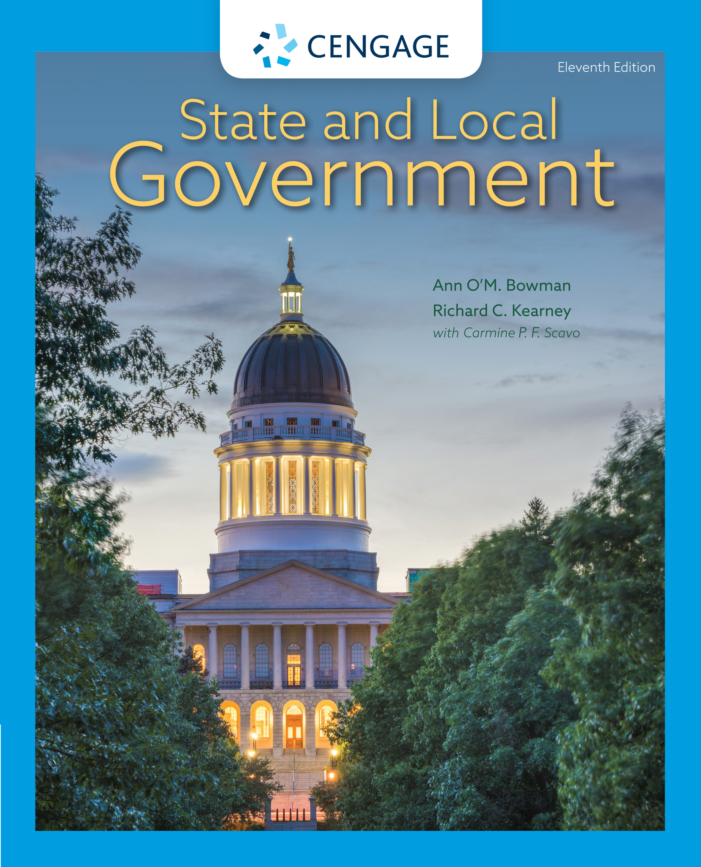
State and Local Government,
11e
Chapter 9: The Judiciary: Independence vs Accountability
Ann O’M, Bowman | Richard C. Kearney | Carmine P. F. Scavo | State and Local Government, Eleventh Edition. © 2022 Cengage. All Rights Reserved. May not be scanned, copied or duplicated, or posted to a publicly accessible website, in whole or in part.

Slide 2
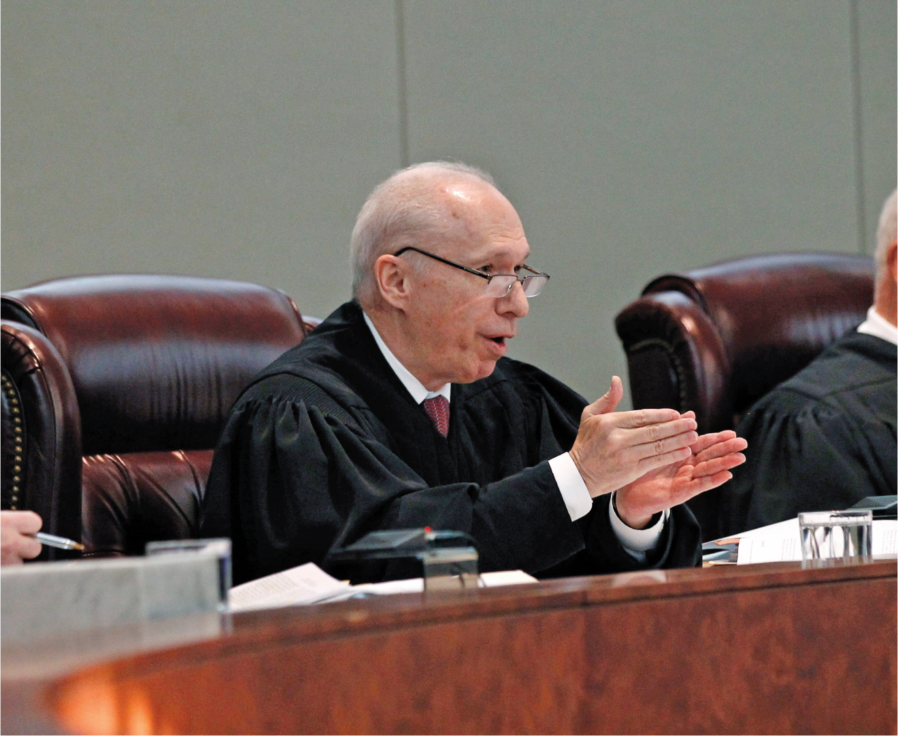
A state trial court judge questions the prosecuting attorney
Notes:
AP Images/Mel Evans

Slide 3
Learning Objectives (1 of 2)
9.1 To demonstrate an understanding of what state courts do, their position within the federal system, and the types of law they address.
9.2 To demonstrate an understanding that state courts are organized into two tiers.
9.3 To describe how structural reforms have been implemented to make the courts more effective.
9.4 To compare and contrast the five methods for selecting judges.

Slide 4
Learning Objectives (2 of 2)
9.5 To recognize the trade-offs between judicial independence and accountability.
9.6 To describe some of the factors that influence judicial decision making.
9.7 To demonstrate an understanding of how judicial federalism is related to increased capability and judicial activism in many state courts.
9.8 To describe efforts to reform state courts.

Slide 5
Introduction (1 of 2)
State supreme courts are policy makers.
  Final authority on laws and constitution
  Rule on important questions
  Protect minority interest

Slide 6
Introduction (2 of 2)
The judiciary deals with three types of cases:
  Civil case: Disputes involving individuals
  Criminal case: State against a person
  Administrative case: Government agency rules challenged
State courts interpret state statutes, state and federal constitutions, and common law.

Slide 7
The Structure of State Court Systems (1 of 2)
The Two Tiers of Courts
  Trial Courts
    Minor—limited jurisdiction trial courts
    Major trial courts
  Appeals Courts
    Supreme court: highest state court
    Intermediate appellate courts: first appellate levels

Slide 8
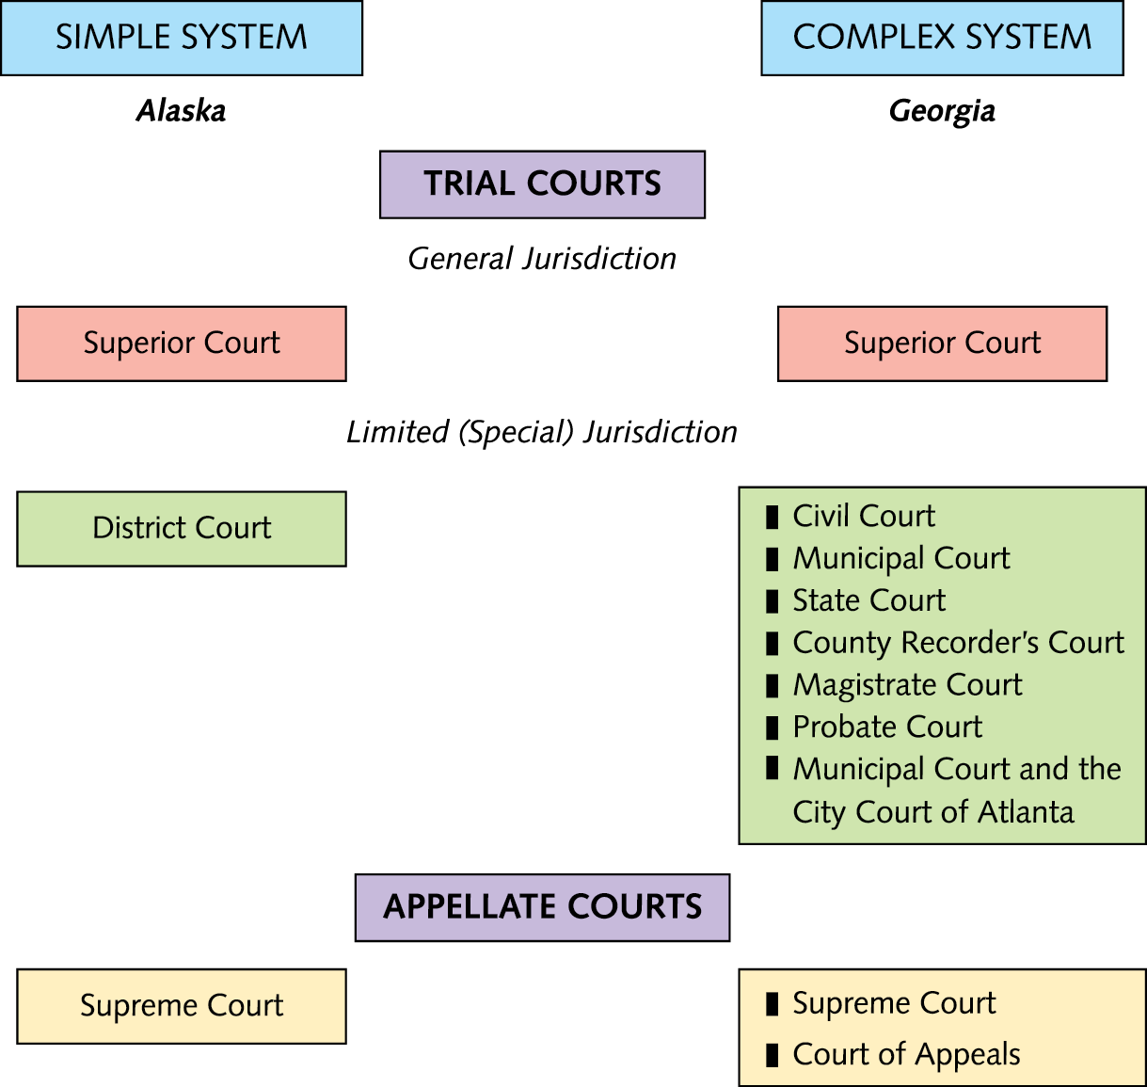
Simplicity and Complexity in State Court Systems
Notes:
Source: National Center for State Courts (www.ncsc.org).

Slide 9
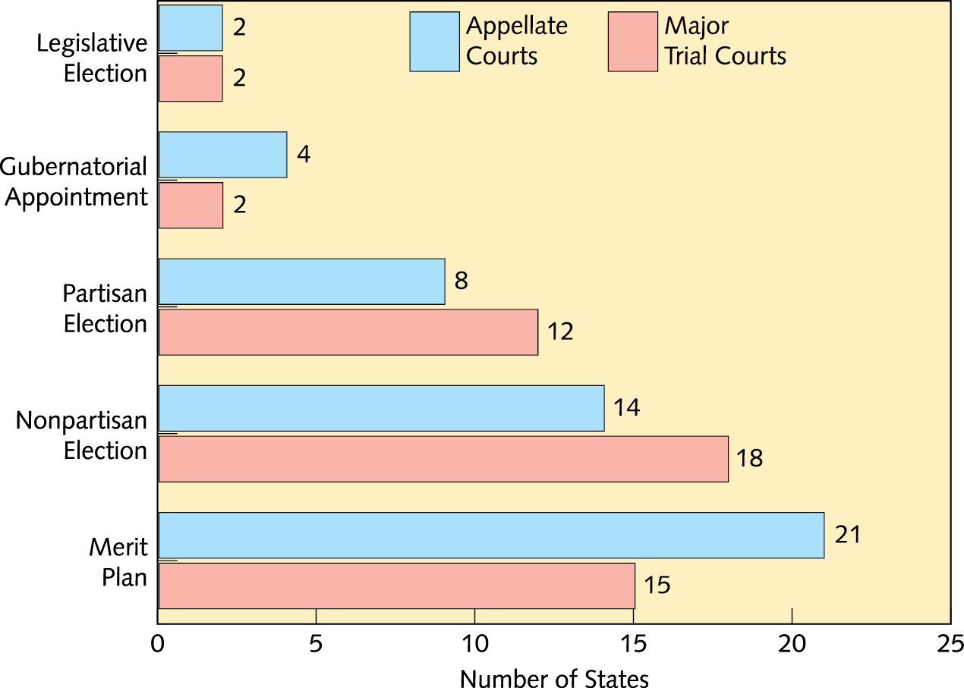
State Appellate and Major Trial Court Selection Plans
Notes:
NOTE: Kansas and Missouri select some major trial court judges through a merit plan and others through partisan elections.
Source: Book of the States, vol. 46 (Lexington, KY: Council of State Governments, 2014): Tables 5.6 and 5.7

Slide 10
The Structure of State Court Systems (2 of 2)
Structural Reforms
  Most courts have considerable authority
  Unification is the goal
  Improvement in information technology
  Despite consolidation efforts much about state courts remain decentralized

Slide 11
How Judges Are Selected (1 of 5)
American Bar Association says judges should be chosen on the basis of solid professional and personal qualifications regardless of politics.
Public is conflicted—wants independent judges who also agree with us!
We want judges who call them like they see them as long as they see them the same as we do.

Slide 12
How Judges Are Selected (2 of 5)
Legislative Election
  Used in South Carolina and Virginia
  Choose former legislators most often
  Not a popular method

Slide 13
How Judges Are Selected (3 of 5)
Popular Election
Partisan Popular Election
Nonpartisan Popular Election
The Problems with Popular Elections

Slide 14
How Judges Are Selected (4 of 5)
Merit Plan
Three Steps
  A judicial nominating commission meets and recommends three or more names of prospective judges to the governor.
  The governor appoints the preferred candidate to the vacant judgeship.
  A retention election is held.
The Politics of Merit Selection

Slide 15
How Judges Are Selected (5 of 5)
Gubernatorial Appointment
Which Selection Plan Is Best?
  No consensus
  Politics in all systems
  No one system produces superior judges
Removal of Judges
  Impeachment is the most popular method

Slide 16
It’s Your Turn
Judges: Elected, Appointed, or Merit-Selected?
Select a state—any one except the state in which you currently reside. Determine how judges are selected for the appellate and trial courts. Based on what you have read in this chapter and other materials you can access, answer the following questions:
What are the pros and cons of the judicial selection process in the state you have chosen?
Is this the “best” or most appropriate system for this
particular state? Why or why not?

Slide 17
Judicial Decision Making (1 of 3)
In and Out of the Trial Court
  Almost all cases (civil and criminal) are decided outside of court.
  Plea bargaining is a commonly used method.
  If a case is not plea bargained, then it goes to either bench trial or a trial by jury.

Slide 18
Judicial Decision Making (2 of 3)
Inside the Appellate Court
  Operates differently; ten trial courts
  Reviews records of low courts
  Decides by majority rule

Slide 19
Judicial Decision Making (3 of 3)
Influences of the Legal System
  Institutional Arrangements
  Legal Procedures and Precedent
  Caseload Pressures
  Access to the System
Personal Values, Attitudes, and Characteristics of Judges

Slide 20
Judicial Federalism (1 of 2)
Judicial federalism: A trend in which state constitutional and statutory laws are consulted and applied before federal law
Judicial Activism in the States
  Attempt to make new law
  Seen on both sides of ideological spectrum
  More prominent in state supreme courts

Slide 21
Judicial Federalism (2 of 2)
Current Trends in State Courts
  Not all courts are activists.
  Judges are unable to be as proactive as legislature.
  Activism can have negative effects.

Slide 22
Administrative and Organizational Improvements (1 of 2)
Financial Improvements and Financial Pressures
  Trials are very expensive.
  Bad times result in reforms such as evidence-based sentencing (EBS).
Dealing with Growing Caseloads
  Tort: A civil case involving personal injury, misconduct, or negligence

Slide 23
Administrative and Organizational Improvements (2 of 2)
Compensating the Judges
Judicial Performance Evaluation
State Courts Today

Slide 24
Internet Resources
www.ncsc.org
https://www.courts.ca.gov/
www.flcourts.org
http://courts.alaska.gov
https://www.americanbar.org/
https://www.thelaw.com/
www.in.gov/judiciary/webcast

