Slide 1
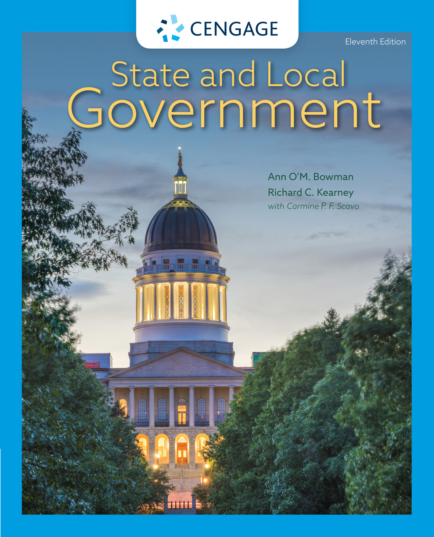
State and Local Government,
11e
Chapter 8: Public Administration: Budgeting and Service Delivery
Ann O’M, Bowman | Richard C. Kearney | Carmine P. F. Scavo | State and Local Government, Eleventh Edition. © 2022 Cengage. All Rights Reserved. May not be scanned, copied or duplicated, or posted to a publicly accessible website, in whole or in part.

Slide 2
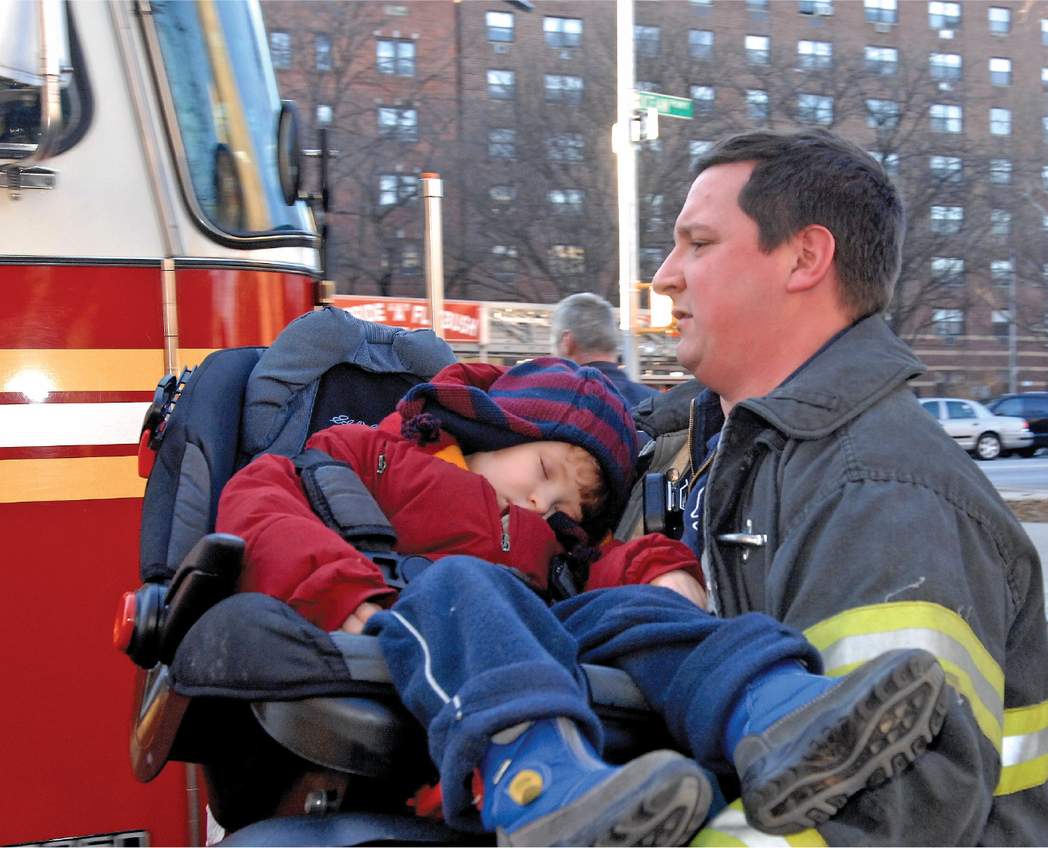
A firefighter rescues a boy after an auto accident
Notes:
Todd Maisel/New York Daily News Archive/Getty Images

Slide 3
Learning Objectives (1 of 2)
8.1 To identify the size, scope, and characteristics of state and local government employment.
8.2 To summarize the state government budgetary process, including key actors and critical processes.
8.3 To describe the components of merit systems.

Slide 4
Learning Objectives (2 of 2)
8.4 To explain the challenges of representative bureaucracy and affirmative action, sexual harassment, and public employee unionization and collective bargaining.
8.5 To explain the clash of politics and bureaucracy.
8.6 To describe new public management, its strategies, and its pros and cons.

Slide 5
Public Employees in State and Local Governments (1 of 3)
Bureaucracy is paradoxical.
  Bureaucracy is often viewed negatively.
  Public employees often do an outstanding job of enacting public policy.
  Public employees should not be seen as scapegoats for all that is wrong with government.

Slide 6
Public Employees in State and Local Governments (2 of 3)
Facts about bureaucracy
  Just over 20 million people are employed by state and local governments.
  The number of bureaucrats varies from state to state.
  Occupations are widespread, from police to doctors.
  One out of six Americans is a state and local government worker.

Slide 7
Public Employees in State and Local Governments (3 of 3)
Distinctions between Public and Private Management
 | Public Management | Private Management
Constraints | Politics, public opinion, resources | Markets, competitors, resources
Clients | Citizens, legislatures, chief executives, interest groups | Customers who purchase products or services
Accountability | To citizens and elected and appointed officials | To customers, boards of directors, and shareholders
Purpose | To serve the public interest and the common good | To make profits and grow the organization

Slide 8
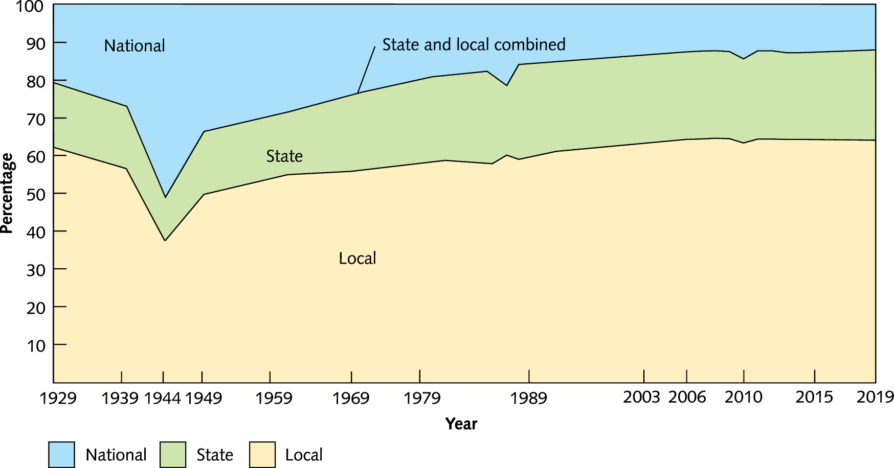
Distribution of Full-Time Equivalent Employment
Notes:
Source: Bureau of Labor Statistics, 2020.

Slide 9
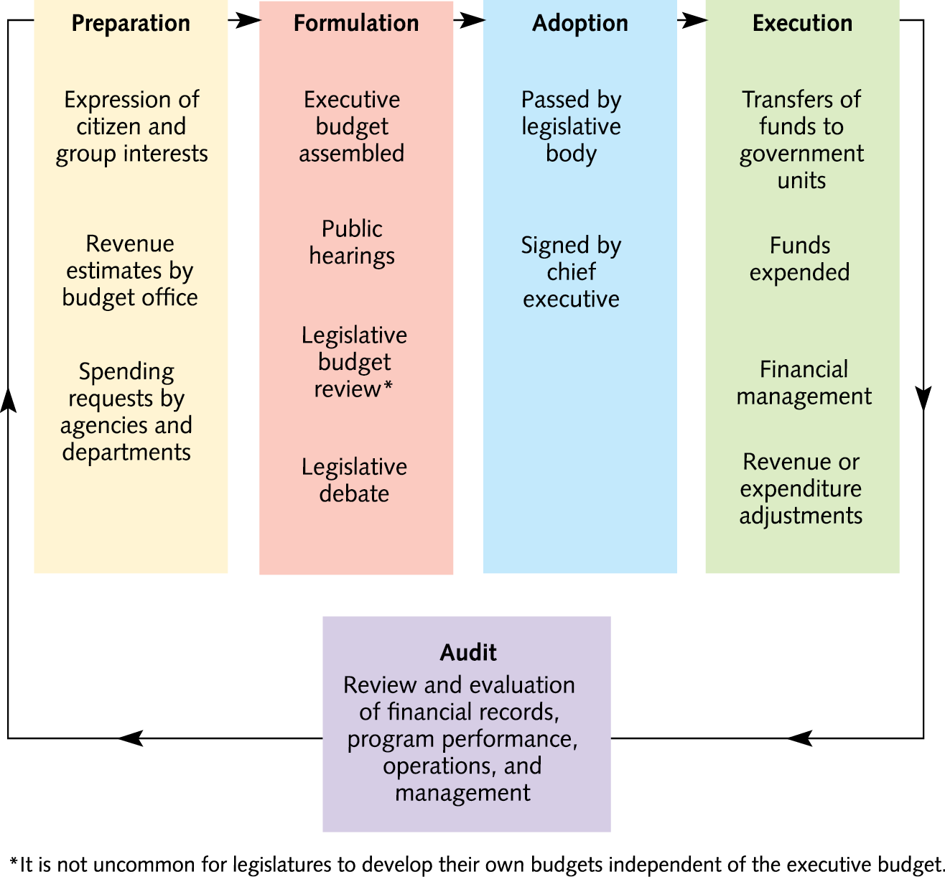
Budgeting in State and Local Governments (1 of 4)
The Budget Cycle

Slide 10
Budgeting in State and Local Governments (2 of 4)
Interest groups
  Testify and lobby to get what they want
Agencies
  Seek political strategies, such as always asking for more money
The chief executive
  Designs budget to fit priorities

Slide 11
Budgeting in State and Local Governments (3 of 4)
The legislature
  Modifies the initiatives of the chief executive
  Reviews agency demands
  Responds to constituents’ desires

Slide 12
Budgeting in State and Local Governments (4 of 4)
Pervasive Incrementalism
Types of Budgets
  Control Through Line Item Budgets
  Budgeting for Performance
    Zero-based budgeting
  Capital Budgets

Slide 13
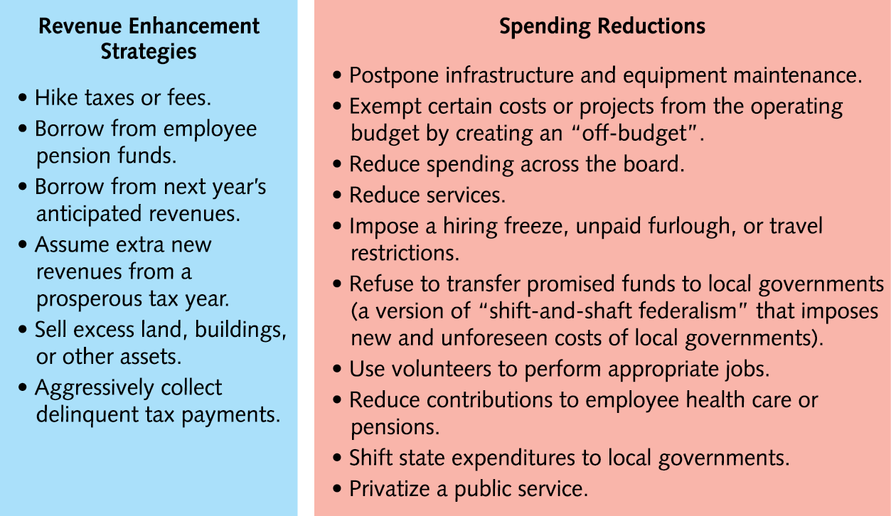
Coping Strategies to Balance an Unbalanced Budget
Notes:
Sources: Jonathan Walters, “Richard Ravitch: How Budgets Really Work,” www.governing.com (accessed April 28, 2014); Kimberly L. Nelson, “Municipal Choice During a Recession: Bounded Rationality and Innovation,” State and Local Government Review 44 (July 2012): 44–63; John Goodman, “Budget Gimmicks Explained: Five Ways States Hide Deficits,” www.stateline.org (accessed June 23, 2011).

Slide 14
Human Resource Policy in State and Local Governments (1 of 2)
The Merit System
  Neutral competence: Primary criterion for obtaining government jobs
  Merit system has had mixed results
The Merit System
State and Local Advances
  State and local personnel systems are improving
  Making executive branch more efficient
  Using new methods

Slide 15
Human Resource Policy in State and Local Governments (2 of 2)
The Merit System (cont.)
Merit System Controversies
  Representative Bureaucracy
  Sexual Harassment
  Unions

Slide 16
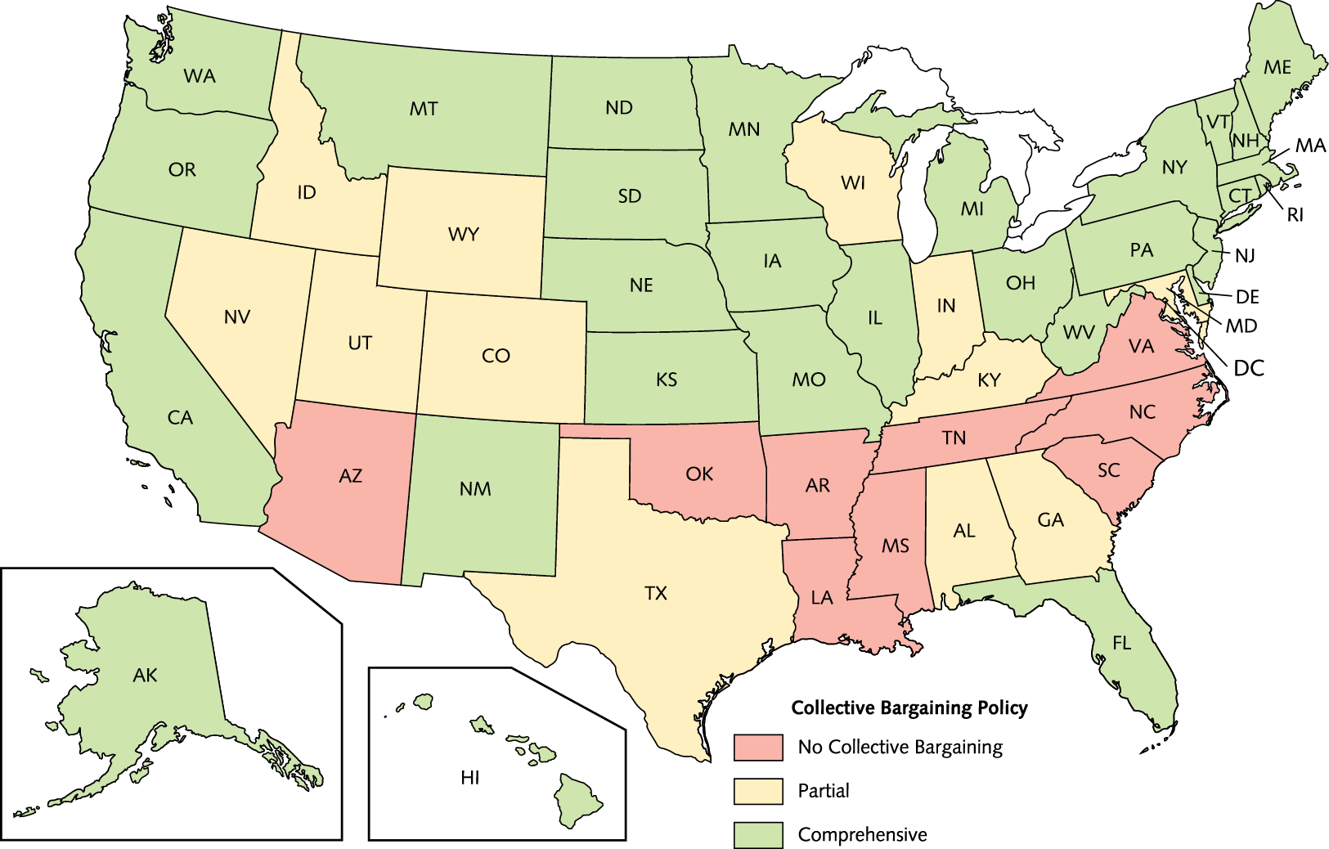
Public Employee Collective Bargaining Rights in the States

Slide 17
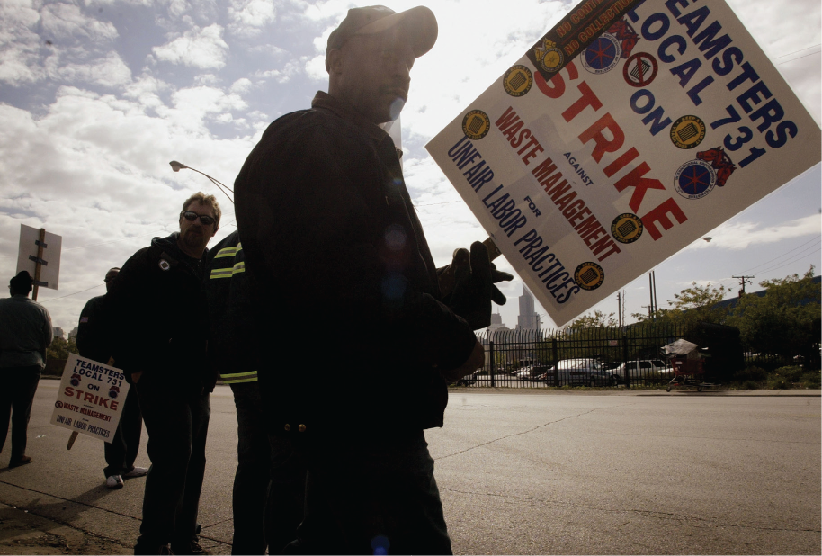
Local sanitation workers on strike in Illinois
Notes:
Bettmann/CORBIS

Slide 18
The Politics of Bureaucracy
Joining Administration and Politics
  Bureaucrats are involved in public policy making.
  Civil servants have considerable bureaucratic discretion.
  Success of public policy depends on administrators.
  Power is derived from knowledge, expertise, information, and discretionary authority.

Slide 19
New Public Management (1 of 2)
New Public Management (NPM): The argument that government should manage for results, through entrepreneurial activity, privatization, and improvements in efficiency and effectiveness.

Slide 20
New Public Management (2 of 2)
Alternative Service Delivery Mechanisms
  Intergovernmental Cooperation
  Coproduction
  Privatization
    Shift state and local services to the private sector.
    The belief is that privatization will save money.
    Some state and local governments attempt competition among private businesses.
    Results have been mixed.

Slide 21
The Quality of Public Administration
Quality has improved
Doing better at managing money, people, infrastructure, and information
In partnership with private sector, able to achieve more

Slide 22
Internet Resources
www.indygov.org
http://servicearizona.com
www.ncgov.com
www.access.wa.gov
www.afscme.org
www.govtech.com

