Slide 1

State and Local Government,
11e
Chapter 7: Governors: Power, Politics, and Executive Leadership
Ann O’M, Bowman | Richard C. Kearney | Carmine P. F. Scavo | State and Local Government, Eleventh Edition. © 2022 Cengage. All Rights Reserved. May not be scanned, copied or duplicated, or posted to a publicly accessible website, in whole or in part.

Slide 2
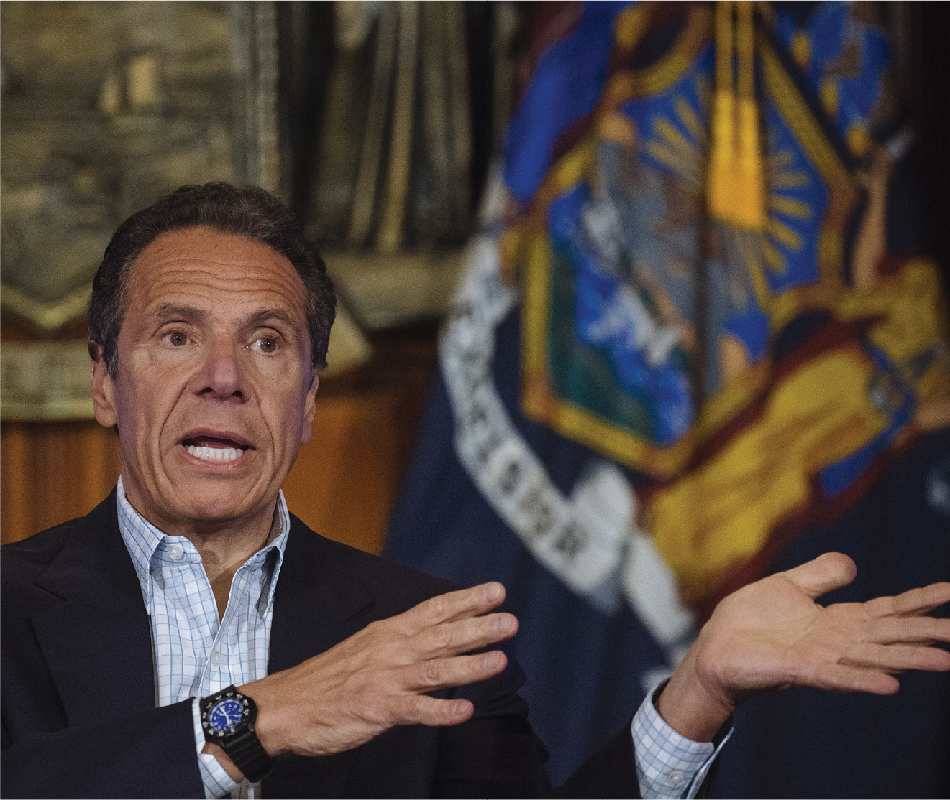
New York Governor Andrew Cuomo
Notes:
Angus Mordant/Bloomberg/Getty Images

Slide 3
Learning Objectives (1 of 2)
7.1 To describe the evolution in powers of the governor from postcolonial days to the present.
7.2 To discuss the diverse roles of the governor.
7.3 To appraise the dynamics of working with the legislature to enact policy.

Slide 4
Learning Objectives (2 of 2)
7.4 To explain the formal powers of the office today and how they are used.
7.5 To analyze the informal powers of the office, their importance, and how they can enhance the formal powers.
7.6 To explain the responsibilities of the other elective statewide executive branch offices.

Slide 5
The Office of Governor
History of the Office
  Originally elected by the legislature
  Plural executive in Pennsylvania and Georgia
  Office strengthened by:
    Longer term
    Popular vote
    Veto power
Today’s Governors
Getting There: Gubernatorial Campaigns

Slide 6
Traditional View of Governor
Mr. Smith Goes to Washington
  https://www.youtube.com/watch?v=lJ6uEort8_s
  Minute 1:00 to 6:01 shows Governor Happy Hopper being told whom to choose as a replacement senator after the sitting senator passes away

Slide 7
Getting There: Campaigns
Oddball candidates
Campaigning is expensive
Role of incumbency

Slide 8
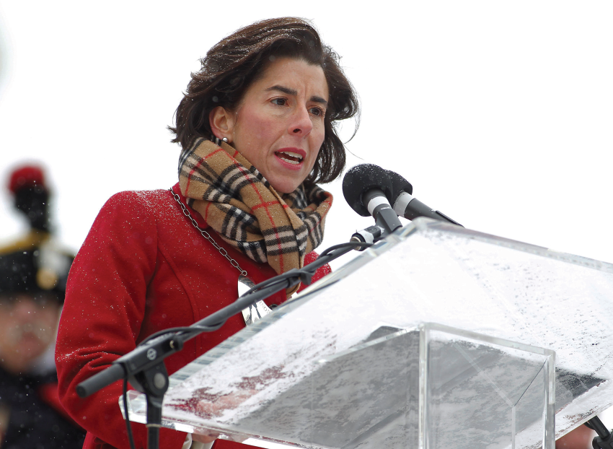
Controversies in States and Localities
Is Private Sector Experience the Best Preparation for the Governorship?
Notes:
Rhode Island governor Gina Raimondo addresses a crowd on a cold day in the Ocean State. (AP Images/Stew Milne)

Slide 9
Being Governor: Duties and Responsibilities (1 of 2)
Developing and Making Policy
Marshaling Legislative Action
  Relationship with the Legislature
  Executive Influence on the Legislative Agenda
Governors and the Courts
Administering the Executive Branch
  Restraints on Management
  Governors as Managers

Slide 10
Being Governor: Duties and Responsibilities (2 of 2)
Master of Ceremonies
Coordinating Intergovernmental Relations
Promoting Economic Development
Leading the Political Party

Slide 11
Formal Powers of the Governor (1 of 3)
Formal powers: Powers of the governor derived from the state constitution or statute
Informal powers: Powers of the governor not derived from constitutional or statutory law

Slide 12
Formal Powers of the Governor (2 of 3)
Tenure
Appointment Power
Veto Power
  Package veto: Reject entire bill.
  Line item veto: Reject parts of a bill.
  Pocket veto: Refuse to sign bill when legislature adjourned.
  Executive amendment: Veto and recommend changes.

Slide 13
Formal Powers of the Governor (3 of 3)
Budgetary Power
Reorganization Power
  The Politics of Reorganization
Staffing Power
The Relevance of the Formal Powers

Slide 14
Informal Powers
Tools of Persuasion and Leadership
Characteristics of a Successful Governor

Slide 15
Leaving Office
Impeachment
Die in office
Forced to resign for misconduct
Take another position, such as one at national level

Slide 16
Other Executive Branch Officials (1 of 3)
Lieutenant Governor
  The office was created for two reasons:
    to provide orderly succession to a governor who is unable to fulfill a term because of death or other reasons, and
    to provide for an official to assume the responsibilities of the governor when the incumbent is temporarily out of state or incapacitated.
  In many states, Lieutenant Governor presides over state senate.
  This office can sometimes be a “springboard” to the governor’s office.
  Confrontation can result when this office is elected independently.

Slide 17
Other Executive Branch Officials (2 of 3)
Attorney General (AG)
  Responsibilities:
    Chief legal officer of state
    Renders written opinions
    Represents state in cases where the state is a party
Treasurer
  Responsibilities:
    Chief financial officer of state
    Collects and distributes state funds
    Signs state employee paychecks

Slide 18
Other Executive Branch Officials (3 of 3)
Secretary of State
  Responsibilities:
    Record keeper of state
    Administers elections
    Registers corporations, securities, trademarks

Slide 19
The Capability of U.S. Governors
Performance has increased governor’s power.
Office is becoming more efficient, effective, accountable, and responsible.
Reforms have extended the formal powers and improved the performance of office.
Personal profile of the governor is improving in areas, such as level of education and political experience.

Slide 20
Internet Resources
www.nga.org
www.nlga.us
www.naag.org
www.nast.org
www.nass.org/

