Slide 1
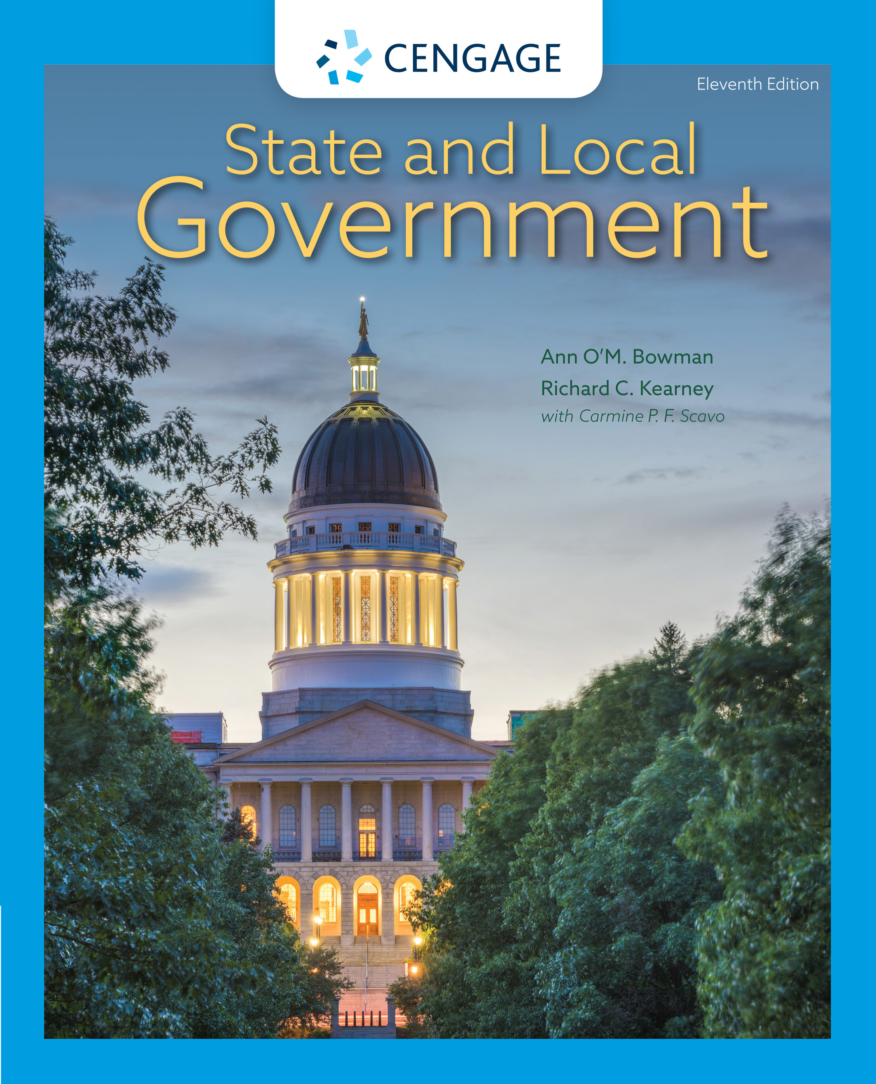
State and Local Government,
11e
Chapter 6: State Legislatures
Ann O’M, Bowman | Richard C. Kearney | Carmine P. F. Scavo | State and Local Government, Eleventh Edition. © 2022 Cengage. All Rights Reserved. May not be scanned, copied or duplicated, or posted to a publicly accessible website, in whole or in part.

Slide 2
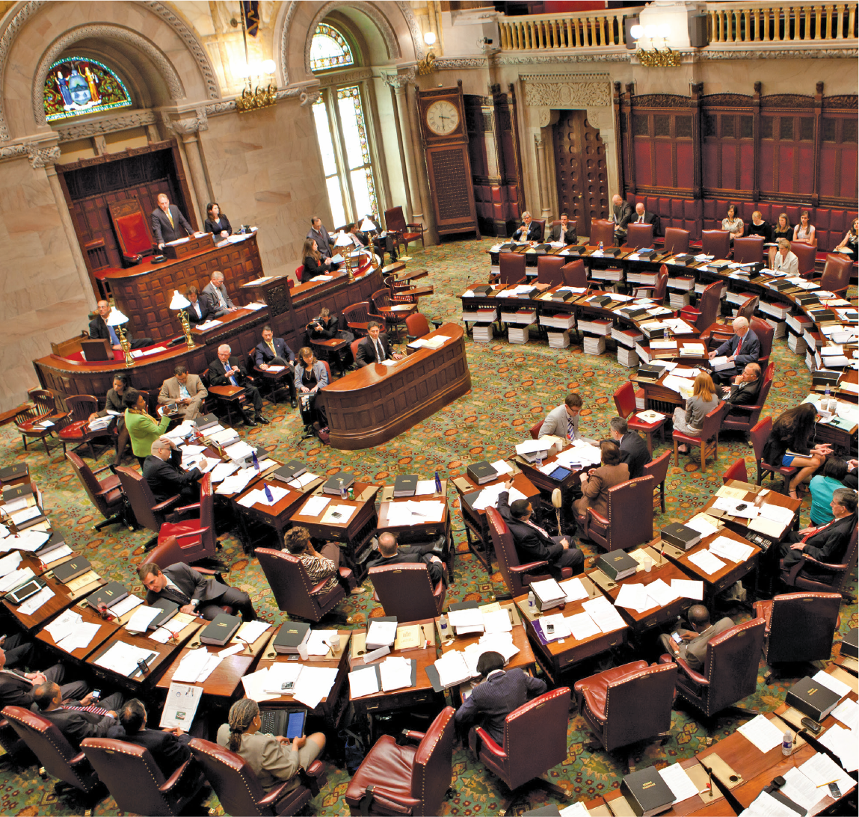
The New York senate in session in its historic chamber
Notes:
David R. Frazier Photolibrary, Inc. / Alamy

Slide 3
Learning Objectives (1 of 2)
6.1 To differentiate the three functions of legislatures.
6.2 To examine the redistricting process and its consequences.
6.3 To weigh the importance of informal norms amid formal rules in the legislative institution.
6.4 To recognize the intricacies of the lawmaking process.

Slide 4
Learning Objectives (2 of 2)
6.5 To appraise the efforts to reform state legislatures.
6.6 To discuss the impact of legislative term limits.
6.7 To interpret the interaction of the legislative branch with the executive branch.
6.8 To examine the link between legislatures and the public.

Slide 5
The Essence of Legislatures
Policy making—enacting laws and allocating funds
Representation—constituency representation as voice and advocate to bureaucracy
Oversight—examine the performance of the bureaucracy
Casework: Legislative assistance on behalf of constituents who have a problem or grievance with a state agency

Slide 6
Legislative Dynamics (1 of 2)
The Senate and the House
  Bicameral
  Senate: Four-year term; House: Two-year term
  Average size: Forty members for Senate and 100 members for House
  State legislators in the United States: 7,382;
    1,971 senators; 5,411 representatives

Slide 7
Legislative Dynamics (2 of 2)
Legislative Districts
  Based on population
  Single-member districts
  Few with multimember districts (MMDs)
Malapportionment
  Malapportionment: Skewed legislative districts
  Reapportionment: Reallocation of seats
Redrawing District Lines
  Redistrict: Redrawing of district lines.
  Gerrymander: Design districts to favor a political party.

Slide 8
Popular Legislative Issues in 2020
Abortion
Climate
Criminal Justice Reform
Election Security
Health Care
Highway funding
Housing
Immigration
Net Neutrality
Pensions

Slide 9
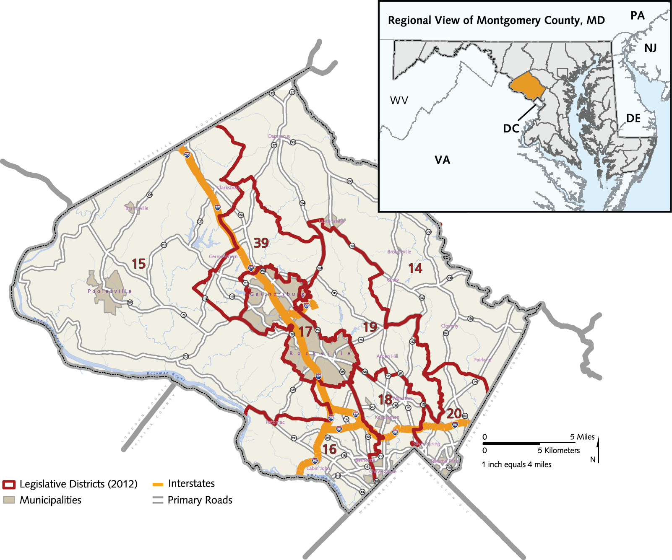
State Legislative Districts in Montgomery County, Maryland, 2012
Notes:
Source: Courtesy Montgomery County, MD, Planning Department

Slide 10
Controversies in States and Localities
Do-It-Yourself e-Redistricting
Are average citizens qualified to draw district boundaries? How can they gain the information that is required to make these decisions?
What components would be included in a computer program to produce unbiased district lines?
Should there be a political component to the districting process? Do politics serve a valid social function here?

Slide 11
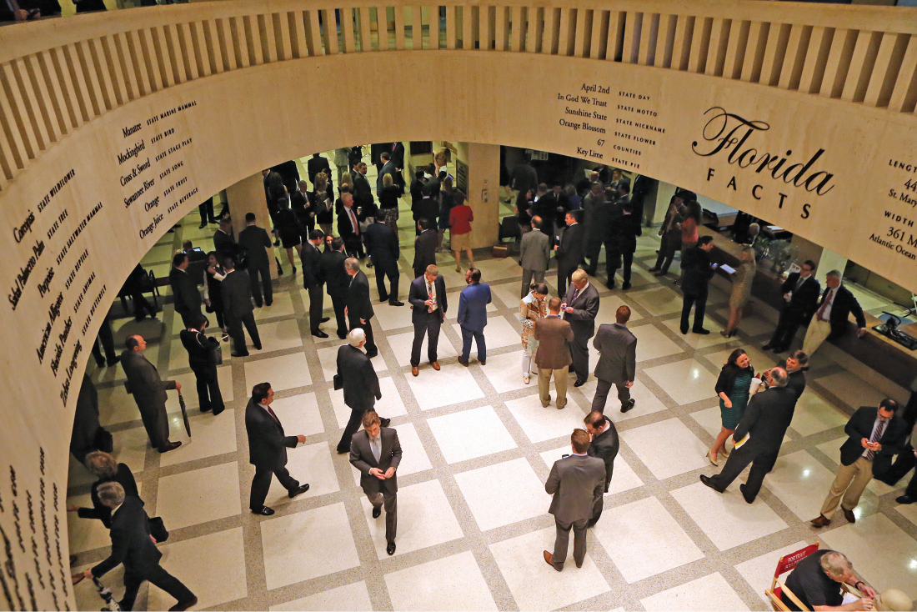
Lobbyists cluster in the Florida Capitol Rotunda
Notes:
Lobbyists cluster in the Florida Capitol rotunda that connects (and separates) the house and senate sides of the building.
AP Images/Steve Cannon

Slide 12
Legislative Dynamics
Compensation
Leadership
  Lame duck: An elected official who cannot serve beyond the current term of office
  War chest: A stash of funds accumulated in advance of a campaign
The Committee System

Slide 13
Legislative Behavior
Norms of the Institution
  Cue taking and policy making
  Political party
  Personal conscience
  Interest groups
  Committee leaders
  Colleagues
  Constituents
Delegates, trustees, and politicos

Slide 14
How a Bill Becomes a Law (or Not)
Policy entrepreneurs
Bill must pass both houses
Long and difficult process
Results in conflict at each step of the process
Has resulted in some reform

Slide 15
Legislative Reform and Capacity (1 of 2)
The Ideal Legislature
  Functional
  Accountable
  Informed
  Independent
  Representative

Slide 16
Legislative Reform and Capacity (2 of 2)
The Effects of Reform
  State legislatures becoming more like Congress
  Less turnover
  More functional, accountable, informed, independent, and representative (FAIIR)
Term Limits
  Term limits have produced changes

Slide 17
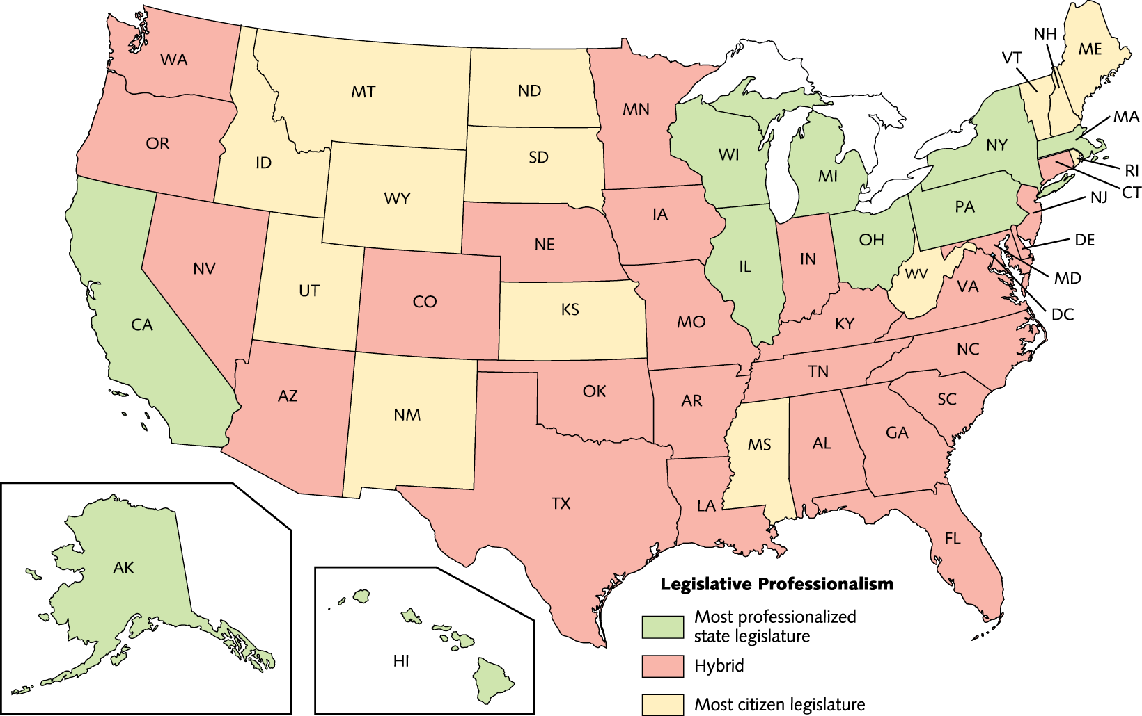
Legislative Professionalism
Notes:
Source: National Conference of State Legislatures, “Full and Part-Time Legislatures,” www.ncsl.org/research/about-state-legislatures/full-and-part-time-legislatures.aspx (accessed January 19, 2020).

Slide 18
Relationship with the Executive Branch (1 of 2)
Dealing with the Governor
Institutional conflict from divided government
Governor has media advantage
Governors who served in the legislature have easier time

Slide 19
Relationship with the Executive Branch (2 of 2)
Overseeing the Bureaucracy
  Policy and Program Evaluation
  Legislative Review of Administrative Rules
  Legislative veto: An action whereby the legislature overturns a state agency’s rules or regulations
  Sunset Legislation: Automatic expiration dates for specified agencies and organizations
  Review and Control of Federal Funds

Slide 20
Legislatures and Capacity
Dynamic institutions
Have undergone modernization
Concern that legislatures are being marginalized in some states due to citizen initiative

Slide 21
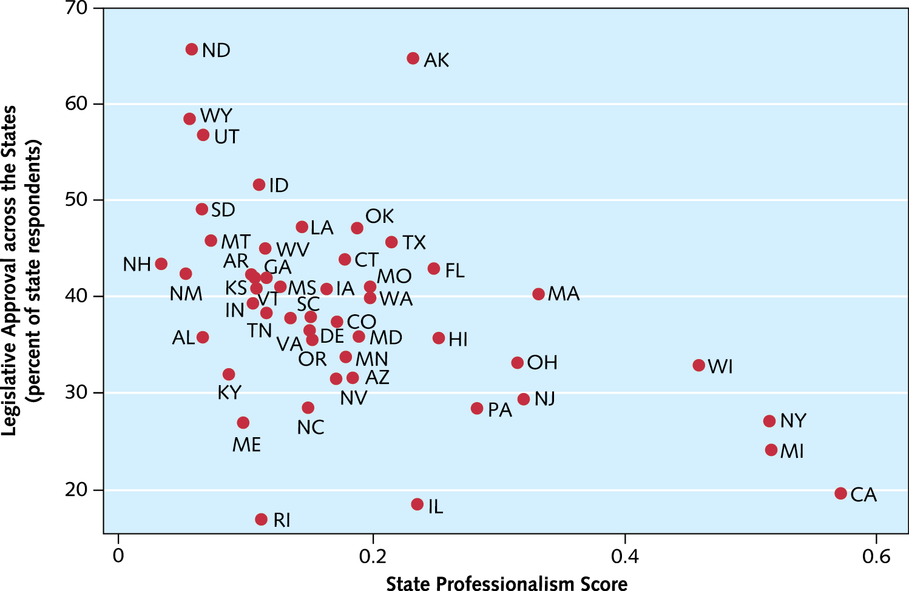
Legislative Approval Across the States
Notes:
Source: Lilliard E. Richardson, Jr., David M. Konisky, and Jeffrey Milyo, “Public Approval of U.S. State Legislatures,” Legislative Studies Quarterly 37 (February 2012): 99–116.

Slide 22
Internet Resources
www.ncsl.org
www.legis.iowa.gov
https://www.wvlegislature.gov/
http://onlinelibrary.wiley.com/journal/10.1002/%28ISSN%291939-9162
https://justfacts.votesmart.org/
http://uniformlaws.org
www.termlimits.org
www.alec.org

