Slide 1
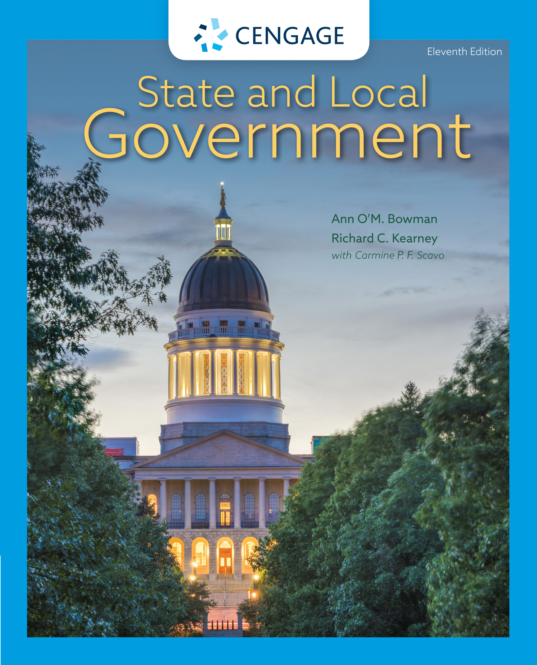
State and Local Government,
11e
Chapter 2: Federalism and the States
Ann O’M, Bowman | Richard C. Kearney | Carmine P. F. Scavo | State and Local Government, Eleventh Edition. © 2022 Cengage. All Rights Reserved. May not be scanned, copied or duplicated, or posted to a publicly accessible website, in whole or in part.

Slide 2

U.S. Border Patrol officer apprehends illegal child immigrant in Arizona
Notes:
John Moore/Getty Images

Slide 3
Learning Objectives
2.1 To describe the history and evolution of American federalism from the writings of the Framers and the growth of national power to the contemporary time.
2.2 To recognize the changing balance of formal and informal power and responsibility between the national government and the states.
2.3 To describe the principal models of federalism that attempt to explain the nature of federal–state–local relationships.
2.4 To explain the complex nature and tools of intergovernmental financial relations.
2.5 To recognize finances as a source of friction and conflict between the three levels of government.

Slide 4
The Concept of Federalism (1 of 2)
Division of government power and responsibility
  Unitary
  Confederate
  Federal
The Advantages of Federalism
  Manages social and political conflict
  Promotes administrative efficiency
  Encourages innovation
  Maximizes political participation in government

Slide 5
The Concept of Federalism (2 of 2)
The Disadvantages of Federalism
  Conflicts can escalate
  Coordination problems across governments
  Ineffective national government programs
  Local biases harmful to national interests

Slide 6
The History of U.S. Federalism (1 of 5)
Early History
  Devices to control factions placed in the U.S. Constitution
    Representative government with citizen elections
    Division of government into three branches
    Federal system with majority controlled by the sovereign states
The Move Toward Federalism
  The Articles of Confederation
    Unicameral Congress
    Limited power
    Lack of national authority

Slide 7
The History of U.S. Federalism (2 of 5)
The Move Toward Federalism
  The Constitutional Convention
    The Virginia Plan
    The New Jersey Plan
    The Great Compromise

Slide 8
The History of U.S. Federalism (3 of 5)
State-Centered Federalism
  Preferred by Jefferson and the Republicans
  Saw the Constitution as a compact that maintained the sovereignty of states
  Compact theory
  Ultimately resulted in secession by eleven states

Slide 9
The History of U.S. Federalism (4 of 5)
The Growth of National Power Through the Constitution and the Judiciary
  The National Supremacy Clause
  The Necessary and Proper Clause
  The Commerce Clause
  The General Welfare Clause
  The Fourteenth Amendment

Slide 10
The History of U.S. Federalism (5 of 5)
The Growth of National Power Through Congress
  Taxing and Spending Power
  Federal Preemption
  Smothering (Then Resuscitating) the Tenth (and Eleventh) Amendments
    National League of Cities v. Usery and United States v. Lopez
  Federalism and the Courts Today

Slide 11
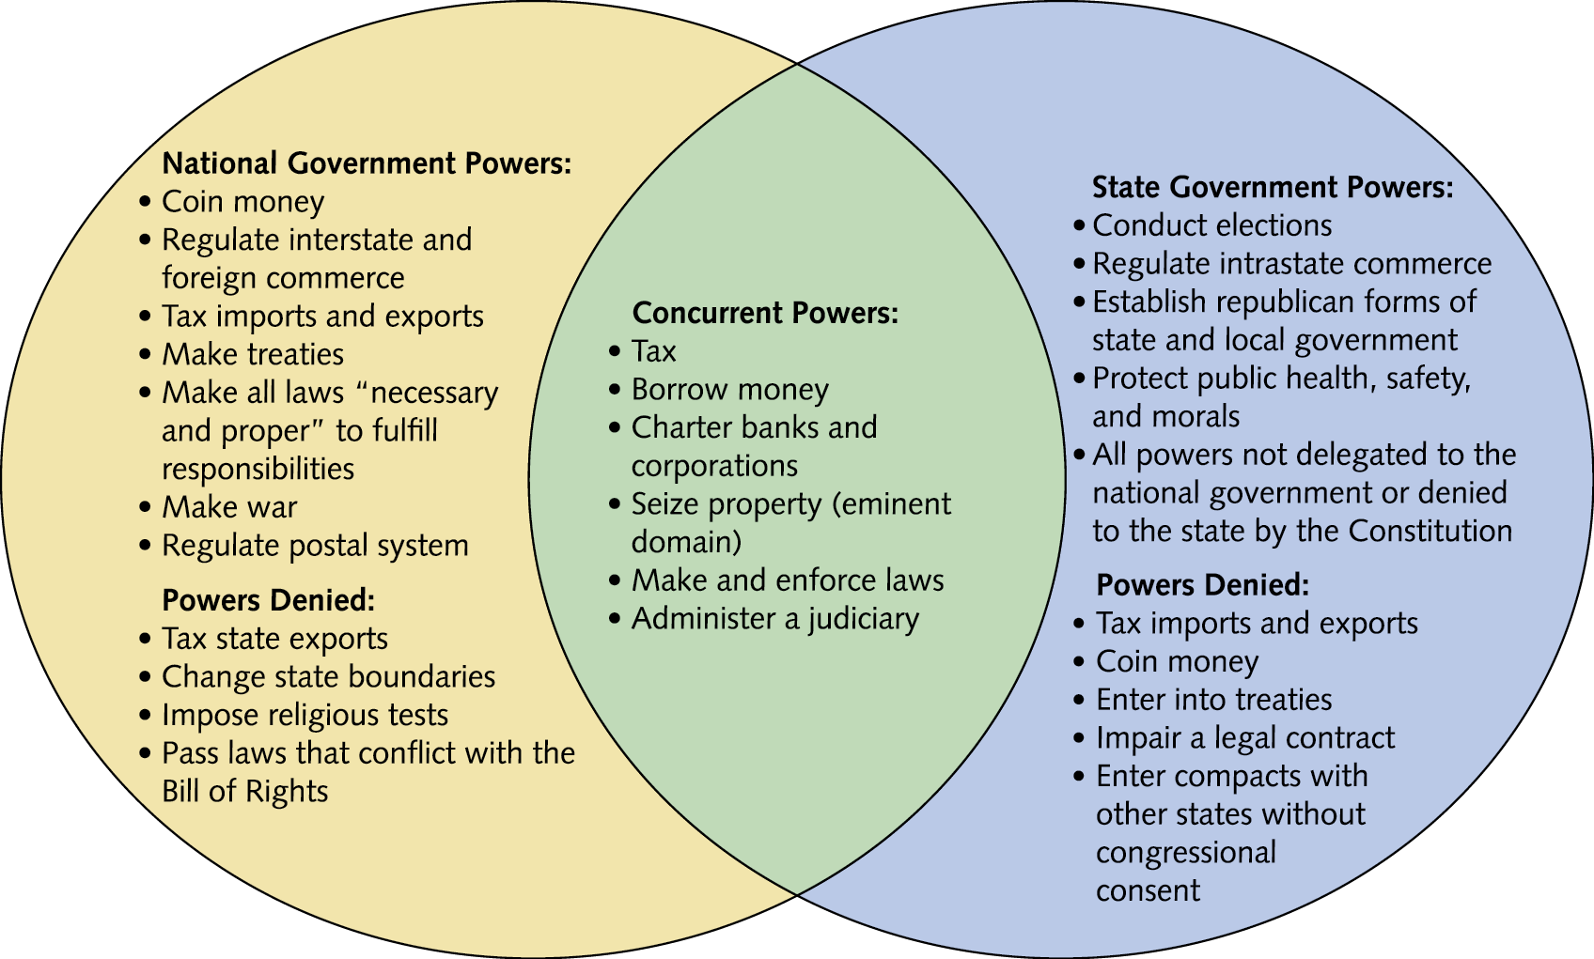
Figure 2.1 Constitutional Distribution of Powers

Slide 12
Models of Federalism
Dual Federalism (1787–1932)
Cooperative Federalism (1933–1964)
Contemporary Variations on Cooperative Federalism (Since 1964)
  Creative federalism
  New federalism
    Devolution
  Coercive federalism
  “Jenga” federalism

Slide 13
Intergovernmental Relations (1 of 3)
Tribal Governments
  McGirt v. Oklahoma (2020)
  Tribal recognition by the federal government
Interstate Cooperation
  Cooperation under the Constitution
    Full faith and credit clause
    Interstate rendition clause
    Privileges and immunities clause
    Interstate compact clause

Slide 14
Intergovernmental Relations (2 of 3)
Interstate Cooperation
  Informal Cooperation Among the States
    Regional interstate commissions
    Uniform laws
    Information sharing
    Interstate compacts
    Arbitration

Slide 15
Intergovernmental Relations (3 of 3)
Intergovernmental Financial Relations
  Grant-in-aid
  Discretion of Recipients
    Categorical
    Block
  Conditions for Grants
    Formula
    Project

Slide 16
Federal Purse Strings
The Importance of Federal Funds
  Aid to states and localities is small share of federal budget (4 percent GDP) but is 31 percent of state and local governments’ revenues
  Most nongrant payments are from Social Security, Medicaid, wages to federal employees
Here’s the Money and Here’s What You Must Do with It: Mandates and Preemptions
  Federal mandates
    Funded and unfunded
    Total preemption and partial preemption

Slide 17
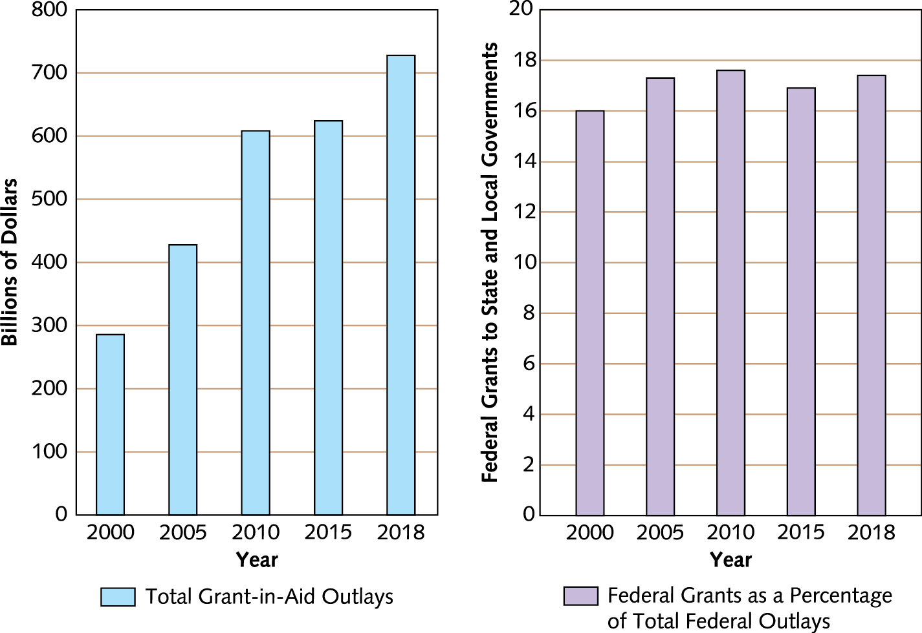
Figure 2.2 Historical Trends in Federal Grant-in-Aid Outlays
Notes:
Source: U.S. Census Bureau, http://www.whitehouse.gov (OMB budget for 2013) (accessed April 12, 2015).

Slide 18
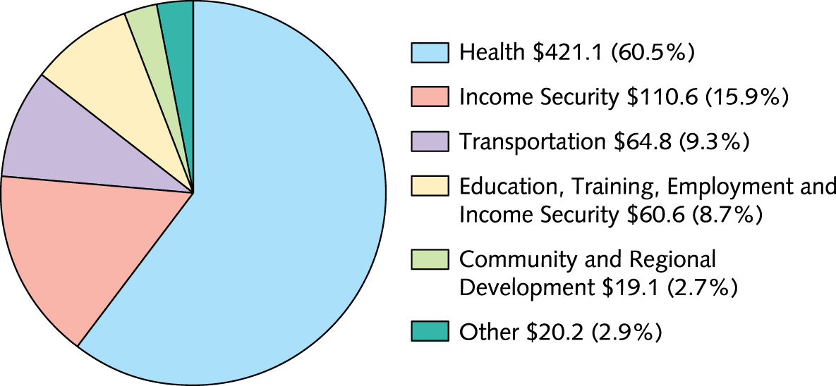
Figure 2.3 Federal Aid to State and Local Governments
Notes:
Source: “Federal Aid to States, Fiscal Year 2014,” U.S. Census Bureau (www.census.gov).

Slide 19
The Future of Federalism
Greater public trust in state and local governments than federal
Social and economic factors
Homeland security and disaster response

Slide 20
Internet Resources
www.statenews.org
www.csg.org
www.census.gov
www.tribal-institute.org
www.narf.org

