Slide 1
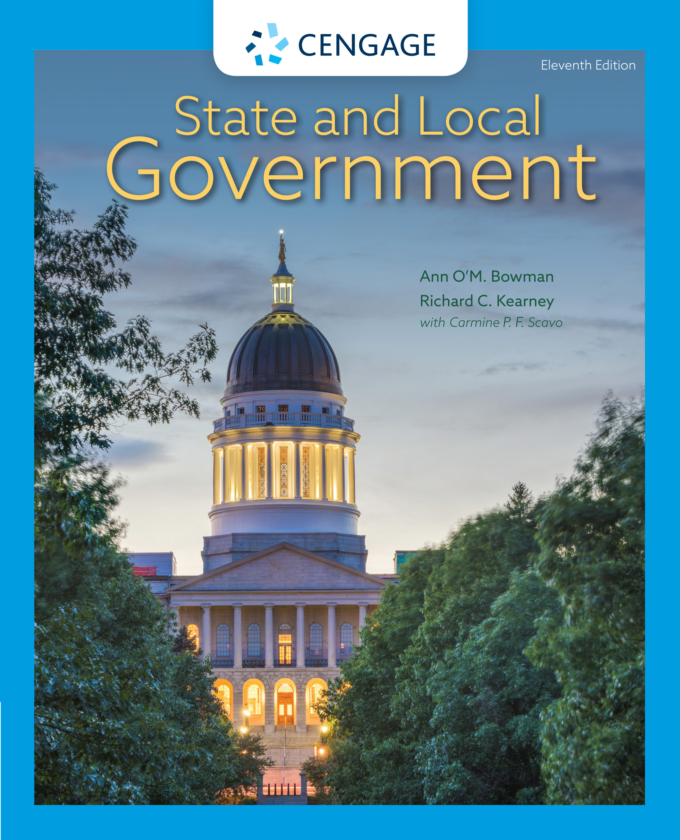
State and Local Government,
11e
Chapter 1: State and Local Governments: New Directions
Ann O’M, Bowman | Richard C. Kearney | Carmine P. F. Scavo | State and Local Government, Eleventh Edition. © 2022 Cengage. All Rights Reserved. May not be scanned, copied or duplicated, or posted to a publicly accessible website, in whole or in part.

Slide 2
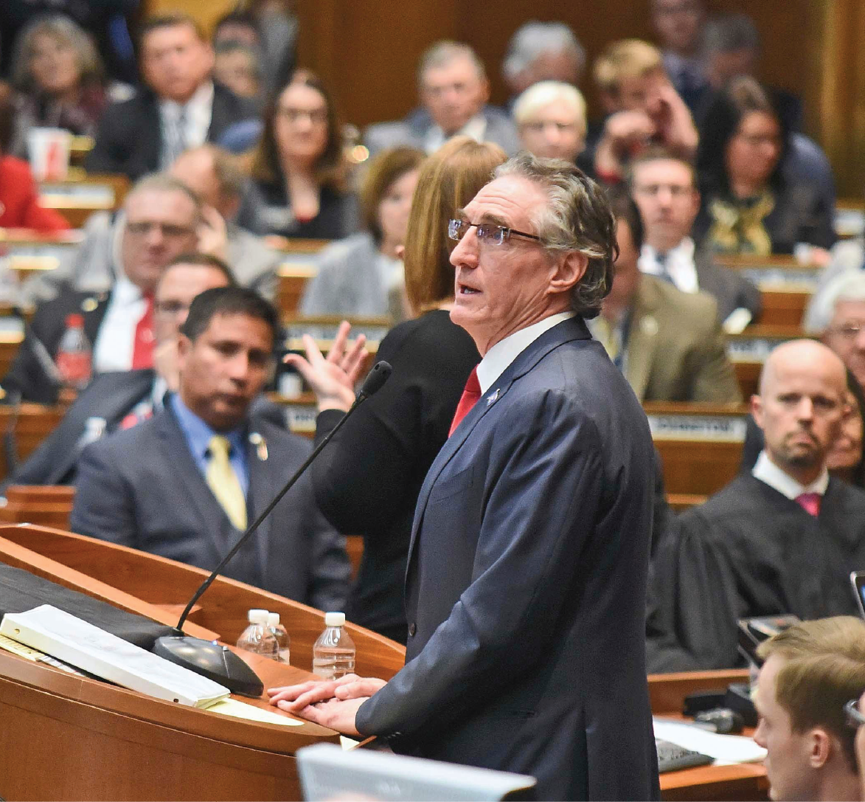
North Dakota Governor Doug Burgum delivers his 2019 State of the State address
Notes:
AP Images/Thom Bridge, Independent Record

Slide 3
Learning Objectives
1.1 To recognize the importance of state and local governments in contemporary America.
1.2 To identify ways in which states and localities have increased their capacity.
1.3 To recognize the challenges that states and localities confront on a daily basis.
1.4 To recognize how changing public attitudes influence government behavior.
1.5 To understand the changing demographic landscape in the United States.

Slide 4
Studying State and Local Governments in the Twenty-First Century (1 of 2)
From Sewers to Science: The Functions of State and Local Governments
  Must perform efficiently, effectively, and equitably, and with evidence-based practices
  Council of State Governments (CSG)

Slide 5
Studying State and Local Governments in the Twenty-First Century (2 of 2)
States and localities have the capacity to play central roles in the U.S. federal system.
  Bureaucracy
  Responsible and democratic governance
  Federalism and intergovernmental relations

Slide 6
Table 1.1 A Sample of New State Laws Taking Effect in 2020 (1 of 2)
State | Description of the Law
Arizona | Mandates training for sixth- through twelfth-grade teachers on spotting the signs of student suicidal behavior.
California | Makes it illegal to discriminate in the workplace and schools based on the individual’s natural hairstyle or texture. Protected hairstyles include Afros, braids, twists, cornrows, and dreadlocks.
Illinois | Legalizes sale and use of recreational marijuana for people 21 and older, making Illinois the eleventh state to do so.
Massachusetts | Automatically registers to vote an eligible resident when they get a driver’s license or health insurance in the state.
New York | Allows state residents who were adopted to have unrestricted access to their birth certificates once they turn 18.
North Carolina | Creates a new felony—Death by Distribution—that targets drug dealers who contribute to a user’s overdose death.
Notes:
Sources: Kelly Beaucar, “New 2015 Laws Tackle Wages and Weed, Pet Tattoos and Tiger Selfies,” Fox News, https://www.foxnews.com/politics/new-2015-laws-tackle-wages-and-weed-pet-tattoos-and-tiger-selfies? The second URL too needs an update as it's not working. Perhaps update to https://www.washingtonpost.com/blogs/govbeat/wp/2014/07/01/thousands-of-new-state-laws-take-effect-today-part-one/, http://www.usatoday.com/story/news/nation/2015/01/01/new-laws-january-first/21055077/ (January 1, 2015).

Slide 7
Table 1.1 (2 of 2)
State | Description of the Law
Ohio | Requires the teaching of cursive writing in first grade through fifth.
Oregon | Allows bicyclists to slow down rather than come to a complete stop at stop signs and traffic signals.
Texas | Requires employees of higher education institutions to report to university authorities sexual harassment, sexual assault, stalking, and date rape incidents committed against an employee or student.
Washington | Requires children to ride in booster seats in cars until they are at least four feet, nine inches tall. When practical, children must ride in the back seat until age 13.
Notes:
Sources: Kelly Beaucar, “New 2015 Laws Tackle Wages and Weed, Pet Tattoos and Tiger Selfies,” Fox News, https://www.foxnews.com/politics/new-2015-laws-tackle-wages-and-weed-pet-tattoos-and-tiger-selfies? The second URL too needs an update as it's not working. Perhaps update to https://www.washingtonpost.com/blogs/govbeat/wp/2014/07/01/thousands-of-new-state-laws-take-effect-today-part-one/, http://www.usatoday.com/story/news/nation/2015/01/01/new-laws-january-first/21055077/ (January 1, 2015).

Slide 8
The Capacity of States and Localities (1 of 4)
Historical context
1950s–1960s
  Elite dominance
  Inefficient and ineffective services
Post 1980s: resurgence
  Increased state role
  Proactive

Slide 9
The Capacity of States and Localities (2 of 4)
How States and Localities Increased Their Capacity
  Changes in legislative apportionment
  Increased lobbying presence
  Modernized constitutions

Slide 10
The Capacity of States and Localities (3 of 4)
Increased Capacity and Improved Performance
  Improved revenue systems
  Expanded scope of state operations
  Faster diffusion of innovations
  Interjurisdictional cooperation
    Informal consultations and agreements, interstate committees, consumer protection, etc.
  Increased national-state conflict
    Unfunded mandates

Slide 11
The Capacity of States and Localities (4 of 4)
Challenges Facing State and Local Governments
  Fiscal stress
    Downsizing, tax increases
  Increased interjurisdictional conflict
    Natural resources and economic development
  Political corruption
    More transparency

Slide 12
The People: Designers and Consumers of Government (1 of 3)
Ethnic-Racial Composition
  2010 census data reports
    72 percent Whites
    13 percent African Americans
    16 percent Latinos
    5 percent Asians
    1 percent American Indians and Alaska Natives
  Illegal immigration
    DREAM Act
    2010 Arizona immigration law

Slide 13
The People: Designers and Consumers of Government (2 of 3)
Population Growth and Migration
  From 2010 to 2019, the United States grew by almost 6 percent
  High rate of growth in the Sunbelt
  Population changes carry political and economic consequences
Political Culture
  “It’s our thing”
  Elazar’s classification of political cultures
    Individualistic: open marketplace, self-motivated
    Moralistic: moral obligation to create good and just society
    Traditionalistic: elite-driven activity to maintain status quo
  Socioeconomic characteristics and political structure factors

Slide 14
The People: Designers and Consumers of Government (3 of 3)
Culture Wars
  Culture affects policy in conflict over moral issues such as:
    Same-sex marriages
    Abortion
    Religion
    Politics
    Reactions to COVID-19

Slide 15
Linking Capacity to Results
States are diverse in their capacities, public services, and taxes
Competition is inherent to federal system
States are resilient: captures ability of state governments to recover from adversity

Slide 16
Internet Resources
Websites to explore:
  www.state.pa.us (substitute 2-alphabet state abbreviation between “state” and “us”)
  www.pewstates.org/projects/stateline
  www.csg.org
  www.census.gov

