Slide 1
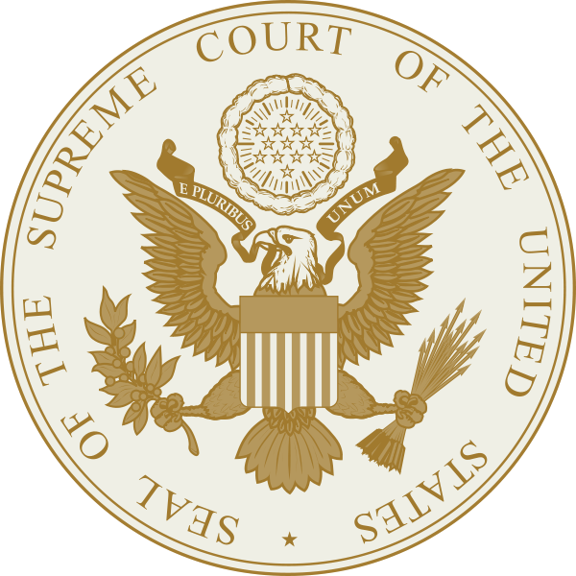
Chapter 9
Federal Judiciary

Slide 2
Chapter 15
Federal Judiciary

Slide 3
The Least Dangerous Branch
Hamilton’s view of the court
Checks on the power of the judiciary
Jurisdiction
Presidential appointment
impeachment
Notes:
Supreme court judges were given life tenure because the framers did not want the court to be subject to the whims of the public, politics, and politicians
Hamilton called it the least dangerous branch
Hamilton argued that judges should be independent so as to “guard the Constitution and the rights of individuals”

Slide 4
Judiciary Act of 1789
Established the basic three tiered structure of the federal court system.
Supreme Court
Circuit Court of Appeals
District Courts
Notes:
At the bottom are the federal district courts, at least one for each state staffed by a federal judge
Circuit Court of Appeals, originally it was one federal judge from district courts and two Supreme Court justices that would meet in a circuit court once a year.
Supreme Court originally set at six justices. A Chief Justice and five associate justices. Eventually it was enlarged to the current size of nine justices to account for more circuit courts as the nation expanded.

Slide 5
American Legal System
SUPREME COURT (appeals and some original jurisdiction)
APPELLATE COURTS (appeals only)
DISTRICT COURTS (original only)
Notes:
Dual Court system- two different three tiered levels: federal and state courts. (p. 253)
Trial court- court of original jurisdiction
Appellate court- court that generally reviews only findings of law made by other courts
Jurisdiction- authority vested in a particular court to hear and decide the issues in a particular case.
Original jurisdiction- jurisdiction of a court that hears a case first, usually in trial. Courts determine the facts of a case under original jurisdiction.
Appellate Jurisdiction- power vested in an appellate court to review and/or revise the decision of a lower court.
Criminal Law- body of law that regulates individual conduct and is enforced by the government.
Civil law- body of law that regulates the conduct and relationships between private individuals or companies.

Slide 6
Civil Law and Criminal Law
Criminal –
Civil -

Slide 7
Structure of the Court System
Constitutional courts-
Legislative courts-
What determines if a case is federal or state?
1. involve the federal government as a party
2. federal question
3. Civil suits involving citizens from different states
Notes:
Constitutional courts- Supreme Court, and the district courts, and appellate courts created by Congress under the authority granted by the constitution under Article III
Legislative courts- courts set up by congress under Article I of the constitution.
implied powers, U.S. Territorial Courts, U.S. Court of Veterans Appeals, these judges are appointed by the President, confirmed
by the Senate and serve limited terms.
District courts- each state has at least one. California, Texas and New York have four.
District Court Jurisdiction
1. involve the federal government as a party
2. federal question (the issue is based on a claim on the constitution, federal law, or a treaty)
3. Civil suits involving citizens from different states
Each federal district court has a U.S. attorney, the chief law enforcement officer of the United States.

Slide 8
Court Of Appeals
Until 1869 federal district judges and two Supreme court justices served as Court of Appeals judges.
1869 appeals court judges appointed for the first time to deal with the increased demands on the federal government.
11 numbered appeals courts that handle appeals from district courts and a few others for special circumstances

Slide 9
Supreme Court
Jurisdiction-
Original jurisdiction-
Appellate-
Writ of certiorari-
1. case must come from a U.S. court of appeals.
2. case must involve a federal question.
3. Rule of four-
Notes:
Since 1925 The Supreme Court hears only those cases it chooses to. (70-80 a year)
Writ of certiorari- request to order up the records from a lower court

Slide 10
Oral Argument
Briefs and amicus curiae
Lawyers for each side speak for one half hour
Green light- begin oral arguments
White Light- five minutes left
Red light- time is up
Notes:
Supreme Court sits in session from October to June, hearing cases for two weeks and having a recess for two weeks.

Slide 11
Supreme Court Decisions
Majority Opinions
At least 5 votes
Explains decision
Concurring Opinions
Highlights different reasoning for majority decision
Dissenting Opinions
Minority opinion
Explains reasoning for disagreement

Slide 12
Judicial Philosophies
Judicial Activism
Judicial Restraint
Strict Construction

Slide 13
Judic ial Branch Quiz
Explain the structure of the federal court system.
Explain the role of the chief justice.
Explain the majority, concurring and dissenting opinions.
How can Congress check the power of the judicial branch?

