Slide 1
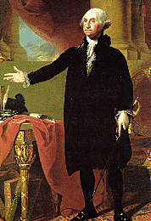
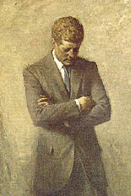
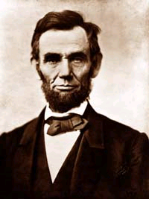
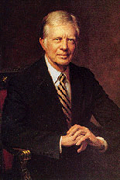
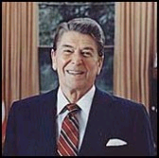
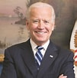
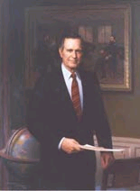
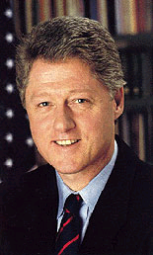
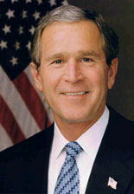
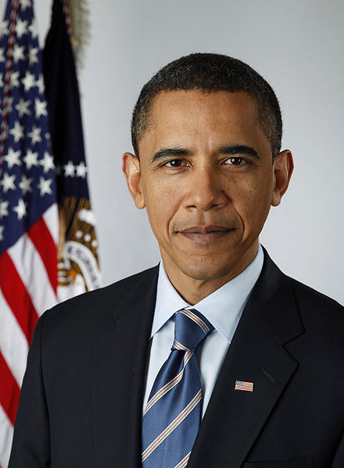
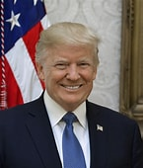
The President of the United States
Chapter 12

Slide 2
Qualifications
1. Natural born citizen
2. 35 years old
3. Resident of the United States for at least 14 years.

Slide 3
INFORMAL QUALIFICATIONS
SOME EXPERIENCE
WEALTH
NAME RECOGNITION
PARTY SUPPORT

Slide 4
Terms
4 years.
Originally no term limits,
1951- 22nd Amendment
2 4yr terms or 10 yrs. Total if former VP becomes P.

Slide 5
Removal
Impeachment-
“treason, bribery, or other high crimes and misdemeanors”
House or Representatives
Senate

Slide 6
Succession
Vice President
Presidential Succession Act of 1947
1. Speaker of the House
2. President Pro-tempore of the Senate
3. Secretary of State, rest of cabinet in order of creation
25th Amendment

Slide 7
Vice President
President in waiting.
President of the Senate
Most Vice Presidents have been very obscure and have had little or no relationship with the President
Walter Mondale (77-81)
Dick Cheney - (01-09)
Balancing the ticket
Regional
Political
Experience
Temperament
Racial/Gender

Slide 8
Constitutional Powers of the President
Article II of the constitution outlines vague powers
“The executive power of the United States shall be vested in a President of the United States.” (Article II) leaves room for interpretation
Power of Appointment
Power to Convene Congress –
Power to Make treaties-
Executive agreements –
Power to Pardon
Executive Orders

Slide 9
Original Limitations
Washington –
Most 19th Century Presidents
Jackson
Lincoln

Slide 10
Evolution in 20th Century
Teddy (1901-1909)
Panama canal treaty
Foreign policy
Progressive reforms
Franklin (1933-1945)
New deal
Fireside chats
WWII
Ex order 9066
Johnson (1964-1969)
Vietnam (lied about Vietnamese attack on US Navy)
Great Society –Education and healthcare
Civil Rights
Nixon (1969-1974)
EPA
China & Taiwan
Watergate
War Powers

Slide 11
Even More Evolution
Reagan (1981-1989)
Fired striking Air traffic Controllers
Exercised considered legislative influence
Foreign policy success
George H. Bush (1989-1993)
Mostly foreign policy
William Jefferson Clinton (1993-2001)
Scandals
Legislative victories
Some foreign policy
Line item veto
George W. Bush (2001-2009)
War on terror
Extensive use of signing statements
Some legislative influence

Slide 12
Expansion of Presidential Power
War
Declared wars vs. AUMFs
War Powers Act
Technological Change
Radio
TV

Slide 13
Roles of President
Head of State
Party Leader
Chief Diplomat
Chief Spokesperson
Economic Leader

Slide 14
Role of the President in the Legislative Process
Liberal Constructionist
Johnson, Roosevelt (both), Nixon, Reagan, Clinton, Bush, Obama, Carter, Bush II , Washington, Wilson, Lincoln
Imperial Presidency
20th and 21st century
Strict Constructionist
Jefferson, Hoover, Almost all 19th century Presidents,
Taft, Harding, Coolidge, (19th century idea)

Slide 15
How Successful is the President?
President’s ability to push agenda depends on
Powers of persuasion
Public perception of job performance (approval ratings)
Political Party Majorities in Congress
Personality

Slide 16
Electing a President
People cannot be trusted!!!
EV total = 538
EV = Congressional Delegation (House + Senate)
Texas = 38 (36 House + 2 Senators)
Winner = 50% + 1 vote (270)

Slide 17
Presidential Nominations
First method - congressional caucus 1789-1830s
Second method - national conventions.
1830’s till mid 1970’s
First the National Convention selected nominees
Now candidates compete in primaries and caucuses for delegates to the national convention

Slide 18
Election Phases
Nomination phase January through June
Party Conventions – Late August/early September
General Election – Labor day till first Tuesday after the first Monday in November
TV ads Rallies
Debates Swing States

Slide 19
Modern Presidential Nominations
Selection of delegates is through primaries and caucuses.
Presidential primary -
Presidential caucus –
Candidates need a majority of delegates to win Party nomination

Slide 20
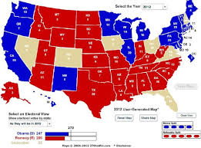
Swing States

Slide 21
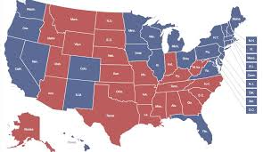
Final Results 2012

Slide 22
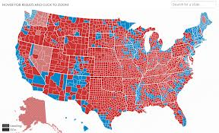

Slide 23
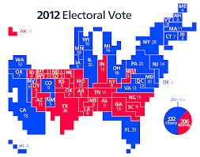
Relative Importance

Slide 24
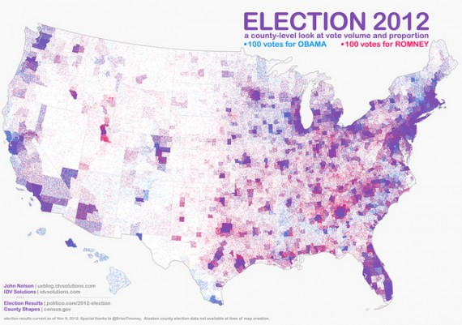

Slide 25
Bureaucracy (chapter 14)
What is bureaucracy?
Hierarchy
Division of labor
Clear lines of authority
Impersonal rules, merit based decisions

Slide 26
From Spoils to Merit
Spoils –
Merit –
1883 Pendleton Act –

Slide 27
4 types of agencies
Cabinet Departments - 60% of bureaucrats
15 departments
Government Corporations
Amtrak and TVA, FDIC, Post Office,
Independent Agencies
CIA, NASA, EPA
Regulatory Commissions
SEC, NLRB, FEC

Slide 28
How it works?
Making Policy
Lots of wiggle room
Rule Making (Federal Register)
Interprets legislation,
Public comment, hearings
Administrative Adjudication
Enforcement of rules

Slide 29
Sources of Bureaucratic Power
External Support – public opinion, President and Congress
Expertise –
Longevity and Vitality –
Leadership -

Slide 30
Controlling Bureaucratic Power
“No politician has ever lost votes by denouncing the bureaucracy”

Slide 31
Executive Control
Appoint and remove agency heads
Reorganize the bureaucracy
Change budget proposals
Issue executive orders
Reduce an agencies budget

Slide 32
Congressional Controls
Pass legislation that alters the agency
Investigate bureaucratic activities
Influence pres. Appointments
Write legislation to limit discretion
Limit use of funds or reduce funding

Slide 33
Judicial Controls
Rule on whether the agency has acted within the law
Rule on constitutionality
Force respect for the rights of individuals through hearings

