Slide 1
CONGRESS

Slide 2
How many people represent each state?
Apportionment – distributing seats
Reapportionment – redistributing seats based on latest census
Reapportionment Act of 1929 –permanent size of House at 435
Decennial Census –

Slide 3
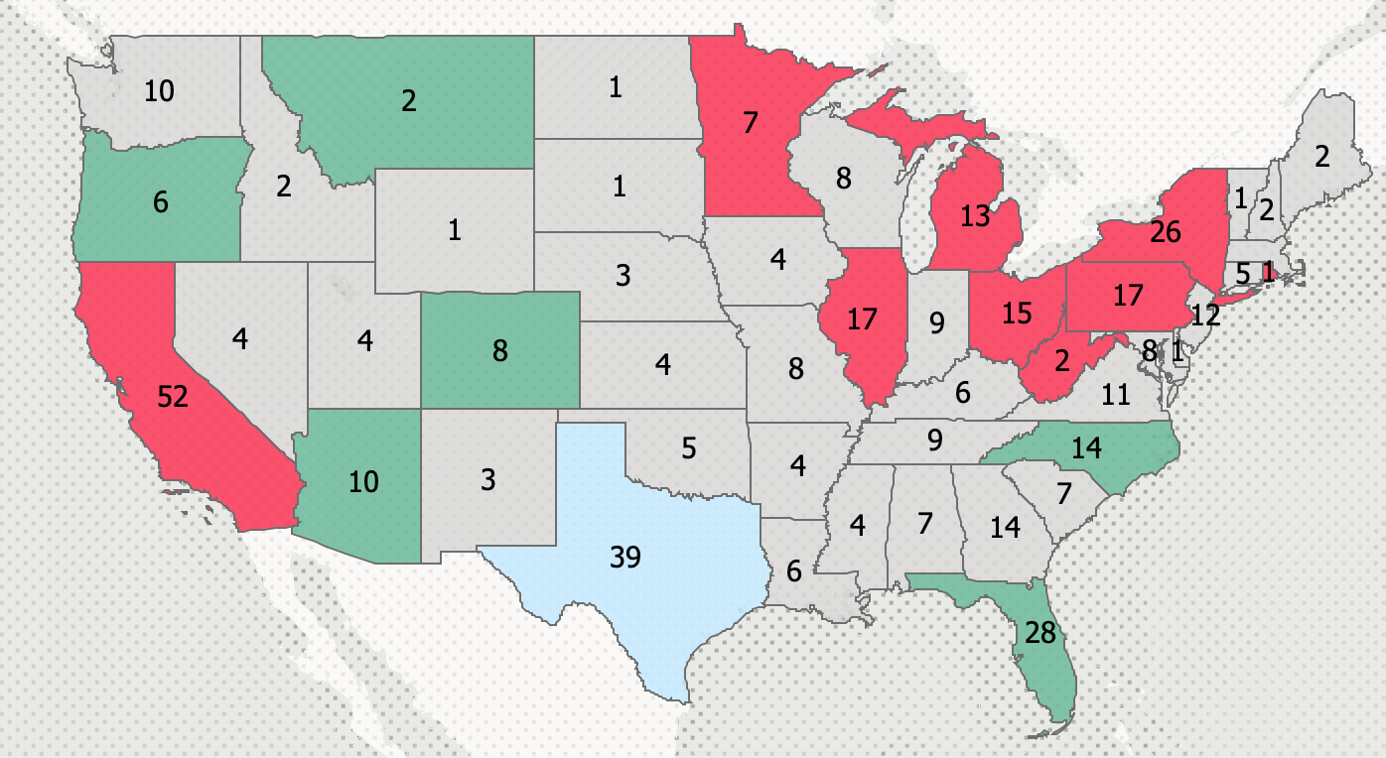
Reapportionment 2020

Slide 4
Redistricting
Redistricting- District maps must be redrawn by state legislatures after every census
Gerrymandering –
Baker v Carr
Shaw v Reno
Wesberry v Sanders

Slide 5
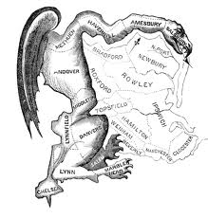
Gerrymandering

Slide 6
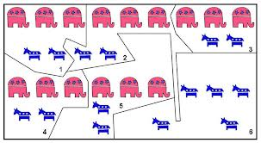
Packing and cracking

Slide 7
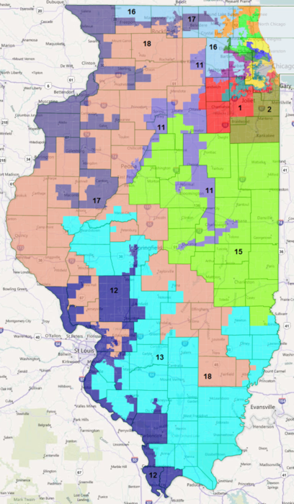
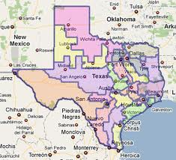
Gerrymandering

Slide 8
Membership
House of Representatives -
Senate -

Slide 9
Terms
House of Representatives-
Senators-

Slide 10
Elections
Incumbents – win 90% of the time
Why?
Fundraising
Name recognition
Casework
Experience
Gerrymandering

Slide 11
Midterm elections
Party in power usually loses seats
1938 – 71 seats
1942 – 55 seats
1946 – 46 seats
1994 – 52 seats
2010- 63 seats
2018 – 41 seats
Party in power has gained seats twice
1934 9 seats
2002 8 seats

Slide 12
Why?
Referendum on majority party?
Coattail effect?

Slide 13
Constitutional Powers of Congress
Authority to make laws
No bill (proposed law) can become law wihout consent of both houses.
Article I Section 8 lists powers
Necessary and Proper clause- gives Congress the power to “make all laws which shall be necessary and proper for carrying into execution all the foregoing powers, and all other powers vested by this constitution in the government of the United States”

Slide 14
Differences between the House and Senate
House
Initiates all revenue bills
Initiates impeachment procedures and passes articles of impeachment
Senate
Offers advice and consent on many major Presidential appointments
Tries impeached officials
Approves treaties

Slide 15
Differences in Operation
House
More centralized, stronger leadership
Rules committee powerful in controlling time and rules for debate
More impersonal
Power less evenly distributed
Members are highly specialized
Emphasizes tax and revenue policy
Senate
Less centralized, less formal, weaker leadership
No rules committee, limits on debate come through unanimous consent or filibuster
More personal
Power more evenly distributed
Members are generalists
Emphasizes foreign policy

Slide 16
How Congress is Organized
Speaker of the House-
Whole house
The majority and minority leader
Party elections called party caucuses
Majority/Minority Whips
Party caucuses

Slide 17
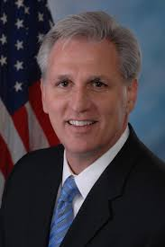
Minority Leader: Kevin Mccarthy (R - California)

Slide 18
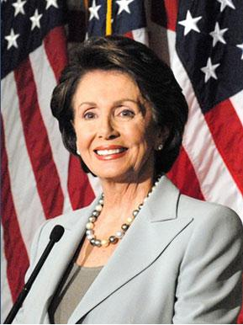
Speaker of the House: Nancy Pelosi (D-California)

Slide 19
Demographics
Congress is better educated and wealthier than the general public
They’re also whiter, and more male dominated than the general public
Senate is often called the “Millionaires Club”
The 117th Congress (2021-2023) has 225 Democrats (4 non voting delegates) and 212 Republicans (1 non voting delegate and 1 non voting resident commissioner).
Terms vs. Sessions for the House
The Senate, which has been in continuous session since 1789, has 48 Democrats, 50 Republicans, 2 independents (both vote in Democratic Caucus) VP breaks tie so Dems have majority

Slide 20
Perceived Role of Representatives
Trustee-
Delegate-
Politicos-

Slide 21
Organization of the Senate
Presiding Officer-Vice President of the United States
Chair of the Senate- President pro-tempore
Majority Leader-
Whips-

Slide 22
Role of Political Parties
Party Caucus-nominates party officers, reviewing committee assignments, discussing party policy, imposing party discipline,
Conference and Caucus chairperson-
Congressional Campaign Committees

Slide 23
Members and their votes
Party –
Constituents –
Colleagues –
Interest Groups -

Slide 24
Committee System
Standing Committees-
Conference Committees-
Ad-hoc or special committees-
Joint committees-

Slide 25
Lawmaking
House of Representatives
Introduced in the House
Referred to Standing Committee
Subcommittee
Markup, debate, referred back to standing committee
Reported by the Standing Committee to the full house
Rules Committee Action
How long is debate? When? Can we offer amendments?
Full House Debate and Vote on Passage
Strictly limited

Slide 26
Senate
Same process
Except for…
No Rules Committee;
Majority leader decides if and when bills will be debated, what committees to send bills to
Unanimous Consent
No one Senator decides how long debate will last
FILIBUSTERS!
holds

Slide 27
A few more important items
What is pork? What’s wrong with it?
Transportation bills
Ban on earmarks

