Slide 1
Chapter 1: The Constitution
Essential Question:
How have theory, debate, and compromise influenced the Unites States’ system of government that balances governmental power and individual rights?

Slide 2
Essential Question:
The Struggle between Individual Liberty and the Common Good:
https://www.c-span.org/classroom/document/?7259

Slide 3
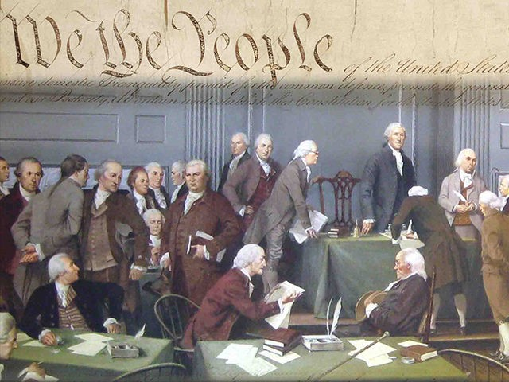
1787 – Framers meet in Philadelphia

Slide 4
1789 – Constitution put into place
Created a legislative, executive, and judicial branch.
Defined federalism and relationship among states.
Provided for a method to alter, or amend the document.

Slide 5
1791 - Bill of Rights* goes into effect
First 10 Amendments to the Constitution

Slide 6
Social Contract*
Contract between a democratic government and the people
If government violated the contract, the people could take power back.
(Read paragraph 2 of Declaration of Independence, pg.619)

Slide 7
Timeline from 1764 to 1791
1764 – Parliament passes Sugar Act
1765 – Parliament passes Stamp Act
1770 – Boston Massacre
1773 – Boston Tea Party
1774 – First Continental Congress
1775 – Battles of Lexington and Concord
1776 – Declaration of Independence
1781 – Articles of Confederation ratified
1783 – Treaty of Paris
1786 – Shay’s Rebellion
1787 – Constitutional Convention
1789 – President Washington, Congress elected
1789 – Congress proposes Bill of Rights
1790 – Rhode Island ratifies Constitution (13th state)
1791 – Bill of Rights ratified

Slide 8
King George III – Financing the 7 Years’ War

Slide 9
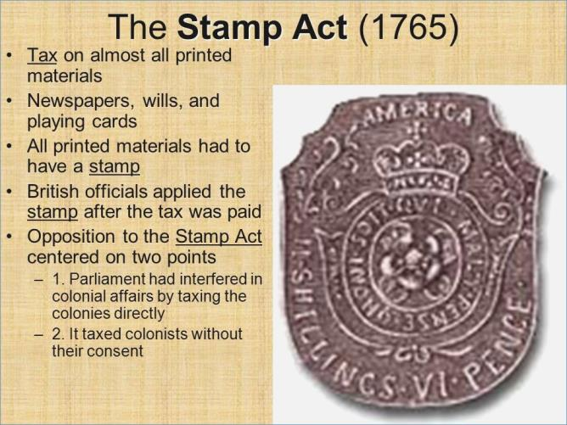
King George III – Financing the 7 Years’ War

Slide 10
King George III – Financing the 7 Years’ War

Slide 11
Taxation Without Representation

Slide 12
90% of those in Britain could not vote
Britain reminded colonists that 90% of British citizens could not vote, so the colonists were “virtually represented” just as the 90% in Britain were.

Slide 13
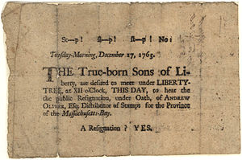
Sons of Liberty
Secret society formed to protect the rights of colonists by protesting the Stamp Act.

Slide 14
John Locke and *Natural Law
Natural Rights – people were born free and equal
“No one subject to another without own consent.”
Obligates people to rebel when rule of kings does not respect the consent of the governed.

Slide 15
Locke & Declaration of Independence

Slide 16
Rousseau
“The Social Contract”- Man was born free, and he is everywhere in chains.
Social Contract is the agreement to give up certain natural rights in exchange for security provided by government and freedom in a single body politic committed to the general good.

Slide 17
Rousseau
Popular sovereignty – people are the ultimate ruling authority

Slide 18
Montesquieu
Separation of Powers – executive, legislative, and judicial branches.

Slide 19
Types of Democracy
Participatory – direct participation of many, if not most, people in a society.
Pluralist – nongovernmental groups organize to try to exert influence on political decision-making
Elite – elected representatives make decisions and act as trustees for the people who elected them.

Slide 20
Declaration of Independence*
Jefferson, Adams, Franklin, Sherman, Livingston – drafted official statement to summarize colonists’ views.
Signed on July 4, 1776
Created a moral and legal justification for the rebellion.
https://www.c-span.org/classroom/document/?974
https://www.youtube.com/watch?v=3W0a3pzF-5M
(Read text of Declaration of Independence, pg. 619)

Slide 21
Treaty of Paris
1783 treaty ending Revolutionary War

Slide 22
Articles of Confederation
Weaknesses-
9 state must agree to enact law
13 (all) must agree to amend
No direct taxation of people
No provision for raising or maintaining an army
No national court system
No national currency
Congress could not regulate commerce among the states

Slide 23
Articles of Confederation
Strengths
Congress could engage in international diplomacy
Congress could declare war
Congress could acquire territory
Provided protection of religion and speech
Provided for extradition – return of fugitives to states where crimes committed and runaway slaves to states they had fled
Encouraged a free flow of commerce among states
Required states provide a public, fair government
Congress could sit as a court in disputes between states

Slide 24
Shay’s Rebellion
1786 – Massachusetts
Farmers (veterans who were not being paid) were losing farms to foreclosures & failure to pay taxes
Shays asked for gov’t to print more money, lighten taxes, and suspend mortgages
Armed rebellion occurs and no federal army to stop them – rich citizens pay to have rebellion put down
Leaders realize need stronger federal government
Meet in Annapolis, MD
agree to meet again in May 1787

Slide 25
55 men in Philadelphia
Confederation Congress called to revise Art. Of Conf.
James Madison (Father of the Constitution)
George Washington (cooling force)
Alexander Hamilton (annoying speeches)
Benjamin Franklin (elder statesman – 81 years old)
¾ had served in Continental Congress
8 signed Declaration of Independence
21 fought in Revolutionary War

Slide 26
55 men in Philadelphia
Proceedings kept secret for duration of convention
Protect convention proceedings from opponents
Allowed for freedom of expression of controversial viewpoints
Kept windows and doors closed all summer

Slide 27
Virginia Plan
Edmund Randolph, VA governor, presented:
Written by Madison
3 branch system with 15 resolves
2 house legislature
People elect lower house which would then elect upper house
Supreme national government
Separation of p0wers
Tiered court system
Large state plan
Representation by population
“national” system – unified authority over nation and states

Slide 28
New Jersey Plan
William Paterson of NJ introduced:
States retain sovereignty
National legislature limited and defined
No national courts
Small state plan
Representation by state
“federal” system: collection of sovereign states gathered to govern

Slide 29
Great Compromise/Connecticut Plan
Grand Committee (one delegate from each state)
George Mason, William Paterson, Ben Franklin, Roger Sherman of CT (lead)
Great Compromise (or CT Compromise)
2 house Congress
House of Representatives (population)
Senate (state)

Slide 30
Slavery & 3/5ths Compromise
Roger Sherman (CT) and James Wilson introduced
Every slave would count as 3/5ths of a person for purposes of representation in House

Slide 31
20-year Ban on Issue of Slavery
Congress prohibited from stopping the international slave trade for 20 years after ratification of Constitution
Extradition clause for how states should handle runaway slaves

Slide 32
Electoral College
Electoral College – compromise for choosing President
States decide how electors chosen
States have same number of electors as representatives in Congress (House & Senate)
People would vote for the electors
Elite model of government still today

Slide 33
Policy
Laws the government creates and the manner in which they are carried out.
Congress passes laws
Executive “executes” or carries out the laws
Agencies create and shape regulations (policy)
Judicial interprets the laws
Makes law anew and shapes policy

Slide 34
7 Articles of Constitution
Article I – Legislative Branch
Article II – Executive Branch
Article III - Judiciary
Article IV- Relations Among States
Article V – Amendment Process
Article VI – National Supremacy
Article VII – Ratification Process

Slide 35
Enumerated Powers
Article 1, Sec. 8, Congress’s listed powers:
Tax
Borrow money
Raise an army
Create a postal system
Address piracy on the seas
Define the immigration and naturalization process
Few others

Slide 36
Commerce Clause
Congress’s power to “regulate commerce with other nations, and among the several states.”
Article I, Sec. 8

Slide 37
Necessary and Proper Clause (Elastic)
“The Congress shall have power… to make all laws which shall be necessary and proper for carrying into execution the foregoing powers….”
Article I, Sec. 8
Grants implicit powers for flexibility in legislating

Slide 38
Full Faith and Credit Clause
Article IV – relations among the states:
FF and CC requires states to be open about their laws and encourages states to respect one another’s laws
“Full Faith and Credit shall be given in each State to the public Acts, Records, and judicial Proceedings of every other State…”
Privileges and Immunities Clause
Republican form of government
Extradition

Slide 39
Supremacy Clause
Article VI
“This Constitution, and the Laws of the U.S. which shall be made in Pursuance thereof… shall be the supreme Law of the Land…”

Slide 40
Ratification
Three delegates refuse to sign Constitution
George Mason (VA)
Edmund Randolph (VA)
Elbridge Gerry (MA)
December 1787 – three states ratify
January 1788 – two more ratify
(Read chart on page 25)

Slide 41
Federalist #10
Warned against the “mischiefs of faction”
Factions = interest groups
Might cause men to dominate government for their own ends rather than for the public good
Believed factions could not be removed, so government had to control them
Advocated for large republic for this purpose

Slide 42
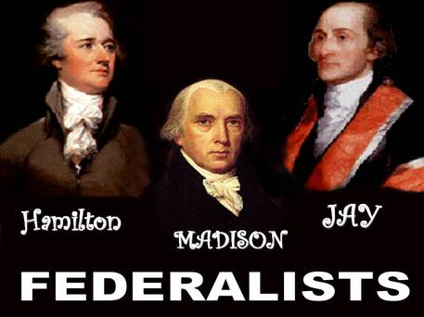
Federalists
Supporters of the Constitution
Wrote The Federalist Papers under the pen name Publius
James Madison
Alexander Hamilton
John Jay

Slide 43
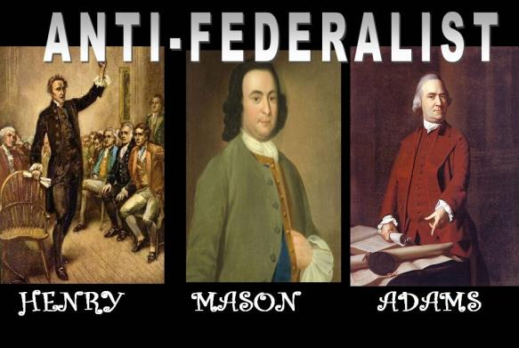
Anti-Federalists
Opposed the Constitution
Wrote the Anti-Federalist Papers under pen name Brutus
Patrick Henry
George Mason
Samuel Adams

Slide 44
Brutus #1
A republic as large as our continent would mean the people would not know their rulers or their proceedings and it would be hard to change them.
Counters argument that a large government will prevent the rise of controlling factions

Slide 45
Federalist / Anti-Federalist Compared

Slide 46
Rights granted in the “Original” Constitution
No religious tests to hold federal office
Right to jury trials in criminal cases
Neither Congress nor the states can pass a bill of attainder
Neither Congress nor the states can pass ex post facto laws
Congress cannot suspend habeas corpus rights except in wartime

Slide 47
USA Patriot Act
Passed after 9/11 to prevent future attacks
Covered:
Intelligence gathering and sharing by executive branch agencies
Points of criminal procedure
Border protection
Government can now:
Share grand jury testimony and proceedings
Detain illegal immigrants for longer periods
Monitor email communications

Slide 48
USA Freedom Act
Passed in 2015
Upheld certain portions of Patriot Act
Phased out:
Bulk collection of phone and Internet data
Set limits for phone and data collection in certain circumstances

Slide 49
Representative Republic
Collection of sovereign states gathered for the national interest, national needs, and national defense
Popular sovereignty for House of Representatives only
Senate elected by state legislators until 1913
President elected by Electoral College after states name their electors

Slide 50
Separation of Powers
Each branch has their own powers and cannot infringe on the other branch:
Legislative Branch – lawmaking body
Executive Branch – enforces the law
Judicial Branch – interprets the law

Slide 51
Federalist #51
“If men were angels, no government would be necessary.”
Separation of Powers = guard against tyranny

Slide 52
Checks and Balances
The limiting powers each branch can use on the others.
Based on Rule of Law = no one is above the law.
Each branch of government checks the other branch by design:
President checks Congress and Judicial
Congress checks President and Judicial
Judicial checks Congress and President
Notes:
Give examples of how this happens: President can veto law, President appoints justices; Congress can override a veto, Congress can refuse to confirm a justice; Court can rule a Congressional act unconstitutional; Court can rule an executive order unconstitutional.

Slide 53
Separation of Powers/Checks and Balances

Slide 54
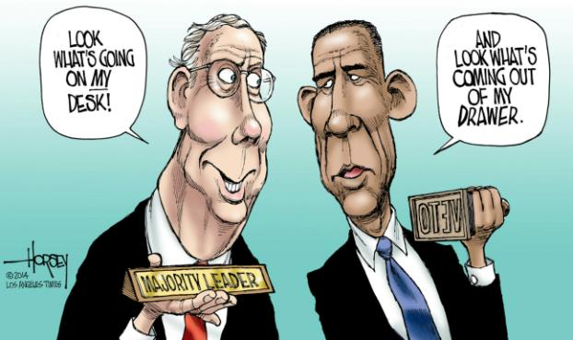
Veto
President may reject a Congressional act by his veto power.

Slide 55
Pocket Veto
If the president receives the bill at the end of a legislative session, refusal to sign is known as a pocket veto and kills the bill.

Slide 56
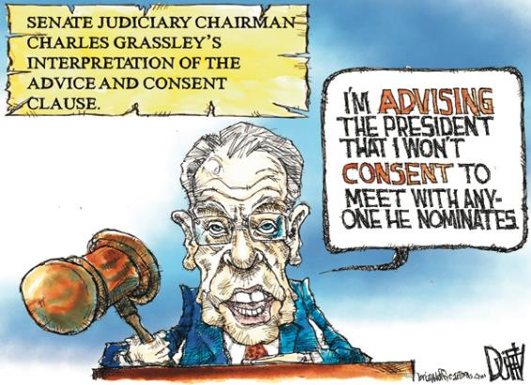
Advice and Consent
Senate provides “advice and consent” to presidential appointments as a way to check the executive branch.

Slide 57
Impeachment
An accusation, an indictment of wrongdoing.
The House of Representatives has the sole power of impeachment. (Article I, Section II)
Senate holds trial of the accused.
Chief Justice of Supreme Court presides as judge.
2/3 majority required to convict.
2 presidents impeached: A. Johnson, B. Clinton
None convicted

Slide 58
Judicial Review
Power of Judicial branch to check the legislative and executive branches.
Courts may deem an act of the legislature or an executive order of the president unconstitutional.
First established in case of Marbury v. Madison.

Slide 59
Federalism
The balance of power among a central, national authority and state or regional authorities.
Assures a limited government.
Tenth Amendment grants all powers not delegated to the federal government to the states.

Slide 60
Difficult to make laws?
Gridlock is by design:
Framers planned lawmaking process to be slow so branches can discuss, debate, and rewrite legislation before fully passed.
Bicameralism – 2 houses = extra step
Veto power – may prevent hasty actions by Congress
Bill of Rights - limitations
Due Process – procedure must be followed by Congress
Tenth Amendment – limits Congressional actions

Slide 61
Supreme Court
Majority Opinion – requires 5 of 9 justices – opinion of the court
Concurring Opinion – members who agree with majority but for different reasons
Dissenting Opinion – members who disagree with the majority

