Slide 1
Chapter 2: Federalism
Essential question:
How has federalism shaped the administration of public policy, and how do state, local, and national governments work within the federal framework today?

Slide 2
Federalism
Sharing of power between a central government and equally sovereign regional governments

Slide 3
Unitary Government
Single governing authority in a central capital with uniform law
Of the 193 UN member states, 165 are governed as unitary states

Slide 4
Table 3.1 Authority Relations in Three Systems of Government
 | Unitary | Confederate | Federal
Central government | Holds primary authority Regulates activities of states | Limited powers to coordinate state activities | Shares power with states
State government | Few or no powers Duties regulated by central government | Sovereign Allocates some duties to central government | Shares power with central government
Citizens | Vote for central government officials | Vote for state government officials | Vote for both state and central government officials
Notes:
As we see in this table, the power relationship between the central government and subunits is different in unitary, confederate, and federal systems.

Slide 5
Main reason the Articles of Confederation were created
“…mainly for national defense and to engage in diplomatic relations with all other countries.”
The Articles held that the national government derived all of its power from the states.

Slide 6
Provisions in Constitution that guide Federalism
Article I, Section 8 – enumerated powers of Congress (necessary & proper clause)
Article I, Section 9 – Powers denied to Congress
Article I, Section 10 – Powers denied to states
Article IV – full faith and credit; privileges and immunities; extradition
Article VI – supremacy clause
Ninth Amendment – rights not listed reserved by people
Tenth Amendment – powers not delegated reserved by states

Slide 7
Full faith and credit clause
States must regard and honor the laws in other states
  Driver’s licenses, birth certificates, warrants, etc.
  Article IV, Section I

Slide 8
Privileges and immunities clause
“citizens of each state shall be entitled to all privileges and immunities of citizens in the several states”
  Article IV, Section 2, clause 1

Slide 9
Extradition
obligates states to deliver captured fugitive criminals back to the state where they committed the original crime
  Article IV, Sec. 2, clause 2

Slide 10
Police Powers
States retain powers to create and enforce laws on health, safety and morals
  Speed limits
  Seat belt laws
  Smoking in public places
  Obscenity laws
  Elections
  Marriage laws
  Education
  Deeds and records

Slide 11
10th Amendment
“the powers not delegated to the United States by the Constitution, nor prohibited by it to the states, are reserved to the states.”
distinguish two governing spheres, creating Federalism
  Delegated powers (federal)
  Reserved powers (state)

Slide 12
Delegated Powers (Art. I, Sec. 8)
expressed powers given to the federal government
  Military
  Coin money
  Regulate trade
  Declare war

Slide 13
Reserved powers (10th Amendment)
any powers not mentioned remain with the states
  Schools
  Marriage
  Safety
  health

Slide 14
Concurrent powers
powers held by authorities at both state and federal level
  Taxing
  Law enforcement
  courts

Slide 15
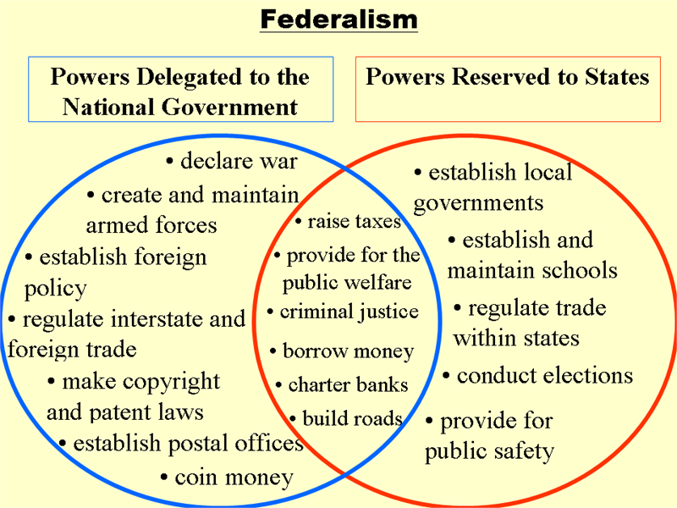

Slide 16
Overlap and Uncertainty:
Obergefell v. Hodges 2015
Some states legalized same-sex marriage
  Other states refused to recognize those marriages
Opposing states passed laws defining marriage as between a man and a woman only
Article IV (Full Faith and Credit) v. Tenth Amendment
Supreme Court ruled 5 to 4 that the right to same-sex marriage was guaranteed by the due process clause (fundamental liberty of marriage) and the equal protection clause in the Fourteenth Amendment
  Marriage had been defined as a fundamental liberty

Slide 17
Strict constructionist
Believes the Constitution should be interpreted literally (strictly construed)
That which the Constitution did not expressly permit, it forbade
Thomas Jefferson

Slide 18
Judicial Activist
Believes the Constitution should be interpreted as a “living, breathing document”
If the Constitution did not forbid something, it permitted it.
Alexander Hamilton

Slide 19
Alien and Sedition Acts
Federal government given power to:
  jail any dissenters against the government’s cause
  Deport foreigners who posed any threat to U.S.
Opponents felt violated First Amendment freedom of speech and caused President Adams and Federalists to lose followers

Slide 20
Compact Theory
C.T. – held that the 13 sovereign states, in creating the federal government, had entered into a compact, or contract, regarding the federal government’s jurisdiction. (states created, therefore they could determine whether the federal government had overstepped its authority)
  Challenged federal judicial branch and supremacy clause
  Believed if Federalists could pass A & S Acts, could take other freedoms away as well
  Penned (anonymously) resolutions to address violations

Slide 21
Nullification
Right to declare null and void any federal law if a state thought the law violated the Constitution.
Result of Jefferson’s belief that federal government had done so with the A & S Acts
  Not used, though, because A&S Acts expired (by design) and then Adams left office, so nothing to be challenged
Will be used though in later decades (eventually leads to Civil War)

Slide 22
Necessary & Proper Clause / Supremacy Clause
McCulloch v Maryland (1819)
https://www.youtube.com/watch?v=V0ST9eVIWFY
Addressed balance of power between states & federal government
Does federal government have implied powers (necessary & proper clause) and supremacy (supremacy clause)?
  Can Congress create a bank?
  Can a state tax a federal institution?
State of MD taxed federal bank (located in state)
Federal bank refused to pay and state sued
  Believed Congress did not have power to create a federal bank
Decision:
  1) Congress has power to create bank under N&P clause because “coin money” “borrow money” “collect taxes” etc.
  2) State cannot tax federal government without its consent. State is not sovereign alone. ALL people gave federal government its power, not each individual state, so state cannot make laws affecting federal government.

Slide 23
Dual federalism
National government supreme in its sphere.
State government supreme in its sphere.
Worked until commerce became more interstate, then more Cooperative Federalism (sharing of powers between feds and states).
Commerce Clause – most frequently contested congressional power – used by feds to “infringe” on state power to regulate commerce within state
“Layer cake” federalism

Slide 24
16th Amendment and expanding power of Congress
Progressive movement brings democratic reforms:
  16 Amendment – federal income tax gave federal government more money - wield more power over states
  17th Amendment – direct election of senators – accountable to people now, and not states – people demand more regulation of railroads, factories, and corrupt government
    Commerce Clause used for:
      Mann Act of 1910 – outlaw prostitution across state lines
      Automobile Theft Act of 1915 – no stolen cars across state lines
      Racketeering, drug dealing, bank robbery – all federal crimes
      Fair Labor Standards Act of 1938 – national min. wage

Slide 25
Cooperative (fiscal) federalism
Congress collects federal tax revenues and distributes to states to take care of national interests.
FDR’s New Deal / Johnson’s Great Society used
“Marble cake” federalism
Grants in Aid:
  Categorical
    Grants with particular congressional guidelines/requirements
  Block Grants
    Introduced in 1966 when states began to resent gov’t over-reach; larger sums of money without strings of categorical grants
  Mandates
    Feds require states to comply with a federal directive, sometimes with money, sometimes without

Slide 26
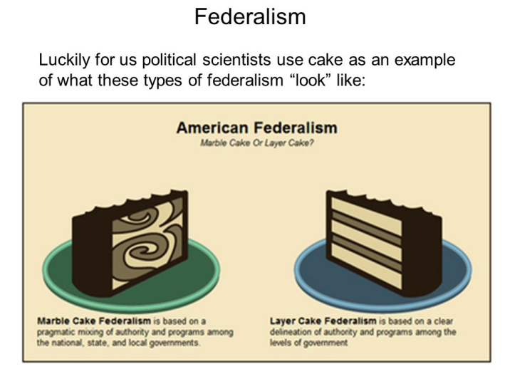
Federalism

Slide 27
Categorical Grant:
National Minimum Drinking Age Act of 1984
Categorical Grant
Congress gives $$$ if state raise drinking age to 21
South Dakota challenges as unconstitutional (to make $$$ conditional on something states had right to control)
  Supreme Court says ok – as long as for general welfare of public and conditions related to federal interest in particular
    South Dakota v. Dole

Slide 28
Mandates:
Clean Air Act of 1970 / ADA of 1990
Congress set requirements and timetables for states to deal with urban smog, acid rain, and toxic pollutants.
Congress mandated that states make public sector buildings and transportation systems accessible for disabled individuals.
  Wheelchair accessibility / wheelchair lifts
  $1 billion in additional costs on states and localities

Slide 29
Devolution
Giving some of the responsibilities assumed by the federal government back to the states.
Contract with America
  Return power and dollars to states
  Republican Congress passes; Bill Clinton signs
  Unfunded Mandates Reform Act
    Denied Congress power to issue unfunded mandates
  Personal Responsibility and Work Opportunity Reconciliation Act
    Restructured welfare to return authority and distribution to states

Slide 30

Commerce Clause Case
US v Lopez (1995)
https://www.youtube.com/watch?v=vQ1weu4-U0k
Conservative Supreme Court, 5-4 decision
Congress does NOT have authority under commerce clause to outlaw guns near schools
  No impact on interstate commerce
  State power only

Slide 31
No Child Left Behind Act of 2002
George Bush signed into law with bipartisan support
Required students show annual yearly progress through federally required and regulated tests
Underperforming schools could be reconstituted
Criticisms
  Congress only provided 8% funding for schools
  Increased control over states and schools
Replaced by Every Student Succeeds Act of 2015
  Got rid of NCLB
  States determine standards with federal approval

Slide 32
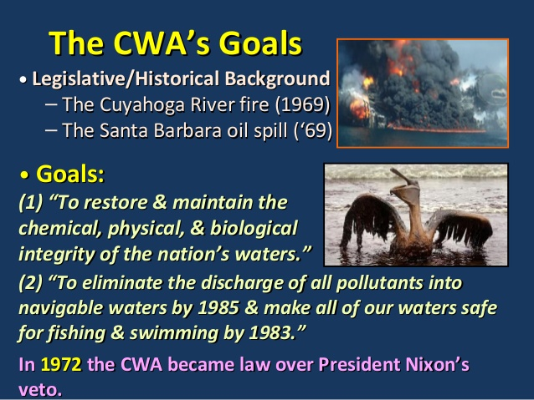
Clean Water Act of 1972

Slide 33
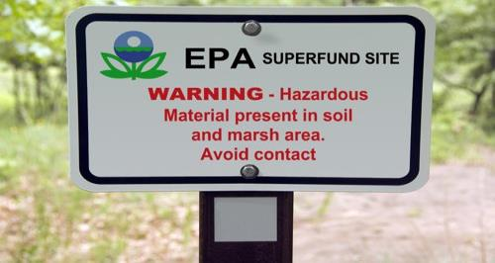
Superfund
An insurance “policy” that industry pays into so taxpayers do not have to pay the bill for waste cleanup when toxic disasters occur from dangerous by-products
Only used if guilty party is unknown or bankrupt

Slide 34
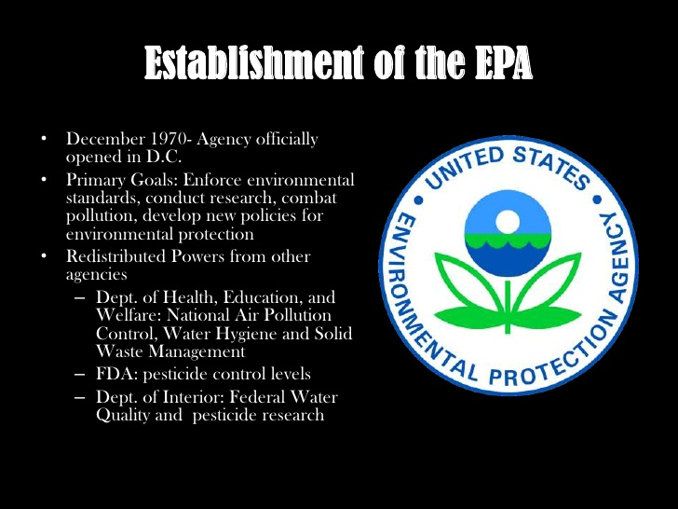
EPA

