Slide 1
Chapter 3: The Legislative Branch
Essential Question:
How do the structure and operation of the legislative branch reflect the United States’ republican ideal?

Slide 2
Congress
535 voting members
Nonvoting members: D.C., Guam, Puerto Rico, Virgin Islands, and American Samoa
48 House, 3 Senators = African American
46 Hispanics
18 Asia-Pacific
56% Protestant; 31% Catholic; 6% Jewish
111 women: 89 House, 22 Senate
More than ½ have new worth > $1 million
Average Age: 58 House; 62 Senate
Dominant professions: law, public service, business

Slide 3
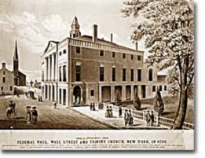
First meeting of Congress
1789 in New York City

Slide 4
Bicameral
House – seats allotted based on population
2 year terms – forced to consider constituent opinions
All elected at the same time (every 2 years)
435 members since 1913
Each Congressional district = 700k inhabitants – reapportioned every 10 years after Census
Senate – two members from each state
6 year terms – insulated from politics – “cooling” house
1/3 re-elected every 2 years – provides continuity
Second house “doubles the people’s security by requiring the concurrence of two distinct bodies.” -James Madison

Slide 5
17th Amendment
Ratified in 1913
Direct election of Senators – broadens democracy

Slide 6
Role of the Senate v. House
Senators represent states, whereas members of the House represent the constituents in their individual districts
Arguments in favor of the disproportionate representation in the Senate focus on its preservation of the states as entities
Arguments against the disproportionate representation in the Senate are among the following:

Slide 7
Arguments Against the Structure of the Senate

Slide 8
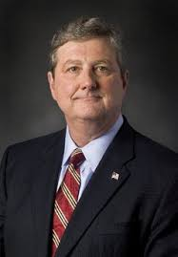
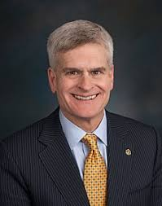
Requirements for Senator
30 years old
Live in state representing
Citizen for 9 years
Notes:
John Kennedy; Bill Cassidy

Slide 9
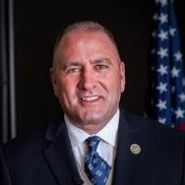
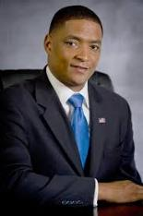
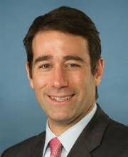
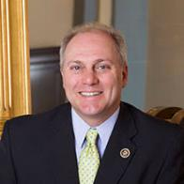
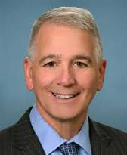
Requirements for Representatives
25 years old
Resident of state representing
Citizen for 7 years
Steve Scalise(1) Cedric Richmond (2)
Clay Higgins (3) Mike Johnson (4)
Ralph Abraham(5) Garrett Graves(6)

Slide 10
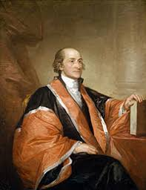
John Jay & Federalist #64
“ by leaving a considerable residue of the old ones (senators) in place, uniformity and order, as well as a constant succession of official information, will be preserved.”

Slide 11
Enumerated Powers
Aka “expressed powers” – expressly stated in Article I, Section 8
Power of the Purse (taxing power)
Regulating Commerce
Foreign and Military Affairs

Slide 12
Power of the purse
Raise revenue (tax)
Appropriations of taxes raised
Coin money
Budgeting

Slide 13
Commerce clause
Power “to regulate commerce among the states, with other nations, and with Indian tribes.”
Gibbons v. Ogden (1824) – Congress has power to regulate navigable U.S. waters.
Most contested power of Congress
Basis for 1964 Civil Rights Act
Basis for Clean Air & Water Acts
Basis for gun control legislation
U.S. v. Lopez (1995) – restriction to federal power
Affordable Care Act – attempted justification

Slide 14
Foreign & Military Affairs
Raise armies & navies
Legislate conscription (compulsory induction of individuals into the Armed Services) procedures
Mandate a military draft (procedure by which individuals are chosen for conscription)
Declare war
Determines $$$ spent on military
Sets salary scale for military personnel
CANNOT deploy troops or receive ambassadors

Slide 15
War Powers Act of 1973
President has 48 hours in which to engage in urgent combat w/o informing Congress
Within 60 days of start of combat, with optional 30-day extension, Congress must take positive action to continue funding if to continue the engagement
Balances checks and balances with need for quick action in days of modern warfare

Slide 16
Implied powers
Not directly stated but required to fulfill obligations of enumerated powers
Necessary and Proper Clause – last of Article I, Section 8 clauses
McCulloch v. Maryland (1819) – Congress can establish a national bank under N & P clause
Examples of use:
Department of Education
Defense of marriage
Minimum Wage & maximum work hours
Federal Reserve Bank

Slide 17
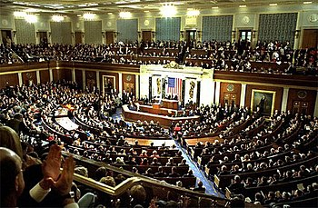
Powers of the House
Introduce revenue bills (tax laws)
Select President if no one wins E.C. vote
Impeachment power
“treason, bribery, and high crimes and misdemeanors.”

Slide 18
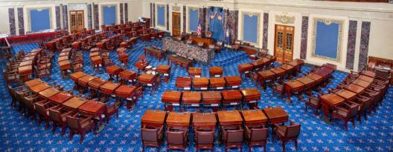
Powers of the Senate
Advice and Consent
Cabinet secretaries and federal judges
Presidential appointments
Approval of treaties
2/3 vote
Conducts trial of impeached official
Reaches a judgment
Determines whether
or not to remove from
office

Slide 19
Policymaking Structures & Processes
Congress is organized by
House
Party
Leadership
Committees
Where the real work of Congress is done

Slide 20
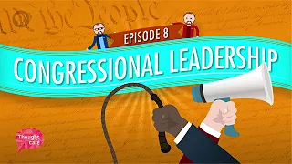
Congressional Leadership
https://www.youtube.com/watch?v=L8urcMLGFyU

Slide 21
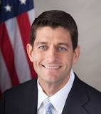
House Leaders
Speaker of the House
Only leader mentioned in the Constitution
Majority party gets to pick
Recognizes members for speaking; organizes members for
conference committees; has influence in lawmaking
Floor Leaders
Majority and minority leaders
Lead debate among their party; guide discussion from their side
Whip
Deputy floor leader
In charge of discipline; tallies votes
Conference Chairs
Takes care of party matters: heading organization of party-centered groups
Notes:
Paul Ryan

Slide 22
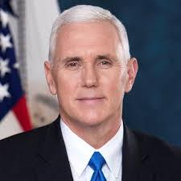
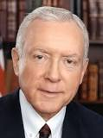
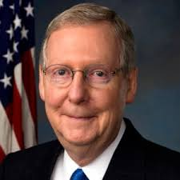
Senate Leaders
President of the Senate
Mentioned in Constitution
VP of U.S. – only votes in case of a tie in the Senate
Rules on procedure and organizes Senate
President pro tempore (temporary President)
most senior member of majority party
Senate majority leader
Chief legislator
Sets legislative calendar; guides party caucus
Whip (same as House)
Conference Chair (same as House)
Notes:
Mike Pence; Orrin Hatch; Mitch McConnell

Slide 23
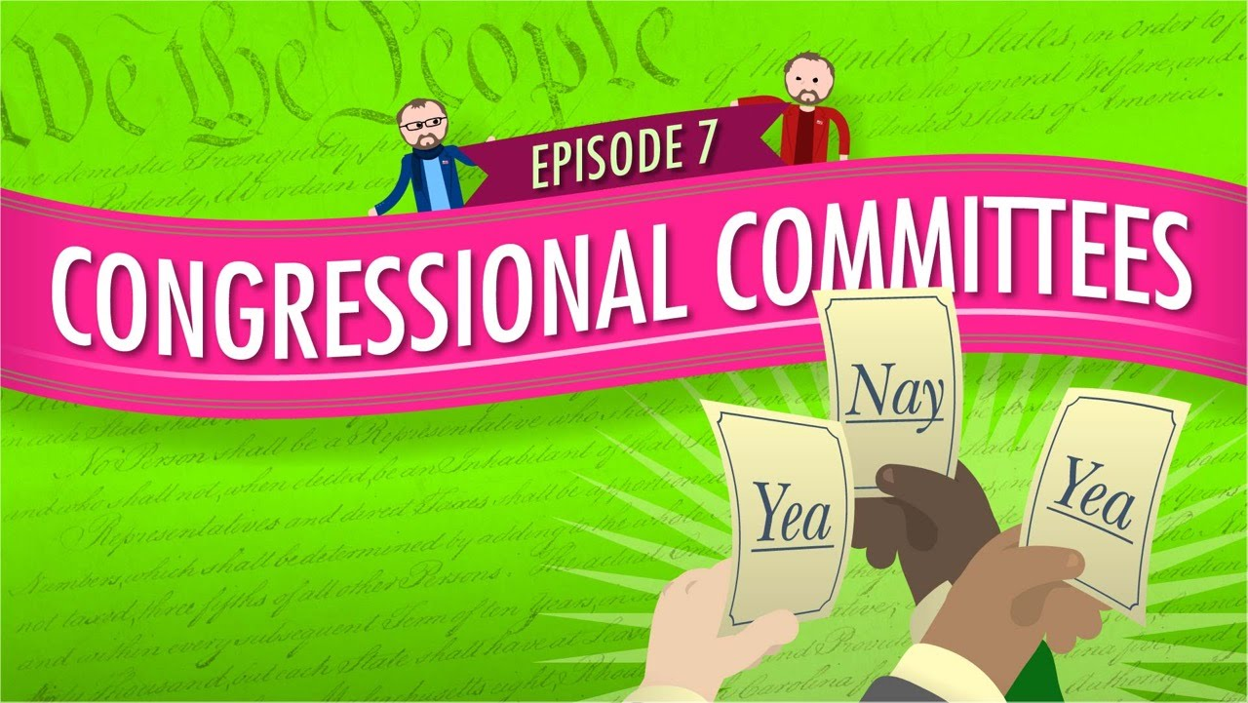
Congressional Committees
https://www.youtube.com/watch?v=evLR90Dx79M

Slide 24
Permanent Committees
Standing Committees (21 House; 16 Senate)
Permanent committees focused on a particular subject and authorized under the rules of each house; handle most of Congress’ work
Chaired by senior member of majority party; vice chair = senior member of minority party
Majority party holds majority of seats
Each full house votes to approve committee membership
Steering and Policy Committee (Democrats) and Committee on Committees (Republicans) assign members to standing committees
EX: House Ways and Means; Senate Budget Committee: House Energy and Commerce Committee; Armed Services Committee

Slide 25
Permanent Committees
Joint Committees
Members of both houses that address a long-term issue or problem
Permanent committees
Routine research-based activities
EX: Library of Congress Committee; Joint Committee on Taxation

Slide 26
Temporary Committees
Select/Special Committees
“for a limited time period to perform a particular study or investigation”; investigate issues to determine if further congressional action is necessary
Can be exclusive to one house, or combine members from both
EX: House Energy Independence and Global Warming Select Committee; committee that investigated the 2012 terrorist attack in Benghazi, Libya

Slide 27
Temporary Committees
Conference Committees
Iron out differences on bills that passed each house but in slightly different forms
Members from both houses gather for a markup session (process by which the bill is altered).

Slide 28
Other Committee Purposes
Congressional authorization
Authorizes entire departments and agencies to carry out law
Congressional oversight
How Congress ensures that the executive branch agencies are carrying out the policy or programs defined by Congress.
Congressional funding, efficiency, general updates
Corruption by agencies or not doing job

Slide 29
Caucuses
Nongovernmental groups of like-minded people in Congress
Unite around a particular belief
Democratic Caucus; Republican Party Conference
Smaller caucuses organized around specific interests
Agriculture; business; women’s issues; race

Slide 30
Committees & Rules Unique to the House
Members may not speak for more than one hour
Only germane amendments to a bill are allowed
Ways and Means Committee
Determines tax policy
Rules Committee
“Traffic cop”
Assigns bills to standing committees; schedules bills for debate; decides when votes take place; how much time a bill can be debated; how many amendments may be added to a bill
Majority members outnumber minority members 2 to 1
Committee of the Whole
Created to allow longer debate w/ fewer members
Nonvoting members may vote
Discharge petition
Brings a bill out of a reluctant committee – minority cannot thwart majority

Slide 31
Rules & Procedures Unique to the Senate
Can speak for as long as desired
Can propose amendments not germane to the bill
Filibuster – speaking for an extremely long time to kill a bill (time runs out or wears down opposition)
Unanimous consent – approval of all Senators required (used to suspend rules and limit debate)
Hold – measure to stall a bill (if anyone objects to unanimous consent request) – can be placed on a motion or on a presidential appointment
Cloture rule – (Rule 22) enabled and required a 2/3 (now 3/5) majority to close up or stop debate on a bill and call for a vote; on nominees to courts, only a simple majority required

Slide 32
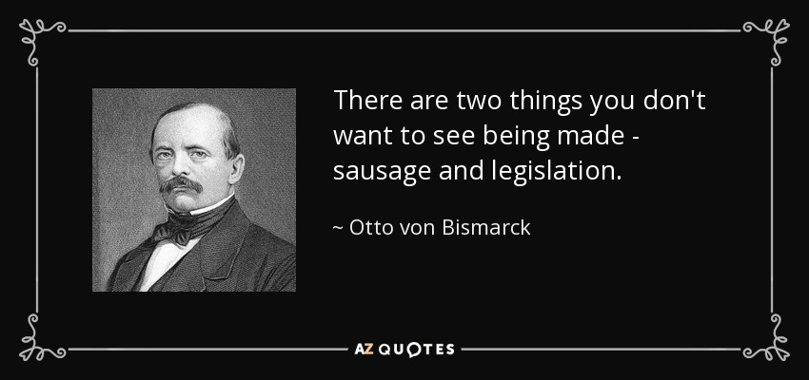
The Legislative Process

Slide 33
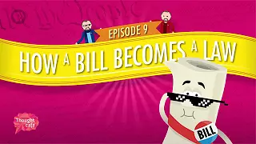
How a Bill Becomes a Law
https://www.youtube.com/watch?v=66f4-NKEYz4

Slide 34
Introducing Bills
Only members of Congress can introduce
Bills are numbered starting with 1 each Congress (S.1, H.R. 1)
Can originate in either chamber (except for ????) but identical bills must pass both houses and be signed by president to become law.
In 2-year Congress 10k bills introduced, only 300-500 become laws

Slide 35
Amending Bills
House:
Must be approved by committee overseeing bill
Must be germane
Senate:
Individual senator can introduce amendment
May be non- germane (aka riders)
Omnibus Bill – when a bill grows to mammoth size from riders
Pork Barrel Spending – product of legislative add-ons
Earmark – when funds are directed to a very specific purpose
Sometimes inserted hours before vote on bill and/or in the dark of night to avoid debate
2011 – Senate Appropriations Committee issued ban on earmarks.

Slide 36
Bill stages within a committee
Hearings
Expert testimony
Thorough discussion
Summary report – includes other branches and/or int. groups
Markup
Committee members amend until satisfied
Reporting out
Sent to House or Senate floor for debate

Slide 37
Voting
Logrolling – trading votes to gain support for a bill
Delegate Model – voting the will of their constituency
Trustee Model – voting using their best judgment
Politico Model – blended delegate and trustee

Slide 38
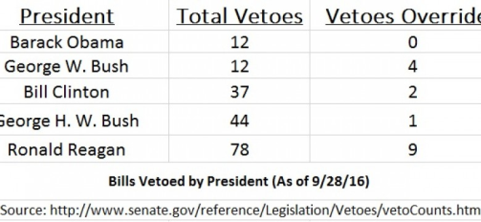
Overriding a veto
President has 10 days to sign or veto a bill. If does nothing within 10 days, it becomes law.
If receives within last 10 days of Congress, President can choose not to sign and it does NOT become law – this is a pocket veto.
Congress can override a veto with a 2/3 vote.

Slide 39
Presidential Vetoes Overridden

Slide 40
How a Bill Becomes a Law

Slide 41
OMB (Office of Management & Budget)
President’s budgeting arm
Created by Congress in 1970’s
Headed by a director (President’s accountant)
Makes annual budget for each FY (fiscal year)
October 1 to September 30
Sends to Congress in February

Slide 42
CBO (Congressional Budget Office)
Congressional agency made of nonpartisan accountants
Serves as a check on the OMB
Examines and analyzes budget from Pres.
Congress then reconciles the budget
Passes changes to revenue and/or spending by a simple majority on both houses – limited time for debate
Sets levels of revenues and expenditures, size of surplus or deficit, and spending priorities.

Slide 43
5 Main revenue sources
Individual income taxes
Paid by workers on income
Corporate taxes
Paid by businesses on profits
Social insurance taxes
Paid by employees and employers to fund SS, Medicare and Unemployment Insurance
Tariffs and excise taxes
Tariffs: Paid on imports or products to make U.S. more competitive
Excise: paid on luxury products and harmful products
Other sources
Interest on government investments
Estate taxes

Slide 44
Revenue

Slide 45
Mandatory spending
Required by law (mandated) for certain programs
Social Security, Medicare, Medicaid, unemployment insurance, other special funds for people in need
60% of budget in 2019
Deficit – spending > revenue
Interest on Debt - $$$ government has to pay on debt (borrowed $$$) from spending more than they make

Slide 46
Mandatory Spending

Slide 47
Discretionary spending
38% of 2019 budget
Everything else after mandatory spending
Military Defense
Physical Resources
Energy, Natural Resources & Environment, Commerce & Housing Credit, Transportation, Community & Regional Development
Other Functions
International Affairs; Science, Space, and Technology; Agriculture; Administration of Justice; General Government.

Slide 48
Discretionary Spending

Slide 49
Partisanship & Polarization
Gridlock - so much congestion of opposing forces that nothing moves forward
Reduced Member Interaction
Free flights home have hampered friendships from developing among congressmen
Redistricting
Required every 10 years after census if populations change
Increased partisanship
Decreased accountabilities
Baker v. Carr (1962)

Slide 50
Reduced Member Interaction
“Despite our various disagreements in the House,” Speaker Tip O’Neill once reflected, “we were always friends after six o’clock and on weekends.”
Ronald Reagan used to call Speaker
O’Neill and ask “is it 6 o’clock yet?”

Slide 51
Baker v Carr (1962) – Redistricting 14th
Facts: Baker was resident of TN. Filed suit against Carr, Secretary of State of TN, claiming state was violating their constitution by not redrawing Congressional districts every 10 years to reflect changes from census. Claimed his vote was being diluted in violation of equal protection clause of 14th Amendment.
Reasoning: Court had to find jurisdiction first – precedent said this was a “political question” that court could not rule on. This court found issue was a “justiciable question” and therefore court could rule on it: when state does not follow constitutional principle and undermines democratic ideal of an equal voice for all voters.
Decision: Baker won – established “one person, one vote” principle
Dissent: believed case was a “political question” and therefore should not be ruled upon. Said court did not possess “purse nor the sword” and should remain detached from political entanglements – would attribute “omnicompetence” to judges.

Slide 52
Partisanship & Polarization
Gerrymandering
Drawing district lines illogically to give advantage to one party
“safe seats” (consistently won by more than 55% of the vote) lowers incentive to compromise among representatives
“getting primaried” (when an extreme challenger beats an incumbent from the same party in the primary) has shrunk the number of moderates in Congress (occurs in “safe seat” districts)
Racial gerrymandering – allowed by S.Ct. only if “narrowly tailored to further a compelling governmental interest…”
Shaw v. Reno (1993)
Divided Government & Senate Showdowns
When President and Congress are from different parties
Supreme Court nominations

Slide 53
Shaw v Reno (1993) – Gerrymandering 14th
Facts: N.C. submitted redistricting for federal review after 1990 census. Only one majority-minority district was drawn and feds said draw another one. N.C. does and district is oddly drawn just to meet fed directives. White voter (Shaw) sues as a violation of 14th equal protection when state separated citizens into classes by race.
Ruling: Shaw won – said race cannot be the ONLY factor used to draw the districts. Must include other factors or else it opposes the “colorblind” ideal of U.S. law. Cannot separate citizens into different classes w/o justification of a compelling state interest – violates 14th Amendment.
Dissent: – white voters did not have their votes diluted; minorities benefitted, so no constitutional conflicts; white voters still had a majority in a disproportionate number of districts.

Slide 54
The public image of Congress
Congress = < 15% approval rating
Individual members = 60% approval rating
50 million email messages; 200 million pieces of mail annually
Population of House districts up by 40%
In session 250 days per 2 year Congress

Slide 55
Gallup Poll – Confidence in Congress

