Slide 1
AP US Government and Politics
Unit One: Foundations of American Government

Slide 2
Learning Objective
LOR-1.A.1: The U.S. government is based on ideas of limited government, including natural rights, popular sovereignty, republicanism, and social contract.
LOR-I.B.1: Representative democracies can take several forms along this scale.
LOR-I.B.3: The three models of representative democracy continue to be reflected in contemporary institutions and political behavior.

Slide 3
Enlightenment thought
Rousseau argued for a social contract in which people give up certain freedoms in exchange for secure protections – popular sovereignty – people are the ultimate authority & gov’t carries out the laws
Locke argued against powerful kings & in favor of popular consent - natural rights – derived from God, not a monarch
Montesquieu argued for a separation of powers
*These formed the idea of republicanism (a representative government)
Notes:
Social contract - (e.g. giving up privacy before going on a plane)

Slide 4
Origins of the Constitution
The Power of Ideas (Locke)
Natural rights: rights inherent in human beings, not dependent on government
Consent of the governed: government derives its authority by sanction of the people
Limited Government: certain restrictions should be placed on government to protect natural rights of citizens; prevent tyranny
Notes:
Jefferson is inspired by Locke.
- Natural rights come from God and nature and cannot be taken away by a king. As a result, natural law leans into the social contract theory that government must be consented by the governed for legitimacy.
- Government is limited and should have restrictions and give individual rights against that right. The purpose of the government is to PROTECT not violate those natural rights.

Slide 5
What Is Democracy?
Democracy–the rule of many
Representative democracy–a government in which leaders make decisions by winning a competitive struggle for the popular vote. (i.e. United States)
An Indian women shows that she voted

Slide 6
Types of Representative Democracies
Participatory
Pluralist
Elite

Slide 7
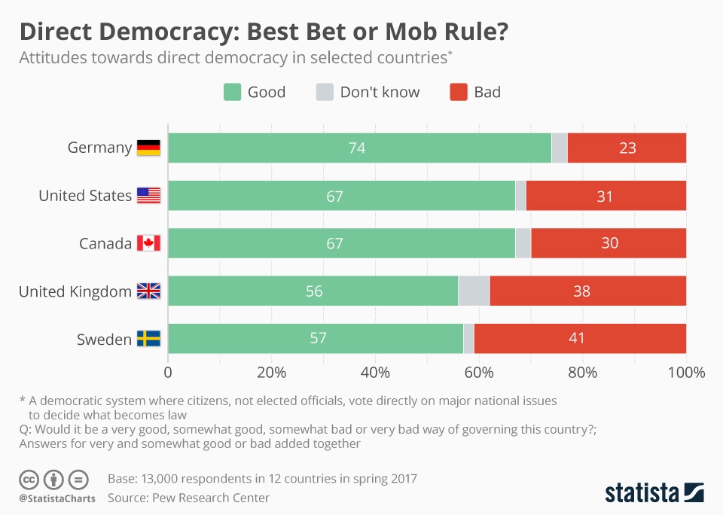
PARTICIPATORY DEMOCRACY
Direct participation in which people directly vote for laws and other matters
No representatives are elected
Example: Athens
Any problems with this?
Notes:
Problems: direct democracy – technical expertise, time, how often to vote and read bills?

Slide 8
Pluralist Theory
Emphasizes broad participation in politics and that it is a competition among groups, each one pressing for its own preferred policies
Groups will work together ☺ Nobody dominates
Public interest will prevail through bargaining and compromise
However, hyperpluralism can occur (groups are so strong that government is weakened, results in policy gridlock and conflicting policies)
Notes:
Example: Conflicting laws on same-sex marriage (before it was legalized) and abortion

Slide 9
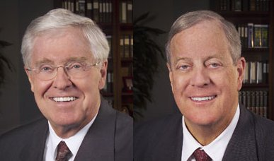
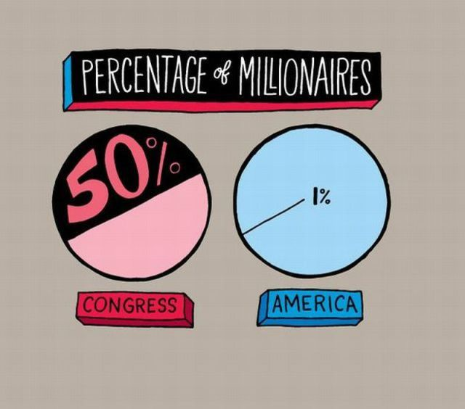
Elite Theory
American democracy is dominated by a few top leaders, many of them wealthy/privately powerful, who do not hold office
Policies benefit those with money and power
Emphasizes little public participation
Koch Brothers
Notes:
Koch brothers are a prime example…they are billionaires who have donated millions of dollars in election campaigns for Republicans.

Slide 10
American Political Culture and Democracy
Political Culture: An overall set of values widely shared within a society.
American culture is diverse and comprised of:
Liberty
Egalitarianism
Individualism
Laissez-faire
Populism

Slide 11
American Democracy
Traditional: Government depends on the consent of the governed, which may be given directly or through representatives
Components of Traditional Democracy:
Effective participation
Enlightened understanding
Equality in voting (*NOT economics)
Inclusion
Citizen control of the agenda
Notes:
Government depends on the consent of the governed, which may be given directly or through representatives

Slide 12
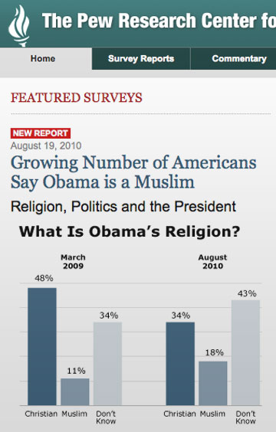
Is a true democracy best?
Notes:
In a true democracy, every person would vote on every single piece of legislation. There would be no elected representatives. Think about the pros and cons of this…do you have the time and expertise to vote? Do the people in the above represented in the above graph have it?

Slide 13
Political Knowledge

Slide 14
Review Question
Which of the following characterizes the main difference between pluralist and democratic theorists?
Pluralists emphasize the role of the masses, whereas democratic theorists emphasize minority rights.
Pluralists emphasize competition among groups, whereas democratic theorists emphasize consent of the governed.
Pluralists emphasize the inability of officials to compromise, whereas democratic theorists emphasize the necessity of compromise.
Pluralists claim that government is dominated by the few, whereas democratic theorists claim that government agenda is controlled by the masses.
Pluralists claim that government is effective, whereas democratic theorists claim that government is efficient.

Slide 15
Citizenship Test
http://www.uscis.gov/citizenship/teachers/educational-products/100-civics-questions-and-answers-mp3-audio-english-version

Slide 16
AP US Government and Politics
Unit One: Foundations of American Government

Slide 17
Learning Objective
LOR-1.A.2: The Declaration of Independence, drafted by Jefferson with help from Adams and Franklin, provides a foundation for popular sovereignty

Slide 18
Origins of the Constitution
Declaring Independence
Adopted June 2 - the Continental Congress lists grievances against the British
Politically, the Declaration was a verbal attack, announcing and justifying revolution.

Slide 19
Origins of the Constitution
Notes:
Notice that Jefferson writes “life liberty and pursuit of happiness” while Locke writes “life liberty and property”

Slide 20
Origins of the Constitution
Winning Independence
In 1783, the American colonies prevailed in their war against England.
The “Conservative” Revolution
Restored unalienable rights the colonists felt they had lost
Not a major change of lifestyles
Notes:
Contrast this with French Revolution which sought to overturn elite and wealthy status in society and have dramatic impacts on the economic/social systems in France. The American Revolution was conservative as they wanted to change as little about life as possible, just who was governing. They didn’t want to change things in their own lives, but restore the rights they already believed was theirs. They thought if they were going to be taxed that they had a right to have representation.

Slide 21
AP US Government and Politics
Unit One: Foundations of American Government

Slide 22
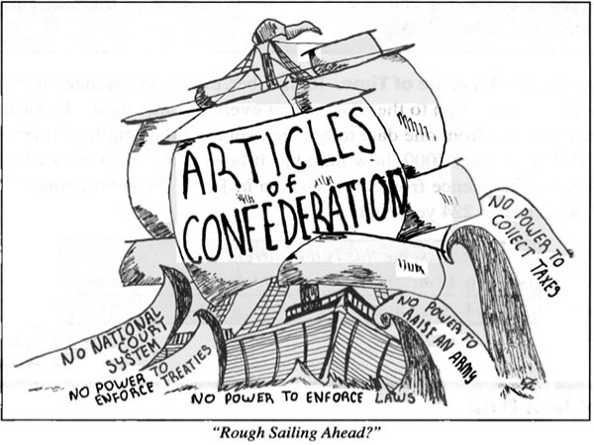
Articles of Confederation
America’s first constitution
It established a confederation, a “league of friendship and perpetual union” among 13 states and former colonies.
Congress had few powers; there was no president or national court system.
All government power rested in the states.
Lack of centralized military power
Lack of tax-law enforcement power
Notes:
AOC: terrible constitution. The federal government had basically no power. There was only a unicameral congress and states could send up to 7 delegates but each state had equality in voting. Congress had very few powers…could have army and navy but had no power to tax (cannot have an army or navy). Congress cannot even regulate trade. New York and New Jersey almost go to war over the Hudson River.
- You even have some states aligning themselves with France while others aligning themselves with England. You can see the problem that might result from this.

Slide 23
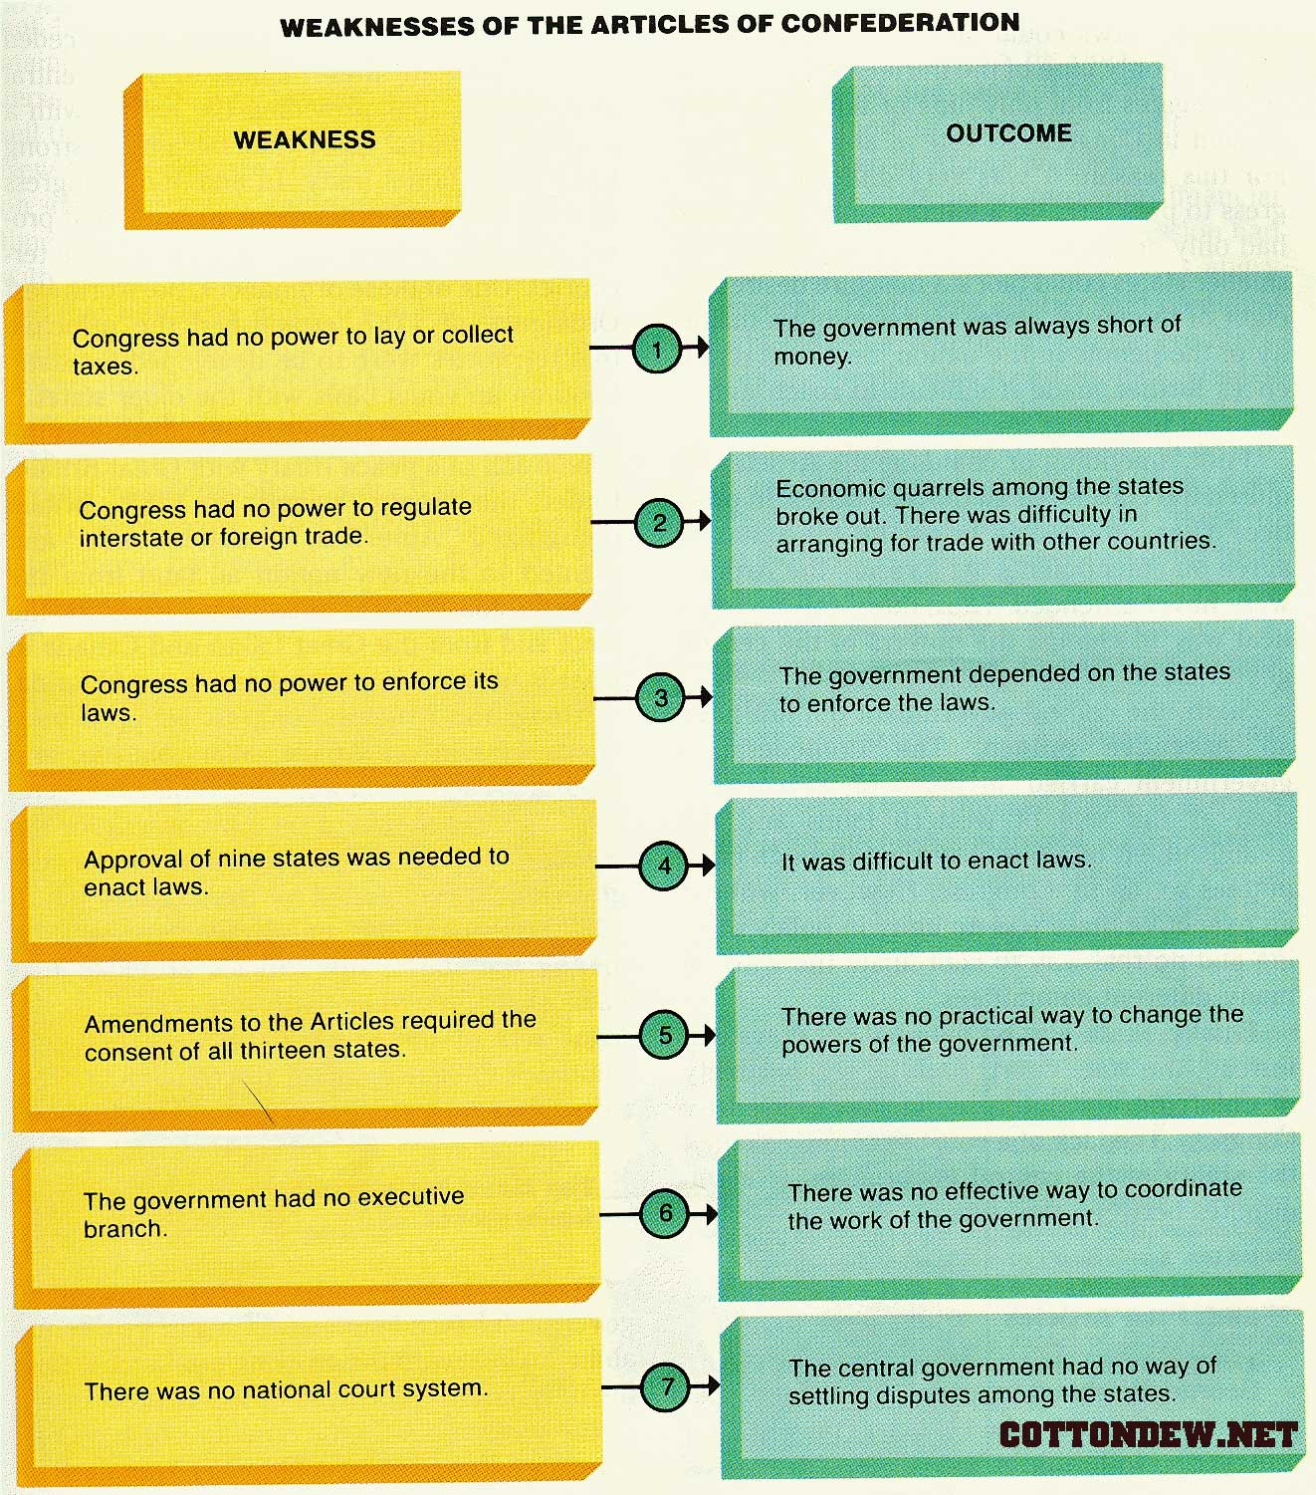
Notes:
Major issues especially amending the constitution – 13 of 13 colonies needed; think about geographical differences or even today. It was purposely designed to be weak. States had different tariffs and taxes and currency.
Feeble national government in Philadelphia. Thomas Jefferson hailed this new structure. He thought it was heaven compared to the hell of Europe.
This was a significant cornerstone for the current Constitution.

Slide 24
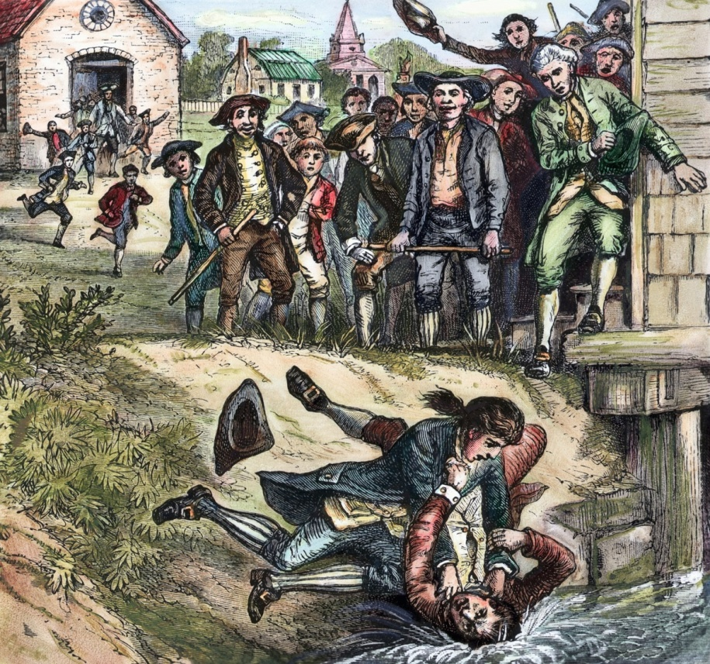
The Government That Failed
Economic Turmoil
Postwar depression left farmers in debt
Shays’ Rebellion
Series of attacks on courthouses by a small band of farmers being foreclosed upon
Economic elite concerned about Articles’ inability to limit these violations of individual’s property rights
Demonstrates weaknesses of the Articles of Confederation
Notes:
Series of attacks on courthouses by a small band of farmers led by Revolutionary War Captain Daniel Shays to block foreclosure proceedings.

Slide 25
Review Question
The importance of Shays’ Rebellion to the development of the United States Constitution was that it:
Revealed the necessity of both adding the Bill of Rights to the Constitution and creating a new system of checks and balances
Demonstrated the intensity of anti-ratification sentiment within the thirteen states
Indicated that a strong, constitutionally designed national government was needed to protect property and maintain order
Convinced the delegates attending the Constitutional Convention to accept the Connecticut Plan
Reinforced the idea that slavery should be outlawed in the new Constitution

Slide 26
AP US Government and Politics
Unit One: Foundations of American Government

Slide 27
Learning Objective
LOR-1.A.2: The US Constitution drafted at the Philadelphia convention led by George Washington, with important contributions from Madison, Hamilton, and members of the “grand committee,” provides the blueprint for a unique form of political democracy in the U.S.
CON-1.C.3: The comprises necessary to secure the ratification of the Constitution left some matters unresolved that continue to generate discussion and debate today
CON-1.C.4: The debate over the role of the central government, the powers of state governments, and the rights of individuals remains at the heart of present-day constitutional l

Slide 28
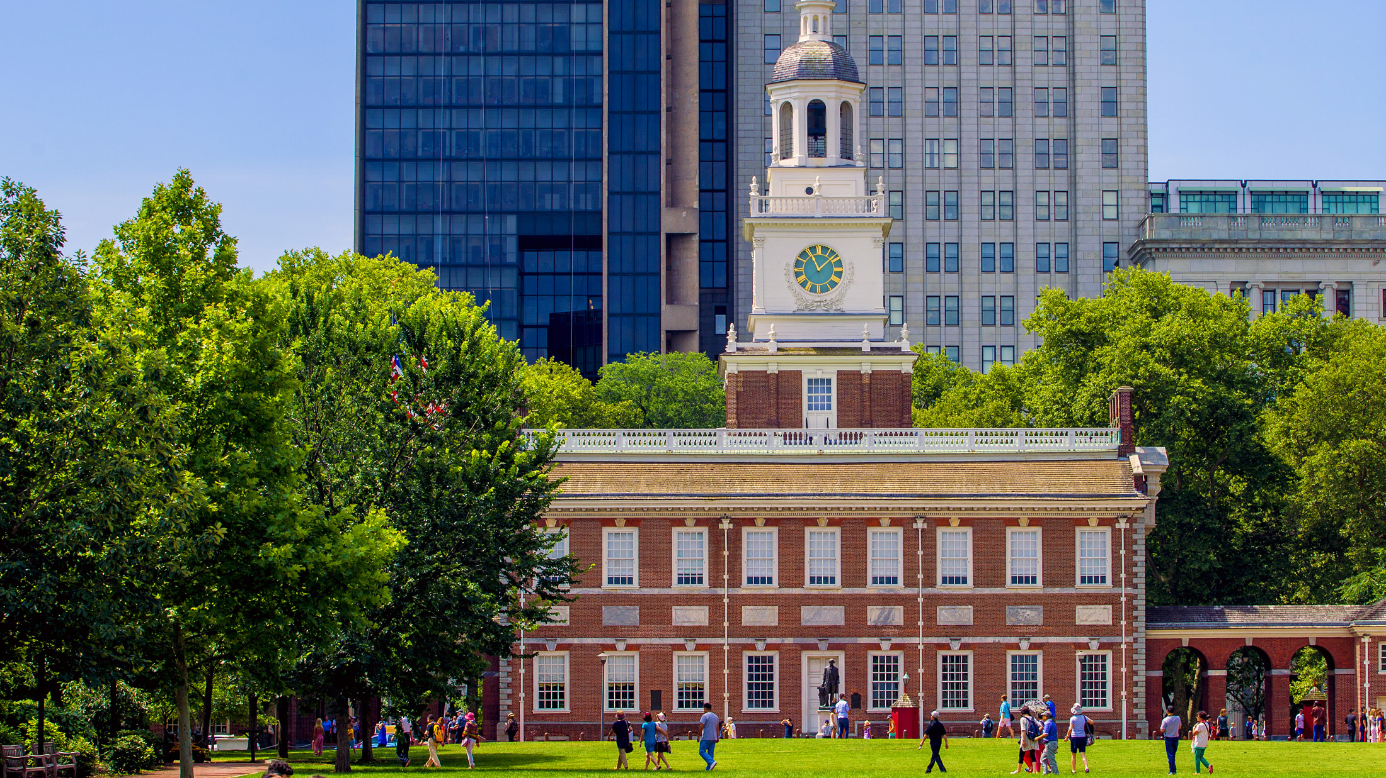
Constitutional Convention
Gentlemen in Philadelphia
55 men from 12 of the 13 states
Mostly wealthy planters and merchants
Most were college graduates with some political experience
Many were coastal residents from the larger cities, not the rural areas
Which view of American democracy does this support?
Notes:
Rhode Island is the only state that does not attend which was skeptical of the reforms.

Slide 29
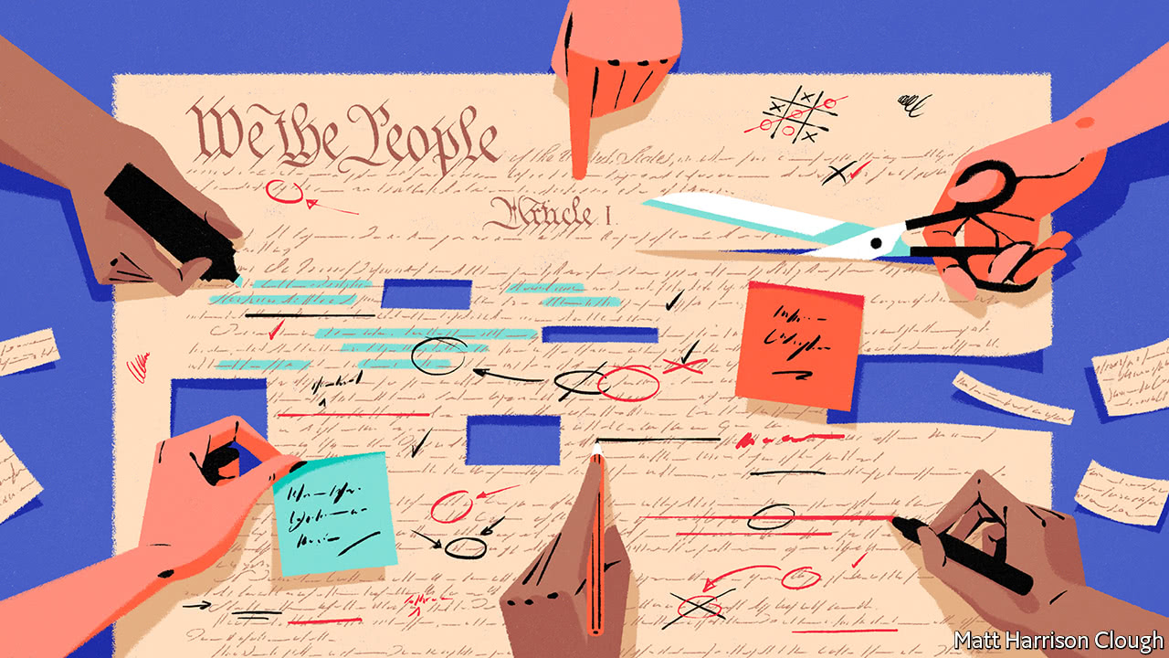
Compromise in Philadelphia
1. Equality and Representation of the States
New Jersey Plan—equal representation in states, sovereignty of states, limited legislature
Virginia Plan—population-based representation, 3 branches, supremacy of nat’l gov’t, separation of powers
Grand Committee: one delegate from each state to settle the differences
Connecticut (“Great”) Compromise - popularly elected house based on state population; state elected Senate, with two members for each state
Notes:
The Virginia Plan–proposal to create a strong national government
The New Jersey Plan–proposal to create a weak national government
The Connecticut “Great” Compromise
popularly elected house based on state population
state elected Senate, with two members for each state
With respect to voting, the Founders finessed the issue by allowing the states to decide it. Some states allow women to vote indirectly (NJ), many without property qualifications, etc.

Slide 30
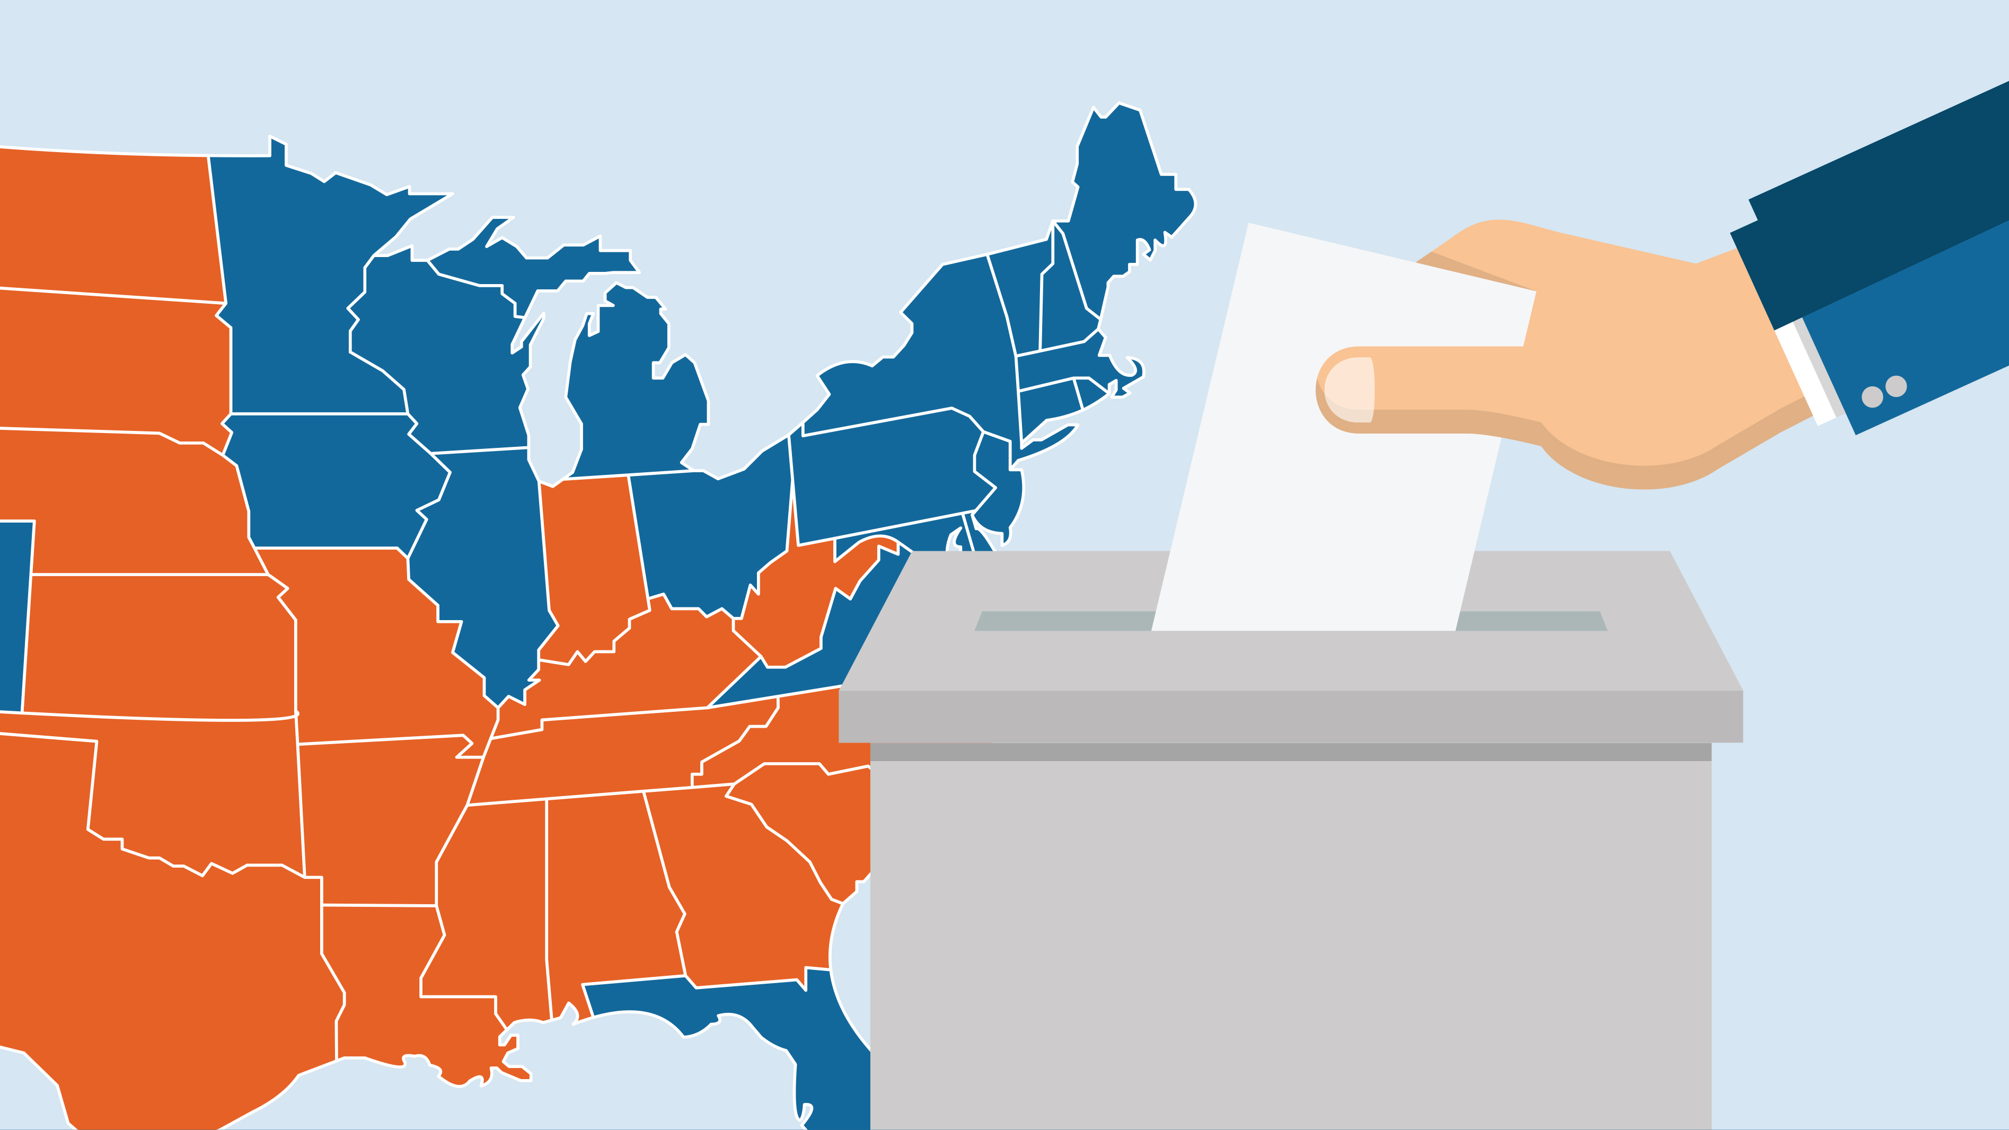
Compromise in Philadelphia
2. Slavery
Not mentioned by word in the Constitution – didn’t solve the issue
Congress cannot interfere with slave trade until 20 years after ratification
3/5ths Compromise
3. Political equality and voting left to the states
Electoral College: compromise in that each state could decide how electors would be chosen
Notes:
The Virginia Plan–proposal to create a strong national government
The New Jersey Plan–proposal to create a weak national government
The Connecticut “Great” Compromise
popularly elected house based on state population
state elected Senate, with two members for each state
With respect to voting, the Founders finessed the issue by allowing the states to decide it. Some states allow women to vote indirectly (NJ), many without property qualifications, etc.

Slide 31
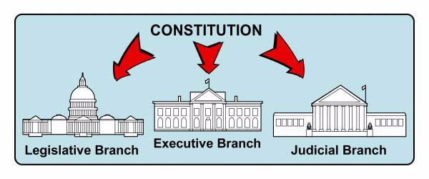
The Madisonian Model
To prevent a tyranny of the majority (limited government), Madison proposed a government of:
Limiting Majority Control
Separating Powers
Creating Checks and Balances
Establishing a Federal System

Slide 32
The Madisonian Model

Slide 33
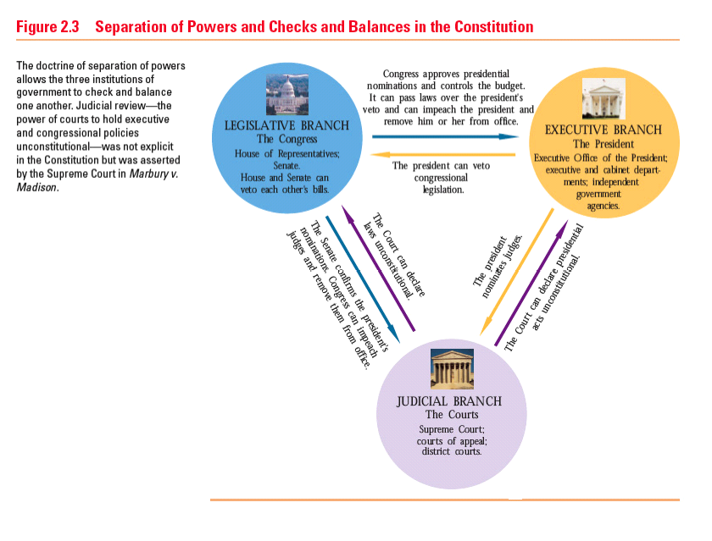
The Madisonian Model

Slide 34
Drafting a new constitution
The Constitutional Republic
Republic: A form of government in which the people select representatives to govern them and make laws
Favors the status quo – change is slow
The End of the Beginning
The document was approved, but not unanimously. Now it had to be ratified.

Slide 35
Questions unresolved by the Constitution
1) How strong should the federal government be?
2) What powers do the states have?
3) What individual rights are protected?
4) Should the Senate have representation based on population?
5) Is the Electoral College fair (2000, 2016 elections)?
*Some of these debates surface on issues like the federal government’s surveillance of US citizens following the attacks on September 11th and the role of the federal government in public school education.

Slide 36
Review Question
“Ambition must be made to counteract ambition. The interest of the man must be connected with the constitutional right of the place. It may be a reflection on human nature, that such devices should be necessary to control the abuses of government. But what is government itself but the greatest of all reflections on human nature? If men were angels, no government would be necessary….”
Refer to the above quote. Which of the following fundamental principles does this statement best reflect?
Federalism
Preservation of property
Representative government
Separation of powers
Rousseau’s view of human nature

Slide 37
AP US Government and Politics
Unit One: Foundations of American Government

Slide 38
Learning Objective
CON-1.B.1: Specific incidents and legal challenges that highlighted key weaknesses of the Articles of Confederation are represented by lack of centralized military power and lack of tax-law enforcement power

Slide 39
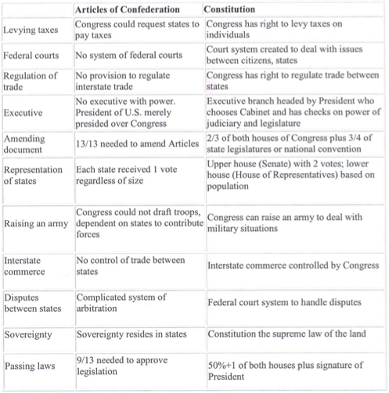

Slide 40
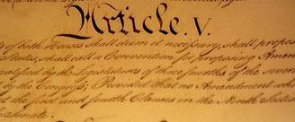
Organization of the constitution
Article 1 – Legislative powers
Article 2 – Executive powers
Article 3 – Judicial powers
Article 4 – Relations among states
Article 5 – Amendment process
Article 6 – National supremacy
Article 7 – Ratification process

Slide 41
Ratification
Federalists: advocated for a strong, central government as well as the ratification of the US Constitution
Federalist No. 10 – factions
Federalist No. 51 – separation of powers
Anti-Federalists: advocated for a small government run by the states
Brutus No. 1. – direct rebuttal to Federalist Papers
Emphasized benefits of a small, decentralized republic
Notes:
Factions emerge!

Slide 42
Ratifying the Constitution
Federalist Papers
A collection of 85 articles written by Alexander Hamilton, John Jay, and James Madison under the name “Publius” to defend the Constitution
Bill of Rights
The first 10 amendments to the U.S. Constitution, drafted in response to some of the Anti-Federalist concerns about the lack of basic liberties

Slide 43
Ratifying the Constitution

Slide 44
AP US Government and Politics
Unit One: Foundations of American Government

Slide 45
Learning Objective
CON-1.C.4: The debate over the role of the central government, the powers of state governments, and the rights of individuals remains at the heart of present-day constitutional issues about democracy and governmental power

Slide 46
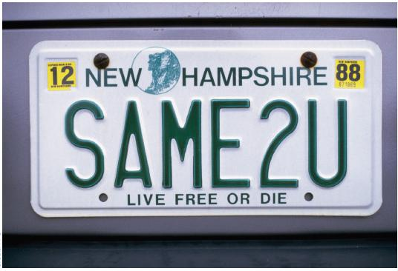
Individual Rights
Prohibits suspension of writ of habeas corpus
No bills of attainder (declares a person guilty of a crime without a trial)
No ex post facto laws (laws passed after the fact)
Religious qualifications for holding office prohibited
Strict rules of evidence for conviction of treason
Right to trial by jury in criminal cases
Some were not specified
Freedom of speech and expression
Rights of the accused
*Few rights included because it was assumed the states would include these rights in their own constitutions
Does this go far enough?

Slide 47
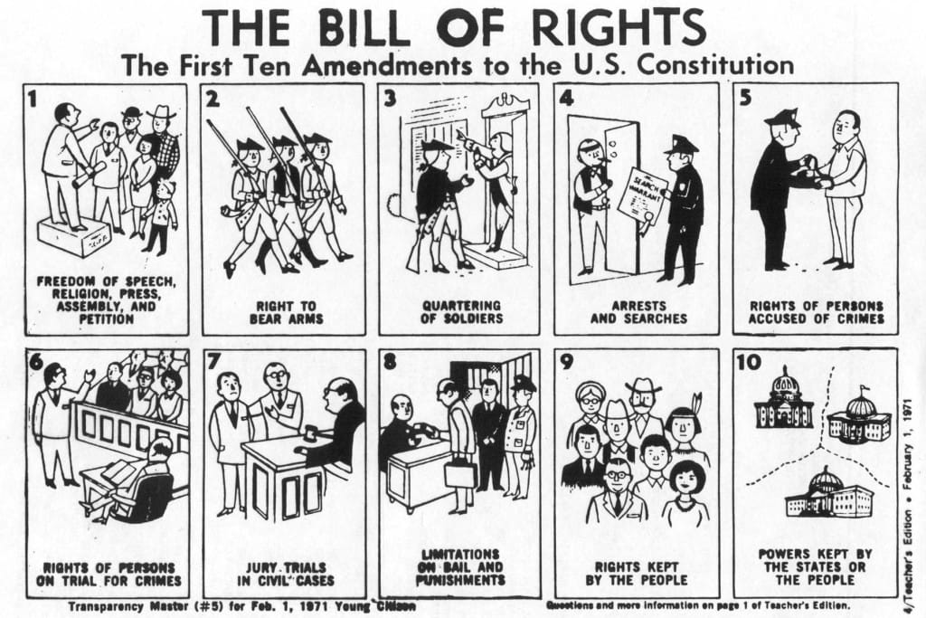
Ratification
Bill of Rights
First ten amendments to the US Constitution
Guaranteed individual and states specific rights
Only applies to the national government

Slide 49
AP US Government and Politics
Unit One: Foundations of American Government

Slide 50
Learning Objective
Debates about self-government during the drafting of the Constitution necessitated the drafting of an amendment process in Article V that entailed either a 2/3s vote in both houses or a proposal from 2/3s of the state legislatures, with final ratification determined by 3/4s of the states

Slide 51
Constitution
Jefferson: “Belongs to the living and not to the dead”
Constantly tested and altered
Has become more democratic over time
E.g. – any laws about child pornography in 1787?

Slide 52
Constitutional Change: Article V
Notes:
Two formal ways :
Phase one: 2/3 of Congress (each house) and then state legislatures (3/4 of the states) or state conventions (3/4) must ratify it.
Phase one: National convention (2/3 of states) → either state legislature (3/4 of states) or state conventions (3/4) must ratify it.

Slide 53
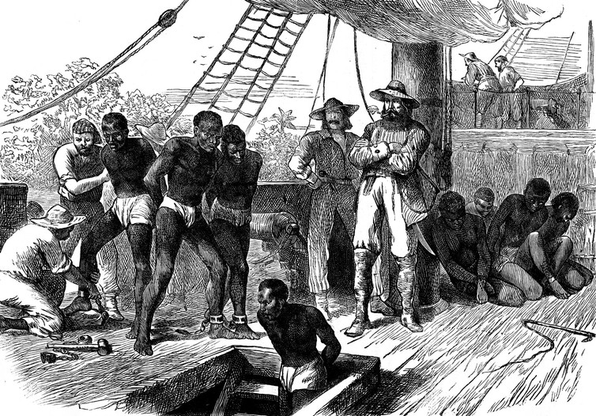
FLEXIBILITY
Formal amendment process
Informal change:
Judicial Interpretation
Marbury v. Madison (1803): judicial review
Changing Political Practice
Technology
If there was no flexibility, would slavery still exist?
Notes:
The Constitution can be changed informally through a concept known as judicial review (established by Marbury v. Madison). This allows the Supreme Court to declare a law unconstitutional. This power was granted by John Marshall himself.
Political practices stretch and shape the Constitution, especially with political parties.
Technology especially through mass media has made people question candidates and shapes people’s opinions.

Slide 54
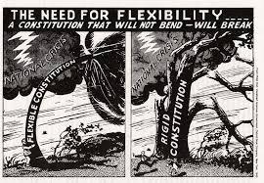

Slide 55
The Importance of Flexibility
The Constitution is short, with fewer than 8,000 words.
It does not prescribe every detail.
There is no mention of congressional committees or independent regulatory commissions.
The Constitution is not static, but flexible for future generations to determine their own needs.

