Slide 1
Federalism
The federal government did not create the states; the states created the federal government. -- Ronald Wilson Reagan
Notes:
1
Created by Bob Fenster, Hillsborough High School, Hillsborough, NJ

Slide 2
DISCLAIMER
Let’s get this out the way immediately. Use NATIONAL government to refer to the government housed in Washington D.C. with that president guy, Congress, and the Supreme Court.
Federalism concerns the relationship between the national, state, and local governments. Using “federal” to refer to the national government makes it really confusing in this context.
Notes:
2

Slide 3
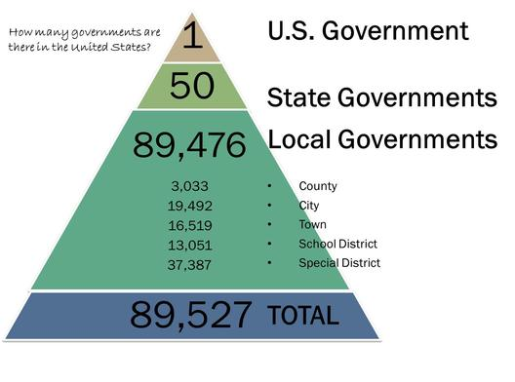
Out of One, Many?
In a unitary government, there’s no question of where the authority lies.
Where should the authority lie in our federalist system?

Slide 4
Federalism Defined
Constitutional arrangement whereby power is distributed between a central government and sub-divisional governments, all of which exercise direct authority over individuals.
Key = powers divided and are clearly defined (at least in theory)
Diffusion of power prevents tyranny.
Notes:
4

Slide 5
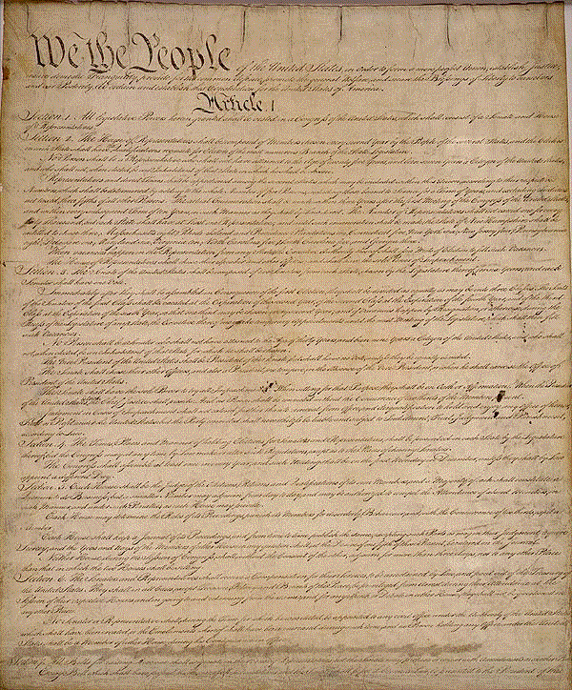
Constitutional Framework
National: powers delegated expressly by Constitution
States: powers not delegated nor denied
Some powers specifically denied to both; some granted to both. Thanks, that’s really helpful. #eyeroll
Notes:
5

Slide 6
National: Expressed Powers
Note the use of “division” as opposed to “separation.” Separation is horizontal. Division is vertical.
Where are all the expressed powers from?
1 of 4
Notes:
6

Slide 7
National: Implied Powers
2 of 4

Slide 8
National: Inherent Powers
3 of 4

Slide 9
National: Denied Powers
4 of 4

Slide 10
States: Reserved Powers
Regulate intrastate trade
Establish local governments
Establish schools
Pass state laws
Run elections
1 of 2

Slide 11
States: Denied Powers
2 of 2
Notes:
11

Slide 12
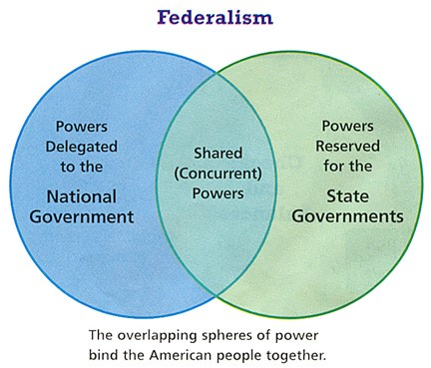
Both: Concurrent Powers
Taxing and borrowing
Crime and punishment
Establish courts
Eminent domain
Provide for public welfare
For realz? How?

Slide 13
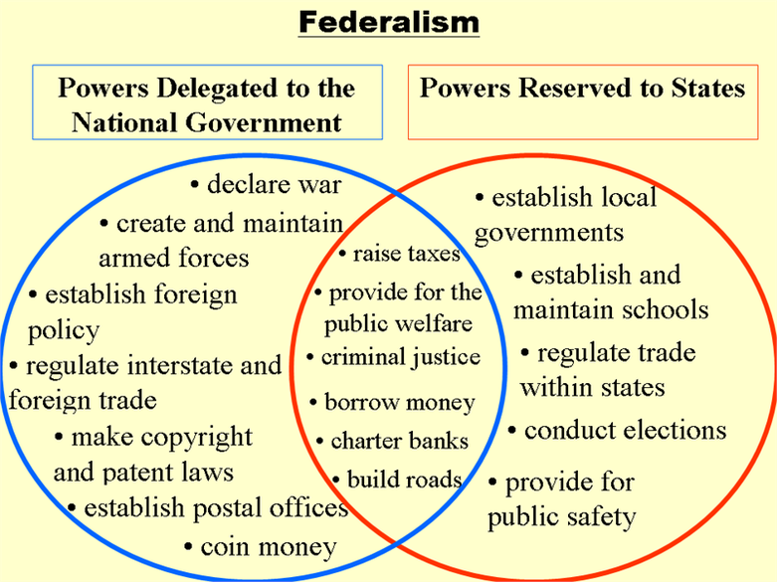
How might concurrent powers lead to conflict between states and the national government?
Notes:
13

Slide 14
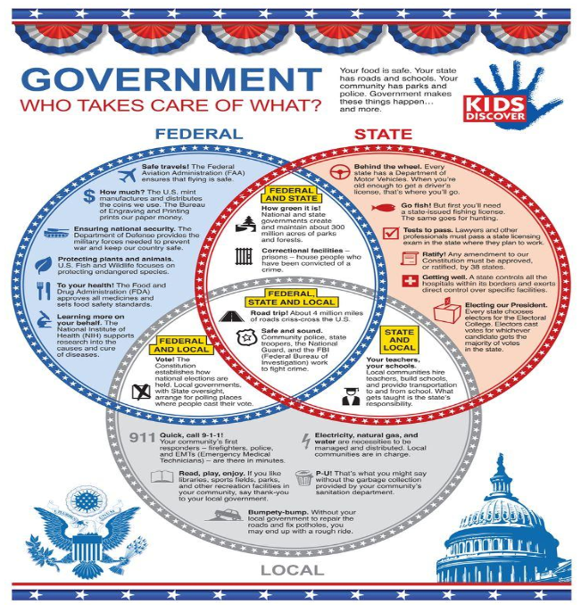
Remember, there are nearly 90,000 governments in the United States. Let’s revisit the definition of federalism, shall we?
Constitutional arrangement whereby power is distributed between a central government and sub-divisional governments, all of which exercise direct authority over individuals.
`

Slide 15
What are some advantages of federalism?
Allows unity without uniformity
Encourages experimentation
Keeps government closer to the people
Well-suited for large country with diverse population
Do you buy these arguments? What counter-arguments could you make? What are the disadvantages of federalism?
Notes:
The quality of services like education is heavily dependent on the state in which the serviceis provided; states differ greatly in the resources they can devote to public services.
Diversity in policy can discourage states from providing services that would otherwise beavailable because poor people may be attracted from states with lower benefits.
Federalism may have a negative effect on democracy when local interests are able to impedenational majority support of certain policies.
The vast number of local governments makes it difficult for many Americans to know whichgovernment is responsible for certain functions.

Slide 16
Establishing National Supremacy
McCulloch v. Maryland
Interpretation of the Commerce and Elastic clauses
Civil War
Civil Rights movement

Slide 17
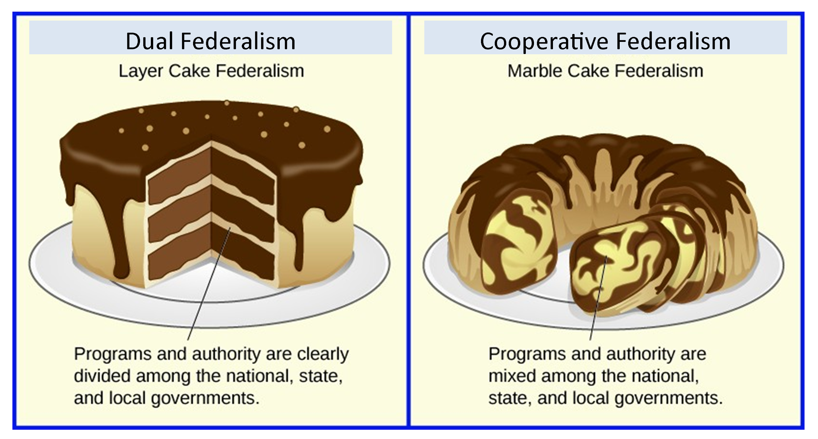
Types of Federalism

Slide 18
Federal Grants-in-Aid (Fiscal Federalism)
To supply state and local governments with revenue.
To establish minimum national standards for such things as highways and clean air.
To equalize resources among the states.
To attack national problems yet minimize the growth of federal agencies.
Notes:
18

Slide 19
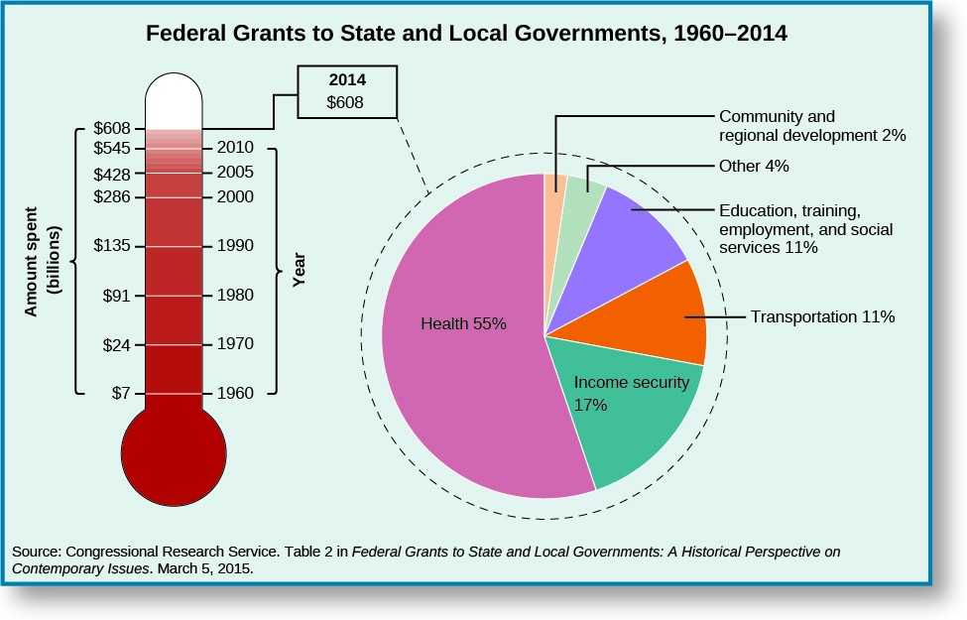

Slide 20
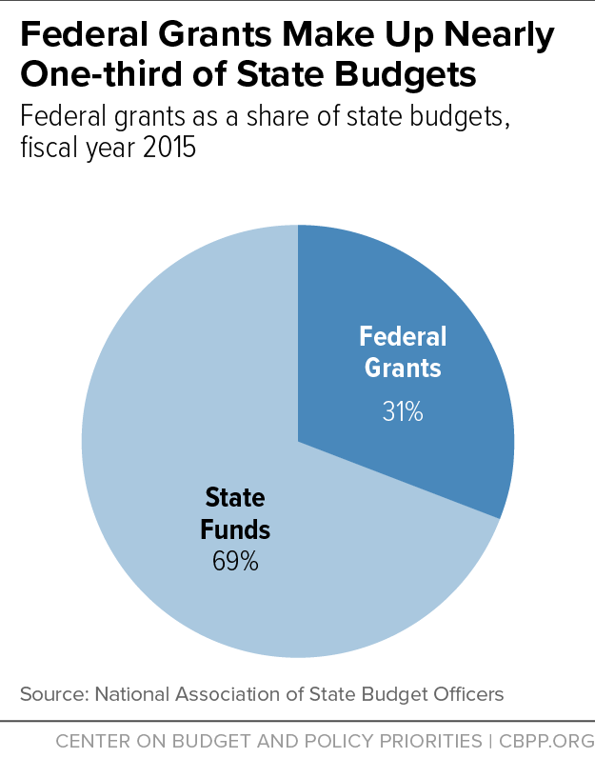
The national government is funded, in part, by income taxes on individuals living in these states. If we abolished that tax and all grants, couldn’t states just make up the difference by increasing their state taxes? Cut out the middle man?
What’s this line of reasoning missing?

Slide 21
The Carrot and the Stick
Categorical - grants given for specific purposes
Formula - uses a mathematical formula to determine size of grant given
Project - competitive, awarded by application
Block - grants for general purposes like community development or social services.
Role of regulations
Highway funding (arguably coercive)

Slide 22
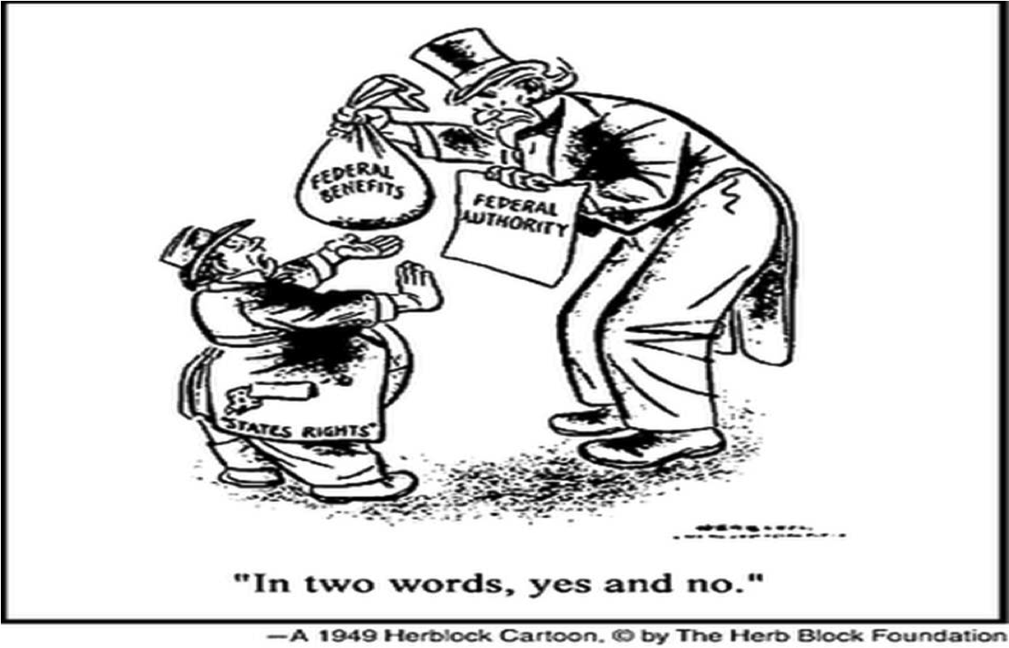
What is the perspective of Herblock, the artist, in this 1949 cartoon?
Can you provide a modern example of this phenomenon?

Slide 23
Interstate Relations
Full faith and credit clause - states required to provide reciprocity toward other states’ public acts, records, and civil judicial proceedings.
Extradition - states must turn over a person charged with a crime from another state for trial or imprisonment.
Interstate compacts - agreements between states, e.g., Port Authority of NY/NJ, Driver License Compact. Usually require Congressional approval.
Notes:
23

Slide 24
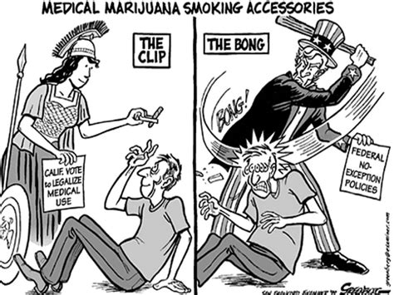
Modern issues in Federalism
Health care
Immigration
Infrastructure
Infectious diseases
Marriage and adoption
Drugs
Gun laws
Education
Environment and Energy
Welfare
Civil rights
Notes:
24

